Slide 1
Fluxus Performance Art Institutional Critique
Notes:
Three different “movements” – only one a true movement
The other two are trends in art that continue into the present day…

Slide 2
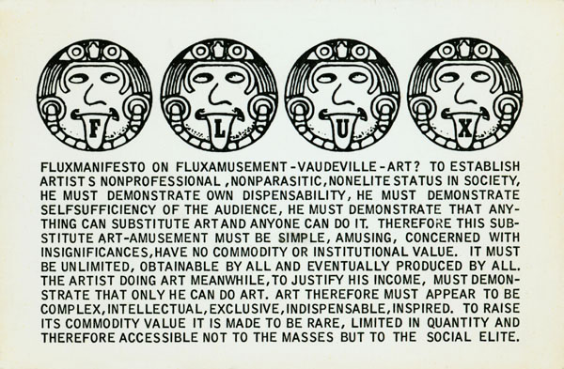
Fluxus
Notes:
Fluxus
The name Fluxus taken from the Latin for “flow”
1961: Term originally conceived by the American writer, performance artist and composer George Maciunas (1931–78)
He is seen as a co-founder, along with Dick Higgins, George Brecht, and others
Maciunas planned to use the term as a title for a book covering the work of artists engaged in experimental music, concrete poetry, performance events and “anti-films”
1962: Performances in Wiesbaden, West Germany mounted under the name
Soon, a range of artists associate with Fluxus
Fluxus work was happening all over the globe before there was ever a “Fluxus” group
Go against normative expectations in art
Culture (western) getting restrictive, so they open things back up
Activities included:
Public concerts or festivals
Dissemination of innovatively designed anthologies and publications
Scores for electronic music, theatrical performances, ephemeral events, gestures and actions
Constituted from the individual’s everyday experience
Also distributed object editions, correspondence art and concrete poetry
Improvisational, anti-institutional, antiauthoritarian, and funny
MANIFESTOS
Under the organization and direction of George Maciunas, a specific program of ideological goals was formulated and disseminated through a series of manifestos
1962: Manifesto published as “Neo-Dada in Music, Theater, Poetry, Art”
So the connection to Neo-Dada is strong
Also to John Cage
Stresses the interest shared by all the artists in manifesting time and space as concrete phenomena
Anti-elite
Anti-commodity
Egalitarian
Embrace concrete poetry, concrete and random music, Happenings, and early-conceptual art
1963: Manifesto exhorted the artist to ‘purge the world of bourgeois sickness, “intellectual”, professional and commercialized culture … dead art, imitation, artificial art, abstract art, illusionistic art … promote a revolutionary flood and tide in art, promote living art, anti-art, … non art reality to be grasped by all peoples, not only critics, dilettantes and professionals’.
If we could experience the world around us the way we experience art, there would be not need for art.

Slide 3
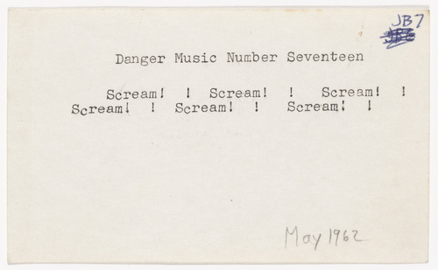
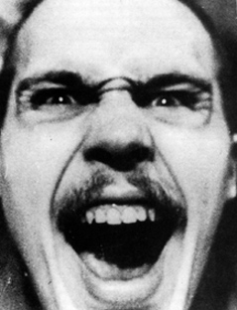
Dick Higgins, Danger Music Number Seventeen, 1962
Notes:
Dick Higgins (1938-98)
Co-founder of Fluxus
Dada had a sense of a movement to change what art was
Fluxus came along by accident (more a group people than a movement)
An outgrowth of happenings and intermedia arts already happening
Term Fluxus applied to work already being made
Studies composition with Cage at the New School
1960: Marries fellow artist Alison Knowles
1962: They both participate in Wiesbaden Fluxus festival
1963: Founds Something Else Press – published many important texts (Stein, McLuhan, Cage, Oldenburg, Brecht, and others
An intermedia pioneer
1965: Coins the term “intermedia” to describe what was happening in the arts in the 60s (in an essay by that name)
He was an early proponent and user of computers as a tool for art making, dating back to the mid-1960s
He and Knowles created the first computer generated literary texts (chance!)
Danger Music scores
A series of 43 short text scores
All explore the element of danger (for the artist, the performer, or members of the public)
Dick Higgins, Danger Music Number Seventeen, 1962
Seeks to see how much expression he can fit into a minimal unit
One of his favorite works to perform
Once performed at a friend’s party and was then asked to leave!

Slide 4
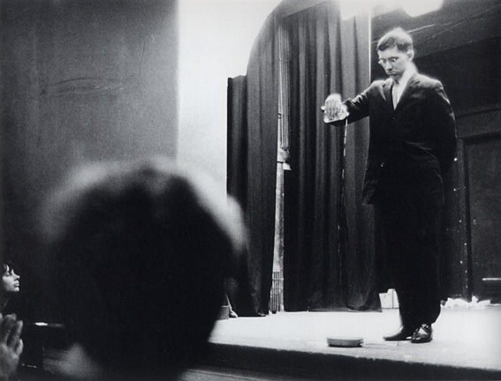
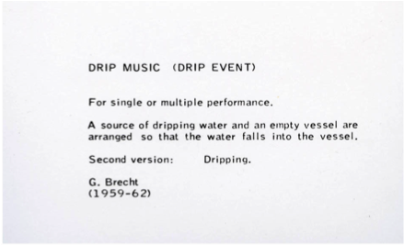
George Brecht’s Drip Music, performed by George Maciunas, Amsterdam, 1963
Notes:
George Brecht
Another co-founder of Fluxus
1957: Begins attending Cage’s Experimental Music Composition classes at the New School for Social Research
The "event” -- a Minimalist performance form where you have a simple instruction like "dripping" or "polishing“ was invented in that class by George Brecht
Cage prompts students to use chance and games as a method of creating art
Other artists in this class are Kaprow and Dick Higgins
Interestingly, some early Pop artists dropped in (Oldenburg and Segal)
Began with writing event scores similar to Kaprow’s
Too didactic for him
Too controlling
Cage suggested Brecht radically simplify the scores
Allows room for new interpretations with each performance
George Brecht’s Drip Music, performed by George Maciunas, Amsterdam, 1963
“For a single or multiple performance. A source of dripping water and an empty vessel are arranged so that the water falls into the vessel. Second version: Dripping” G. Brecht (1959-62)
Very influenced by Duchamp and the readymade!
Prompts us to pay attention to the mundane, “readymade” situations in our daily lives
Shifts our perception!
Yam
1962: A term created as an umbrella for “all manner of immaterial, experimental, and yet unclassified forms of expression.”
Aims to create a platform for non-purchasable art
Early works consist of mailing to friends event cards stamped with the word “Yam”
Yam Festival
May 1963: Held on a farm in NJ
Consisted of happenings and actions by Higgins, Kaprow, Knowles, and others
Aimed to go around the gallery system
Gave artists and “receivers” freedom!
Wants to make an art that cannot be bought or sold
Paralleled George Maciunas’ Fluxfests in Europe
Featured many of the same artists

Slide 5
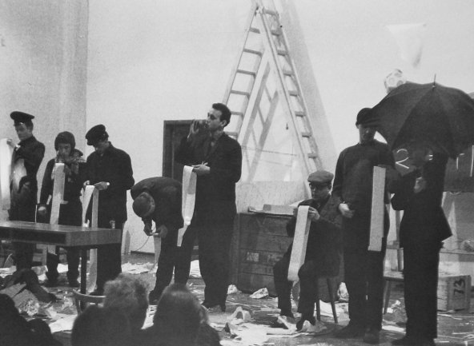
George Maciunas, Homenaje a Adriano Olivetti, Concierto, Academia de Arte de Düsseldorf, 1963
Notes:
Fluxfests (European arm of the movement)
These Fluxconcerts took place across Europe in the early 60s – instigated by George Maciunas
1961: Maciunas first engaged with this group of artists from Cage’s class
Through his gallery, AG, on the Upper East Side of Manhattan
He later invented the Fluxus Kit, objects for handling and using, a materialization of the event
He also gave concerts to La Monte Young and many key figures in the avant-garde
Began publishing Fluxus scores and objects
Stationed in Germany with US Army
Aware of Yam Festival in NJ
1962: The first of many Fluxfests (Fluxconcerts) organized by Maciunas in Wiesbaden, Germany
Same year as American Yam Fest
The International Fluxus Festival of the Newest Music consisted of 14 concerts
Presented musical and performance work by Joseph Beuys, George Brecht, John Cage, Alison Knowles, Nam June Paik, and others
Artists who did not participate in these concerts were still a part of Fluxus via publications
The typical Fluxconcert consisted of a rapid series of performances of short events of scored actions and music
Consisted of physical performances representative of mundane activities (think Kaprow)
Or music based on non-musical sound sources (think Cage)
Humorous and concerned with involving the audience
Aimed to disrupt the expected conventions of musical and theatrical performance and spectatorship
Event scores characterized by reduction, repetition, improvisation and chance
All choreographed

Slide 6
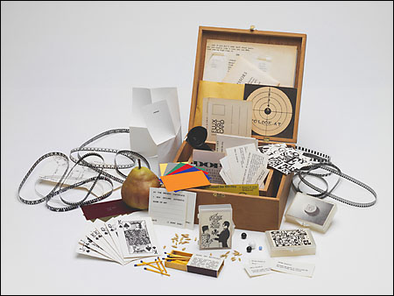
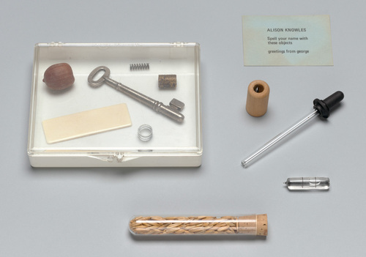
Flux Year Box 2, c. 1967
Edited and produced by George Maciunas
George Maciunas, Your Name Spelled with Objects: Alison Knowles, 1972
Notes:
George Maciunas
1963: Collects 73 of Brecht’s event-scores and puts them in a box
A designer, so there is an aesthetic to them
Simple, inexpensive way to disseminate art
First Fluxkit
Publishing activities:
Object multiples --- conceived as inexpensive, mass-produced unlimited editions
Flux Year Box 2, c. 1967
Works made by individual Fluxus artists, sometimes in collaboration with Maciunas, or, most controversially, Maciunas’s own interpretations of an artist’s concept or score
George Maciunas, Your Name Spelled with Objects: Alison Knowles, 1972
“Spell your name with these objects. Greetings from George”
Their purpose was to erode the cultural status of art and to help to eliminate the artist’s ego
His ego is present, however…
These kits are highly collectible and fetishized now
Let’s look at a few more Fluxus artists…less of a “movement” and more of a tendency

Slide 7
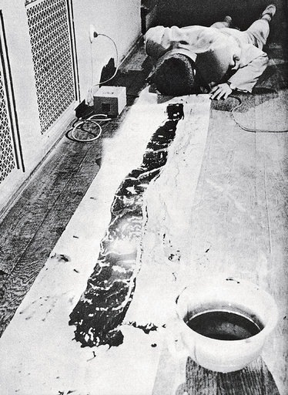
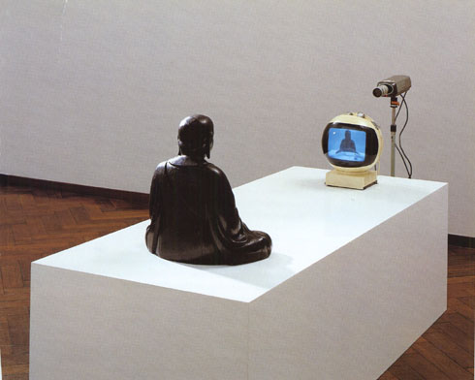
Nam June Paik, TV-Buddha, 1974
Nam June Paik, Zen for Head, Wiesbaden, 1962
Notes:
Nam June Paik (1932-2006)
Korean member of the group
Seen as a founder of video art
Trained as a classical pianist
Flees Koran during the Korean War
Lives in Japan
Writes his thesis on composer Arnold Schoenberg
Moves to Germany
Meets Cage
Opens his eyes to the possibilities with sound and conceptual art
Cage suggests he investigate Eastern religious traditions
Nam June Paik, Zen for Head, Wiesbaden, 1962
Connected to the body and to expressionism
Also connected to Gutai and action in artmaking
References a scroll
Cutting edge in technology
Known for the transformation of video into a medium for art
1965: Uses Sony Portapak heavily
Gives him freedom of movement
Nam June Paik, TV-Buddha, 1974
Closed circuit video installation with a bronze sculpture of a Buddha
A television projects the image of the Buddha as he sits looking at the screen
Creates an infinite looping of the image as the Buddha’s gaze is redirected back at him
Blends the sacred and the profane
Self-reflective
Paik was the pioneer of smashing musical instruments onstage
The Who adopted it first, and then the punk bands
Punk is HUGE in the 70s
Now bands do it all the time--in fact, it has become predictable and not very interesting

Slide 8
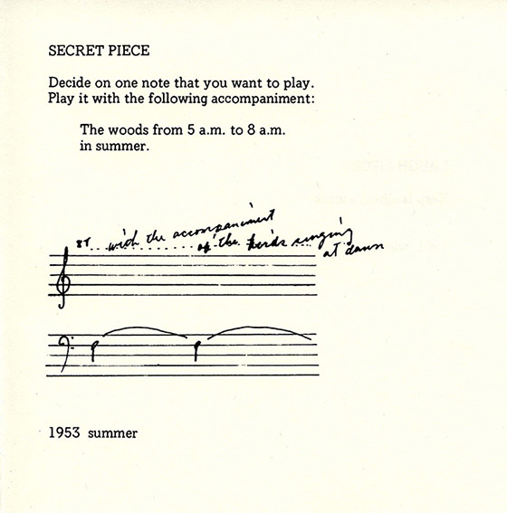
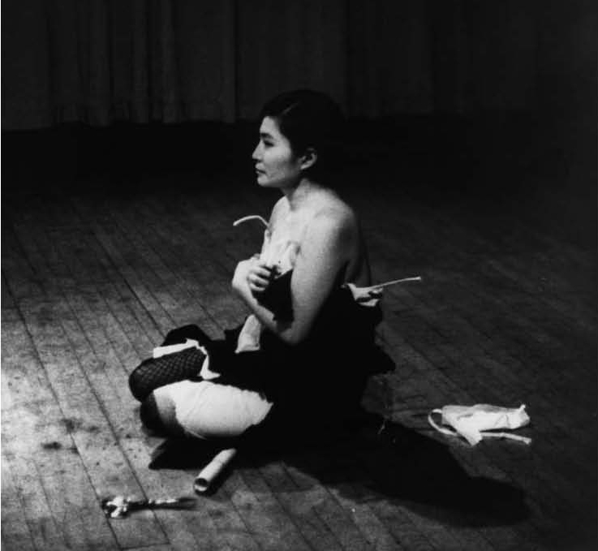
Yoko Ono, Secret Piece, 1953
First published in Grapefruit
Yoko Ono, Cut Piece, 1964
Notes:
Yoko Ono (1933- )
Japanese, aristocratic family
Classically trained pianist
Moves to art and a Fluxus artist
Not truly tied socially to the Fluxus community
1964: Self-published Grapefruit, a collection of short texts she called “instructions.”
Yoko Ono, Secret Piece, 1953
“Decide on one note that you want to play. Play it with the following accompaniment: The woods from 5 am to 8 am in the summer (or the accompaniment of kids singing at dawn).
Yoko Ono, Cut Piece, 1964
Wearing clothes she treasured, invited the audience to cut them from her body
Exposure and faux-intimacy
Has been re-performed again and again
AUDIENCE PARTICIPATION KEY!

Slide 9
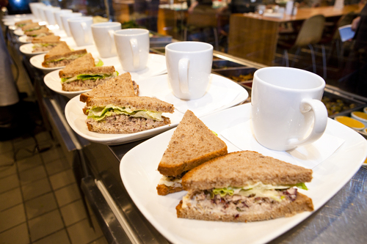
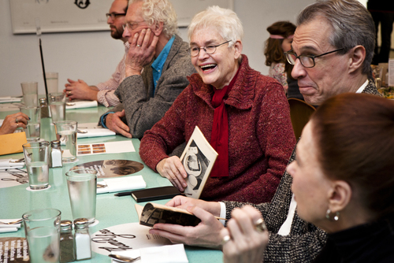
Notes:
Alison Knowles (1933- )
A founding member of Fluxus
Notably the first woman to participate in Fluxus
Studied with Joseph Albers and Adolf Gottlieb and graduated from Pratt University in 1954
Began with making paintings
Disappointed in their reception
Marries Dick Higgins
Works with him at Something Else Press
Comes to performance art
Fluxus appealed to her because she could present things live
Abandons painting and begins to travel with Fluxus artists
Perform across Europe (with Maciunas)
Fresh way to approach artmaking
No categories – could do everything!
Then returns to New York
Works to this day as a Fluxus artist

Slide 10
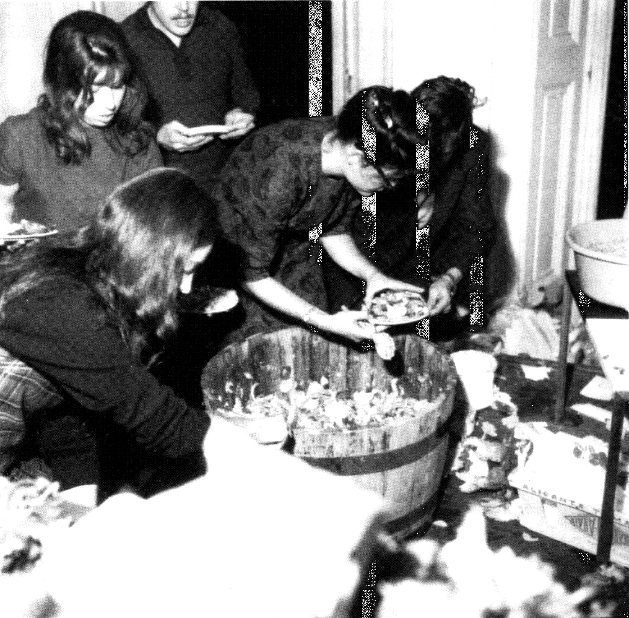
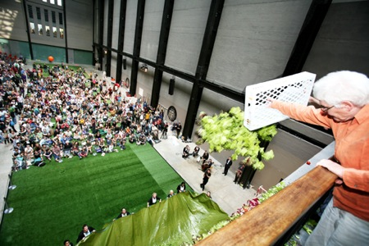
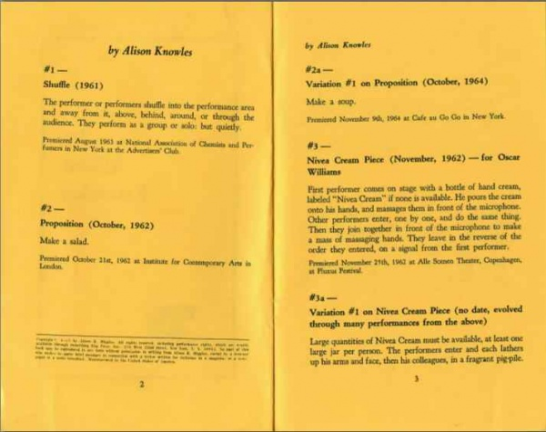
Alison Knowles, Make a Salad, 1962
Notes:
Alison Knowles, Make a Salad, 1962
ICA Gallery, London
An event score
Recreates it throughout the years
Flexible, according to the venue
Usually has 4-5 performers with her
Invited to perform all over the world
Tate Modern performance, 2008 (above, right)
Scale necessarily changes
Note: the spirit of Fluxus is alive, but have been commodified to some extent
Contemporary performance and relational aesthetics (1990s) owe a huge debt to Fluxus
Not avant-garde anymore, but the norm

Slide 11
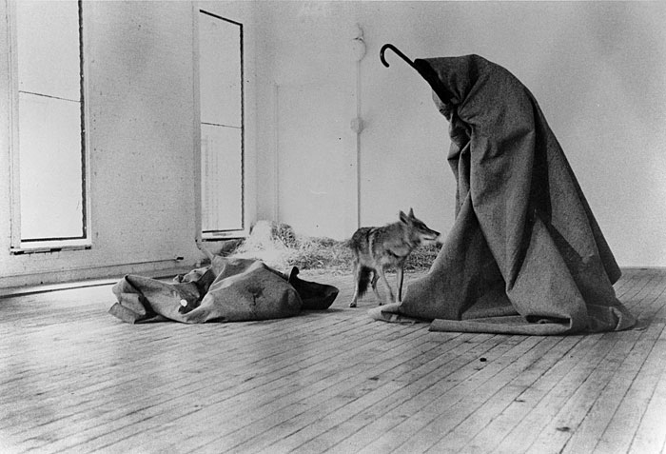
Performance Art
Joseph Beuys I Like America and America Likes Me, 1974, René Block Gallery, New York
Notes:
Performance Art
Descriptive term applied to ‘live’ presentations by artists
It was first used very loosely by artists in the early 1960s in the USA to refer to the many live events taking place at that time
Happenings, Fluxus concerts, Events
1969: performance more specifically incorporated into titles of work in the USA and UK
Interchangeable with ‘performance piece’ or simply ‘piece’
Note the musical influence in the term
Anti-commercial
A statement against the gallery system and the art establishment (anti-commodification)
Like Conceptual Art, Performance still becomes a commodity (photo and video)
Joseph Beuys (1921-86)
Works alongside Fluxus in the 1960s
Acquainted with the experimental work of artists such as Nam June Paik and the Fluxus group
Their ideas were a catalyst for Beuys' own performances, which he called "actions”
Also add to his evolving ideas about how art could play a wider role in society
Aesthetic of Social Sculpture
Suggested art's potential to transform the life of the individual observer, as well as the social condition of her/his larger culture
Beuys believed that if one were, by default, an artist, then one might be an artist everywhere, or in every context in which one finds oneself
The studio, the street, work, etc.
Blurs boundaries between art and life to do this work
Sees art as a democratic endeavor – everyone who is fully thinking and feeling is an artist
His work moves toward social and political activism as the years go on
Also a performance and Conceptual art pioneer
Born, Germany
1940: Joined the military, volunteering in order to avoid the draft
A combat pilot shot down 5 times (near-fatal)
Coming to terms with his involvement in the war was a long process and figures in much of his artwork
Beuys had developed a very personal symbolic language drawn from alchemy, shamanism and his own personal experiences
Predominant themes of healing, regeneration and enlightenment
MYTHIC BACKGROUND
Beuys often said that his interest in fat and felt as sculptural materials grew out of a wartime experience
A plane crash in the Crimea, after which he was rescued by nomadic Tartars who rubbed him with fat and wrapped him in felt to heal and warm his body
The story appears to have little grounding in real events (Beuys himself downplayed its importance in a 1980 interview)
Strong enough to have made the story one of the most enduring aspects of his mythic biography
1945: Enrolls in the Düsseldorf Academy of Art to study sculpture
Focuses on drawing and reading
Becomes a professor at Düsseldorf Academy of Art
1960s: Düsseldorf develops into an important center for contemporary art
Joseph Beuys I Like America and America Likes Me, 1974, René Block Gallery, New York
1974: Travels to the United States to perform an action entitled I like America and America Likes Me at the René Block Gallery in New York
The action actually began at Kennedy Airport
Friends wrapped him in felt and transported him to the gallery in an ambulance
Beuys then spent several days in a room with only a felt blanket, a flashlight, a cane that looked like a shepherd's staff, copies of the Wall Street Journal (which were delivered daily), and a live coyote
His choice of employing a coyote was perhaps an acknowledgment of an animal that holds great spiritual significance for Native Americans
Or a commentary on a country that through its Western expansion had become "lost" America
Action ends with his return ambulance ride back to JFK Airport – never touches US soil

Slide 12
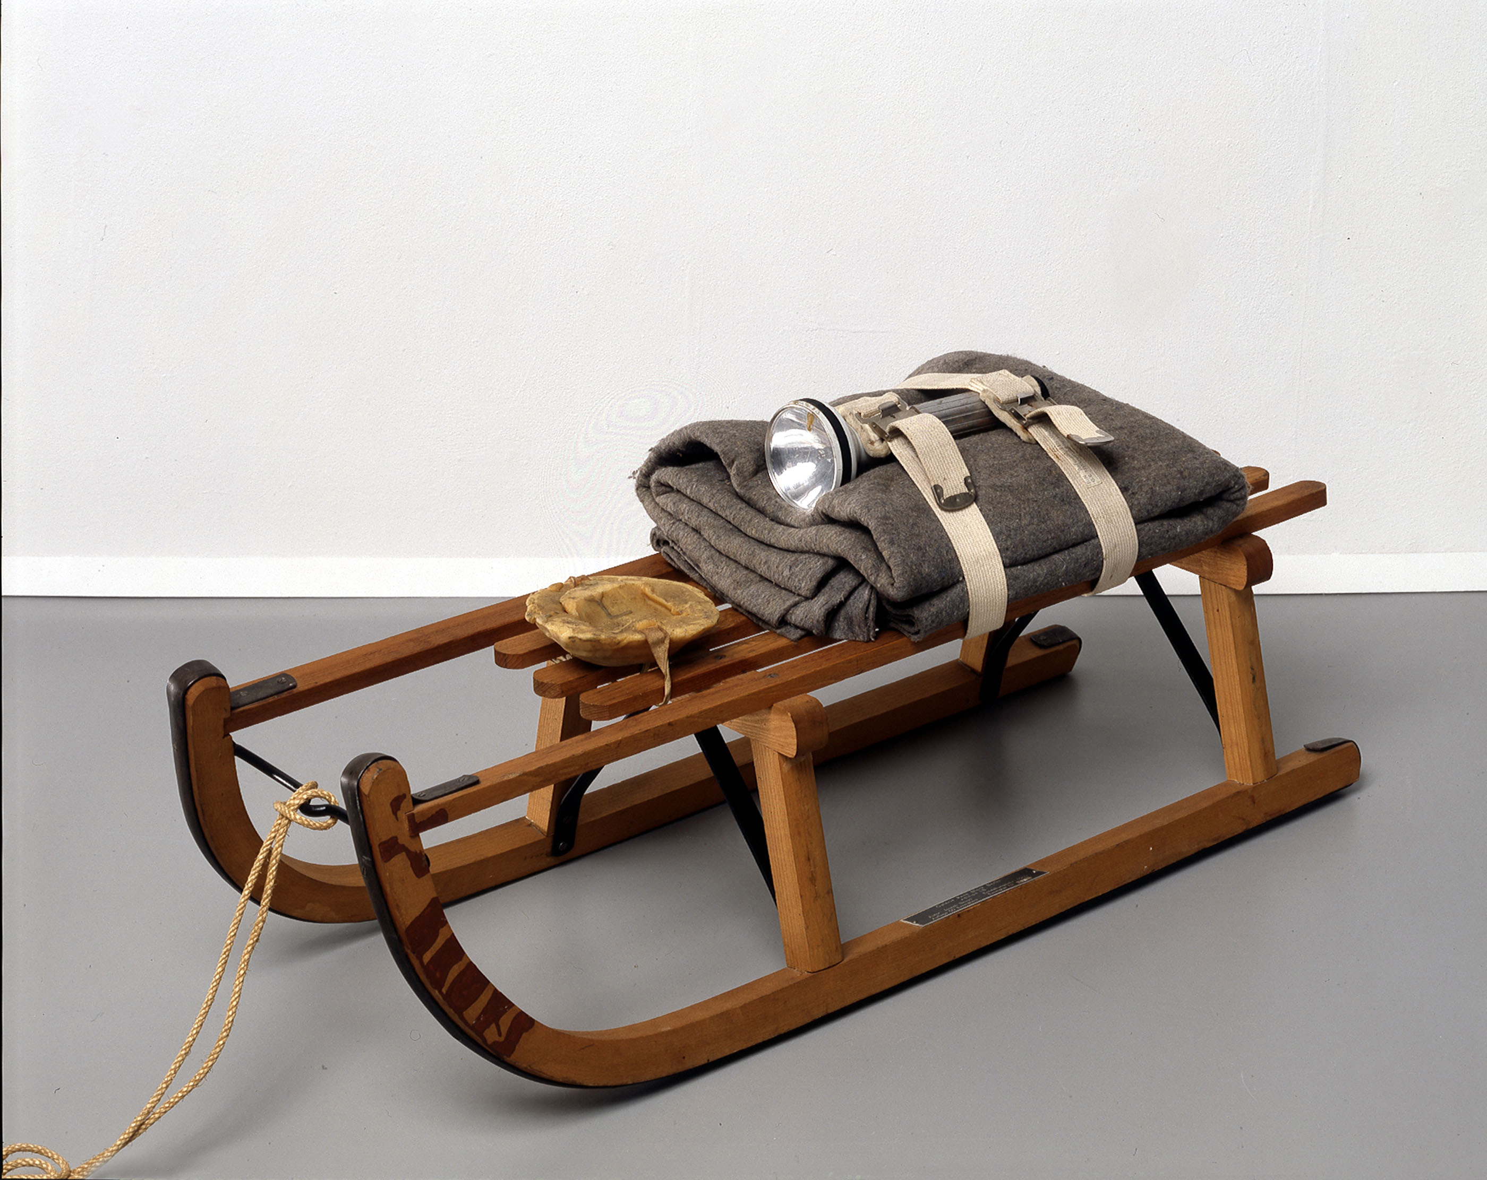
Joseph Beuys, Schlitten (Sled), 1969
Wooden sled, felt, belts, flashlight, fat and rope; sled stamped with oil paint
Notes:
Joseph Beuys, Schlitten (Sled), 1969
He began to publicly exhibit his large-scale sculptures, small objects, drawings, and room installations
He also created numerous actions and began making editioned objects and prints called multiples
“Stuff” comes together to form a personal narrative
Suggests a journey
Depicts a survival kit for Beuys
Beginning in the mid-1970s, Beuys increasingly used his actions as a forum for his political and environmental beliefs
Repeatedly said that his art was intended to arouse in other people a "spiritual response”
His role to provide "the means to point out that the human being is a creative being."
Mystery important
Blurs the line between fact and fiction
"Art is not there to provide knowledge in direct ways. It produces deepened perceptions of experience. . . . Art is not there to be simply understood, or we would have no need of art."

Slide 13
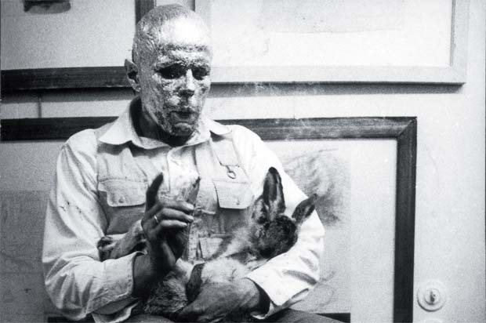
Joseph Beuys, How to Explain Pictures to a Dead Hare, 1965
Solo performance
Notes:
Beuys demonstrated how art might originate in personal experience
Also address universal artistic, political, and/or social ideas
Joseph Beuys, How to Explain Pictures to a Dead Hare, 1965
Uses those materials of personal significance (felt wrapped on one foot, dead animal, gold leaf)
Poetically suggests the healing potential of art for a humanity
Beuys suggested, in both his teaching and in his mature "action" and sculptural artworks, that art is a way of conducting one's life
Uses the realm of daily activity
Signals a new era in which art has increasingly become engaged with social commentary and political activism
Took place on the opening night of Beuys’ exhibition of drawings in Düsseldorf
The invited public arrived at the gallery to find the doors locked
Through the glass front of the gallery they saw Beuys sitting in a chair with his face covered in honey and gold leaf, cradling a dead hare in his arms
Symbolic materials of healing and regeneration
Slowly he got up and wandered around the exhibition, as if explaining each work to the hare
Beuys’ performances have left behind relics of his actions
Photographs become stand-ins for the performances
They have a reliquary feel to them

Slide 14
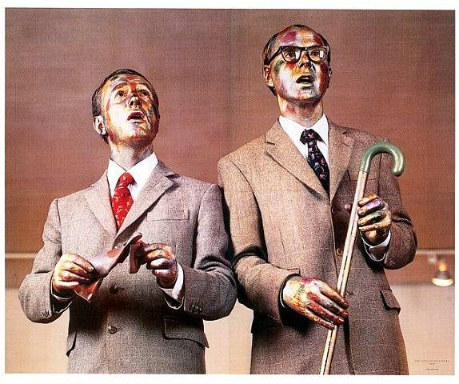
“We try not to have ideas, preferring accidents. To create, you must empty yourself of every artistic thought.”
Notes:
Gilbert and George (Gilbert Prousch (Italy) and George Passmore (England))
1967: Met one another
Students at St. Martin’s School, London
Were against the current vogue of abstract expressionism and minimalism
Hit upon the idea of living sculpture to assert their twinned individuality
Presented themselves as “living sculptures”
Performed a rather post-modern parody of a popular music hall duo of the war years (Flannagan and Allen)

Slide 15
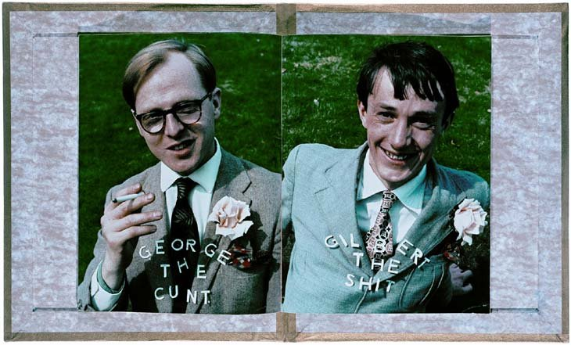
George the Cunt and Gilbert the Shit 1969, A Magazine Sculpture
Notes:
Liked to shock their audience
Though this looks like a wedding photo, they were not married until 2008
Created large-scale pictures
Most works created in groups and for the space in which they are first exhibited
Themes: human experience, urban life, superstition, aging, death, race and identity
They have always worked as a duo
By mid-1970s: use a trademark grid of photos and include themselves

Slide 16
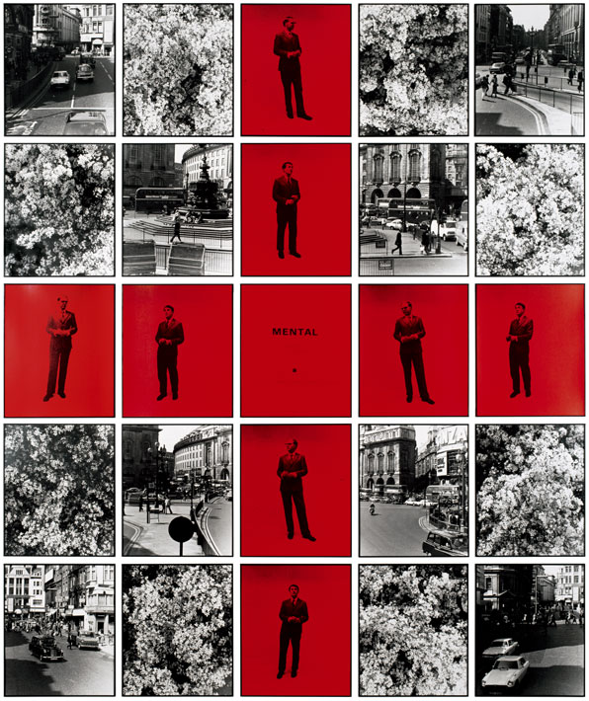
Gilbert and George, Mental No. 3, 1976
Collection MAMFW
Notes:
Gilbert and George, Mental No. 3, 1976
Depicts photos of London taken on their daily walks
Live in London’s East End, on Fournier Street
Formerly seedy, the area of Jack the Rippers murders
They are notoriously bound by habit (eat in the same place every day, wear the same things, etc.)
Interested in their environment
The dichotomy of city life and the countryside
Cruciform shape contains them, in spades
Speaks to their early performances

Slide 17
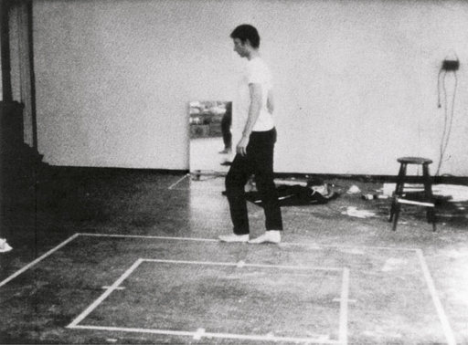
Bruce Nauman, Walking in an Exaggerated Manner Around the Perimeter of a Square, 1968
16 mm film, 10 minutes 30 seconds
Notes:
Bruce Nauman (reminder)
Nauman a California-based artist
If he was an artist, and he was in the studio, then all his activities were art!
Early performance involves him in the studio
Bruce Nauman, Walking in an Exaggerated Manner Around the Perimeter of a Square, 1968
Sways his hips back and forth as he slowly walks the perimeter
Recalls the contrapposto stance of traditional figurative sculpture
Asks the big questions: what is art? The role of the artist?

Slide 18
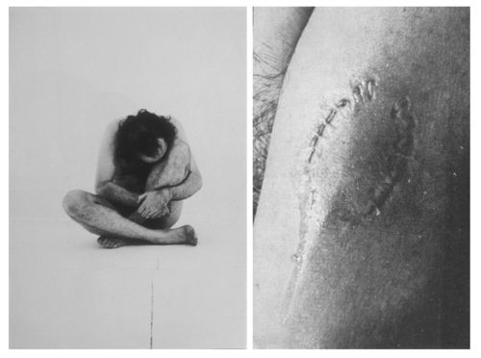
Vito Acconci, Trademarks, 1970
Notes:
Vito Acconci (1940- )
Sculptor, performance artist and video artist
Initially devoted himself to poetry and writing
1969: Begins to produce visual work, most of which incorporates subversive social comment
Early work consists of photographic records of actions such as bending and throwing
Uses his own body
Vito Acconci, Trademarks, 1970
Performed a series of contorted poses and bit into his arms, legs and shoulders
Resulted in impressions of his teeth left on his skin
He then covered these marks with printers ink and used them to stamp various surfaces
Refers to the commercial practice of branding (marking) a product for the purpose of exchange (trade)
Trademarks was not carried out in front of a live audience
Instead photos where reproduced for the fall 1972 issue of Avalanche magazine
The ephemera becomes the commodity

Slide 19
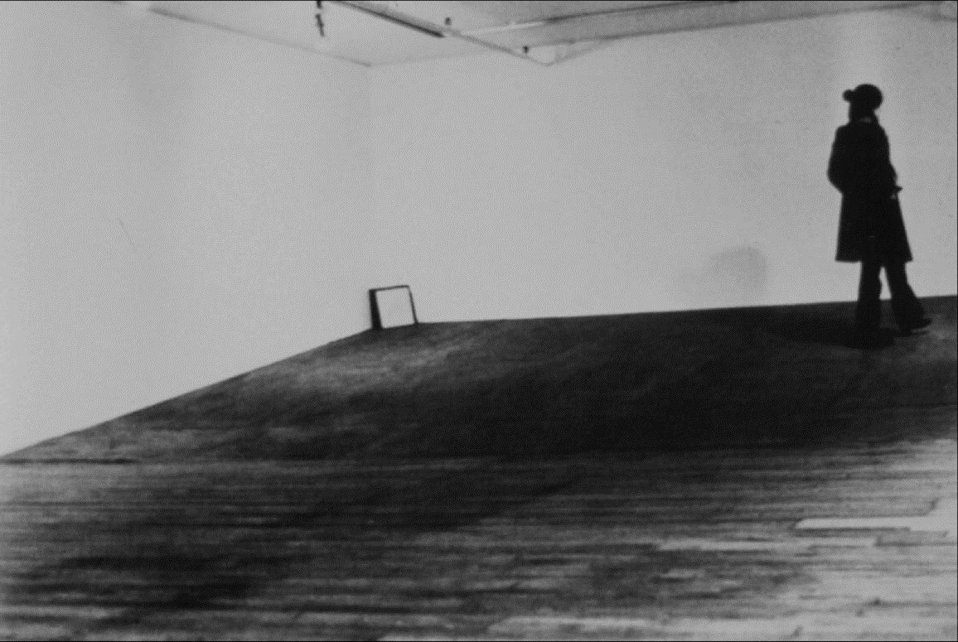
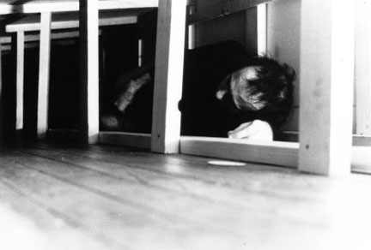
Vito Acconci, Seedbed, 1972, New York City
Notes:
Vito Acconci, Seedbed, 1972, New York City
In January 1971, Acconci performed Seedbed intermittently at New York's Sonnabend Gallery
On days he performed, visitors entered to find the gallery empty except for a low wooden ramp
Below the ramp, out of sight, Acconci masturbated, basing his sexual fantasies on the movement of visitors above him
He narrated these fantasies aloud, his voice projected through speakers into the gallery
A video documents the performance (owned by MoMA)
Text documenting and transcribing Seedbed was published in Avalanche magazine in 1972

Slide 20
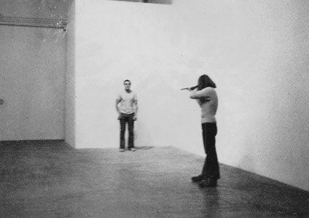
Chris Burden, Shoot, 1971
Notes:
Chris Burden (1946- )
Highly radical
Controversial
Performances meant to shock
Often involve bodily danger for the artist
Attends UC Irvine
Trained as a minimalist
Noticed that is forces the viewer to move around it
About bodily movement and physical activity
Thought of building a sculptural box and getting into it, then saw a bank of lockers:
They wouldn’t be mistaken for the art (the activity is the art)
A eureka moment: “I can do something and it can be art. I don’t have to make something.”
His thesis show consisted of him locking himself in a locker for five days
Five Day Locker Piece, April 26-30, 1971
University of California, Irvine
Above Burden was a 5-gallon supply of water, while the locker below him contained an empty 5-gallon jug
He remained in the locker for the entire 5 days without food
Chris Burden, Shoot, 1971
Shot in the left arm by an assistant from a distance of about 5 meters with a .22 rifle
“It was supposed to be a graze wound, but the marksman missed.”
No audience
Performance fleeting, but the photos made it legendary
Many more shocking performances – you can look him up on your own…you’ve read about them already
Interested in the interaction between the self and the experience
An audience is not essential

Slide 21
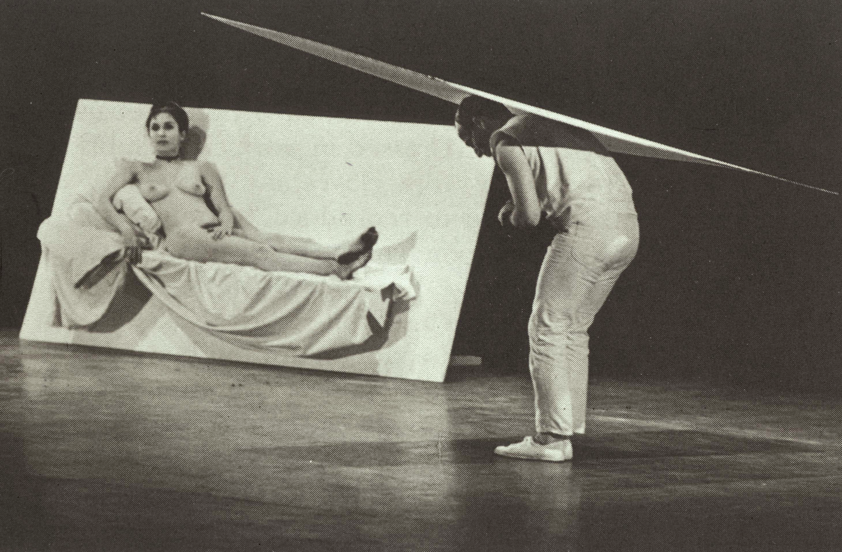
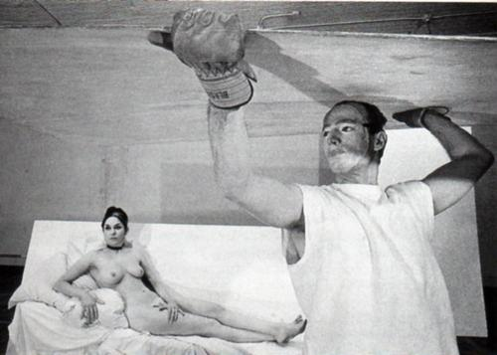
Robert Morris, Site, 1964
with Carolee Schneemann
Notes:
Carolee Schneemann (1939- )
FEMINISM
Performance artist known for her work on the female body, sexuality, and gender
While a student at Bard College, became aware of the differences in perception between male and female bodies
Model for her boyfriend’s portraits and her own nude self-portraits
Begins as a painter in the late 50s
Sort of Neo-Dada, with a little expressionistic brushwork added
The climate was misogynistic, for sure
Part of the First Wave of Feminism
Early 1970s: Part of the Feminist art movement in Europe and the US
Contributes to feminist theory with texts
Becomes familiar with Kaprow and writers such as Simone de Beauvoir
Works with Oldenberg, Cunningham, Cage and Rauschenberg at the Judson Memorial Church’s art program
Uses her nude body in works – needed to be taken back from the status of a cultural possession
Robert Morris, Site, 1964
Performed at the Surplus Dance Theater, NY and other locations
Schneemann the model (based on Olympia)

Slide 22
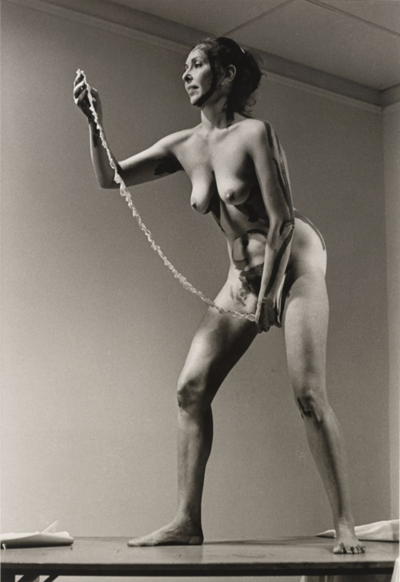
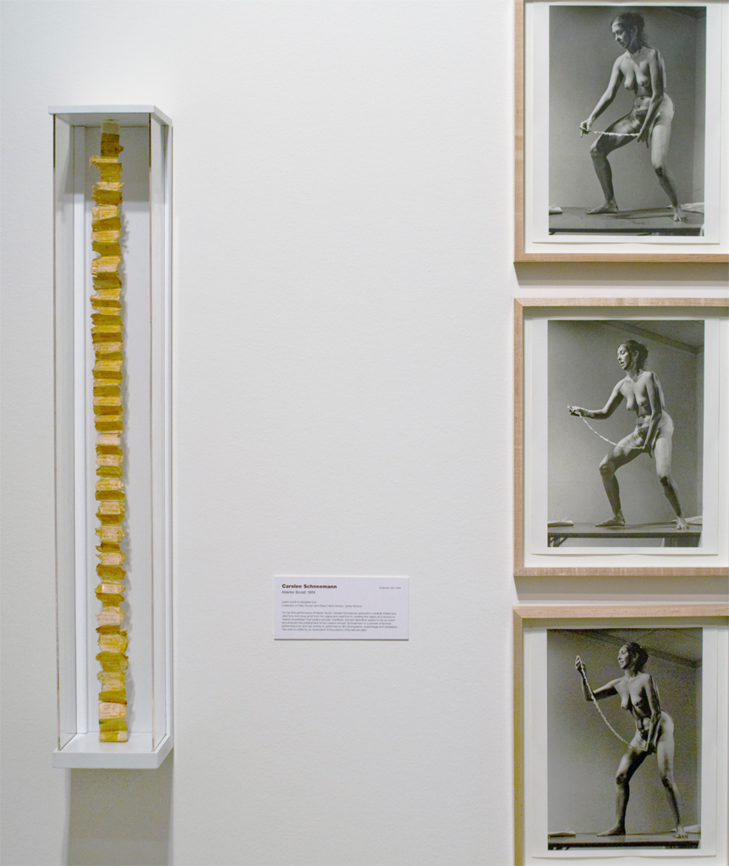
Carolee Schneemann, Interior Scroll, 1975
Notes:
Uses her body to explore the power of female sexuality
This against the backdrop of the broader women’s movement in the 1970s
Schneemann’s work was about liberating women from oppressive artistic and social conventions
Highly personal and political works
Interior Scroll, 1975
First performed in East Hampton for the “Women Here and Now” festival
Schneemann insisted on the artist’s body as explicitly sexual
Her refusal to divorce sexual experience from art-making introduced the body of the female artist as the source of her creative and imaginative energy
Schneemann stood naked on a table, painted her body with mud, and then slowly extracted a forty-inch-long scroll from her vagina and read from it, describing the sexism women artists encountered in the art world.
Following is the text that Schneemann read from the scroll during her performance:
I met a happy man
a structuralist filmmaker
—but don’t call me that
it’s something else I do—
he said we are fond of you
you are charming
but don’t ask us
to look at your films
we cannot
there are certain films
we cannot look at
the personal clutter
the persistence of feelings
the hand-touch sensibility
the diaristic indulgence
the painterly mess
the dense gestalt
the primitive techniques
(I don’t take the advice
of men who only talk to
themselves)
PAY ATTENTION TO CRITICAL
AND PRACTICAL FILM LANGUAGE
IT EXISTS FOR AND IN ONLY
ONE GENDER
even if you are older than me
you are a monster I spawned
you have slithered out
of the excesses and vitality
of the sixties……..
he said you can do as I do
take one clear process
follow its strictest
implications intellectually
establish a system of
permutations establish
their visual set……..
I said my film is concerned
with DIET AND DIGESTION
very well he said then
why the train?
the train is DEATH as there
is die in diet and di in
digestion
then you are back to metaphors
and meanings
my work has no meaning beyond
the logic of its systems
I have done away with
emotion intuition inspiration—
those aggrandized habits which
set artists apart from
ordinary people—those
unclear tendencies which
are inflicted upon viewers……..
it’s true I said when I watch
your films my mind wanders
freely……………..
during the half hour of
pulsing dots I compose letters
dream of my lover
write a grocery list
rummage in the trunk
for a missing sweater
plan the drainage pipes for
the root cellar………..
it is pleasant not to be
manipulated
he protested
you are unable to appreciate
the system the grid
the numerical rational
procedures
the Pythagorean cues—
I saw my failings were worthy
of dismissal I’d be buried
alive my works lost………
he said we can be friends
equally tho we are not artists
equally I said we cannot
be friends equally and we
cannot be artists equally
he told me he had lived with
a “sculptress” I asked does
that make me a “film-makeress”?
“Oh no,” he said. “We think of you
as a dancer.”

Slide 23
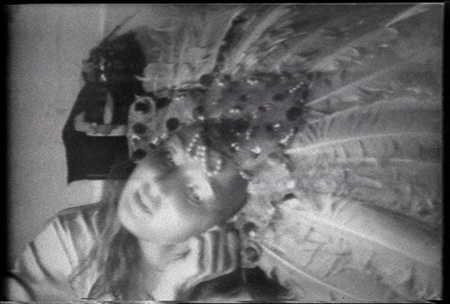
Joan Jonas, Organic Honey’s Visual Telepathy, 1972
Notes:
Joan Jonas (1936- )
Performance and multimedia artist
Influenced by her experience of the New York art scene in the early to mid-1960s
John Cage and Claes Oldenberg and their interest in ‘non-linear’ structure
Her early performances (1968–71), called Mirror Pieces, were held in large spaces and included large and small mirrors
Either as a central motif or as props or costume elements
Works became increasingly symbolic, game-like and ritualistic
Organic Honey’s Visual Telepathy, 1972
Not biographical, but personal
Organic Honeys Visual Telepathy evolved as she was continually investigating my own image in the monitor
Decided to buy the mask of a doll's face, which transformed her into an erotic seductress
Took the role of ‘Organic Honey’, a part-real, part-mythical and part-fantastical woman
Explores artifice, masquerade, and narcissism
She hums and sings a capella as she tries on different identities, putting on masks and vamping in front of the mirror.
She's opening up herself to her inner personality, her alter ego
Keeps her narcissism in check by scanning her own image in a video monitor
Jonas’s performances, films and videos are characterized by de-synchronized, non-linear, fragmentary features
“I was making a videotape pretending to make a film, but playing with various electronic devices, exploring the differences between film and video. So I simply showed the process all the objects, props, the sets for each scene and moved through the tape changing costumes, lighting, etc. The process was exposed.”

Slide 24
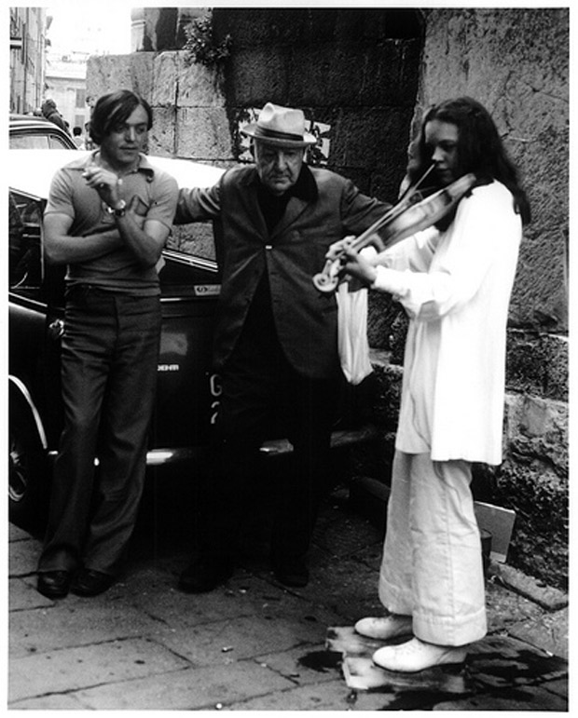
Laurie Anderson, Duet on Ice, 1975
Notes:
Laurie Anderson (1947- )
Classically trained musician
Performance artist
Not specifically a feminist artist, but interested in gender roles and androgyny
The art scene of the early 1970s fostered an experimental attitude among many young artists in downtown New York that attracted Anderson
Some of her earliest performances as a young artist took place on the street or in informal art spaces
Laurie Anderson, Duet on Ice, 1975
Stood on a block of ice, playing her violin while wearing her ice skates
When the ice melted, the performance ended
Since that time, Anderson has gone on to create large-scale theatrical works which combine a variety of media—music, video, storytelling, projected imagery, sculpture—in which she is an electrifying performer

Slide 25
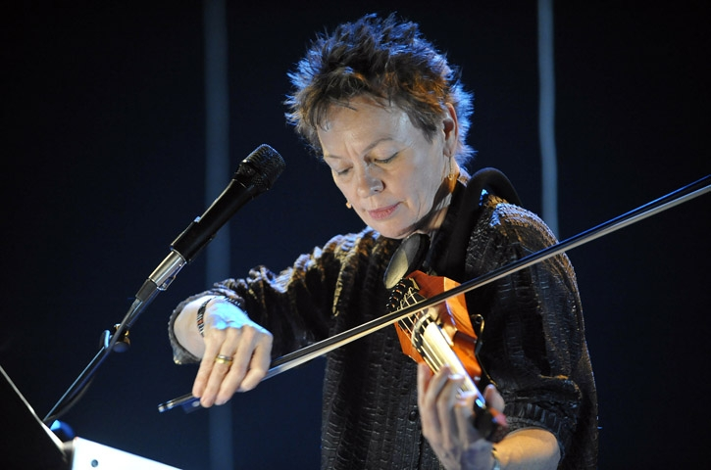
Notes:
Describe her recent performance in October…

Slide 26
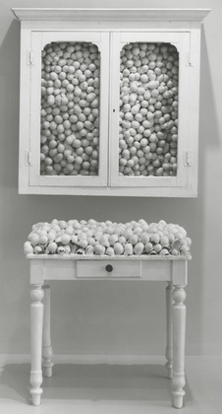
Institutional Critique
Marcel Broodthaers, White Cabinet and White Table, 1965
Painted cabinet, table, and eggshells
Notes:
Institutional Critique
A critique of the institution of the museum
Museum as tomb – elitist – constructing history instead of displaying it objectively
The excluded is as important as the included
Curatorial choices – appear infallible
Who is being promoted, artist or curator?
What is the agenda?
We’ll look at race, gender, and social class as factors
A postmodern idea
Modern roots:
Think of Courbet – Salon des Refuses
Hearkens back to Futurism (death to the museum, remember?)
Marcel Broodthaers (1924-76)
Belgian poet, photographer, film-maker and artist
Had some early contact with Belgian Surrealists, especially Magritte
That Magritte painted words, creating a disjunction between the painted word and the object, influences Broodthaers
1958: Begins to publish articles illustrated with his own photos
1963: Decides to become an artist and begins to make objects
Uses visual and verbal puns
Marcel Broodthaers, White Cabinet and White Table, 1965
"I, too, wondered if I couldn't sell something and succeed in life. . . . The idea of inventing something insincere finally crossed my mind and I set to work at once."
Broodthaers often used found or discarded materials, favoring eggshells, which are "without content other than the air."
Using antique-looking furniture and organic materials, Broodthaers:
Critiqued museum display
Avoided modern products

Slide 27
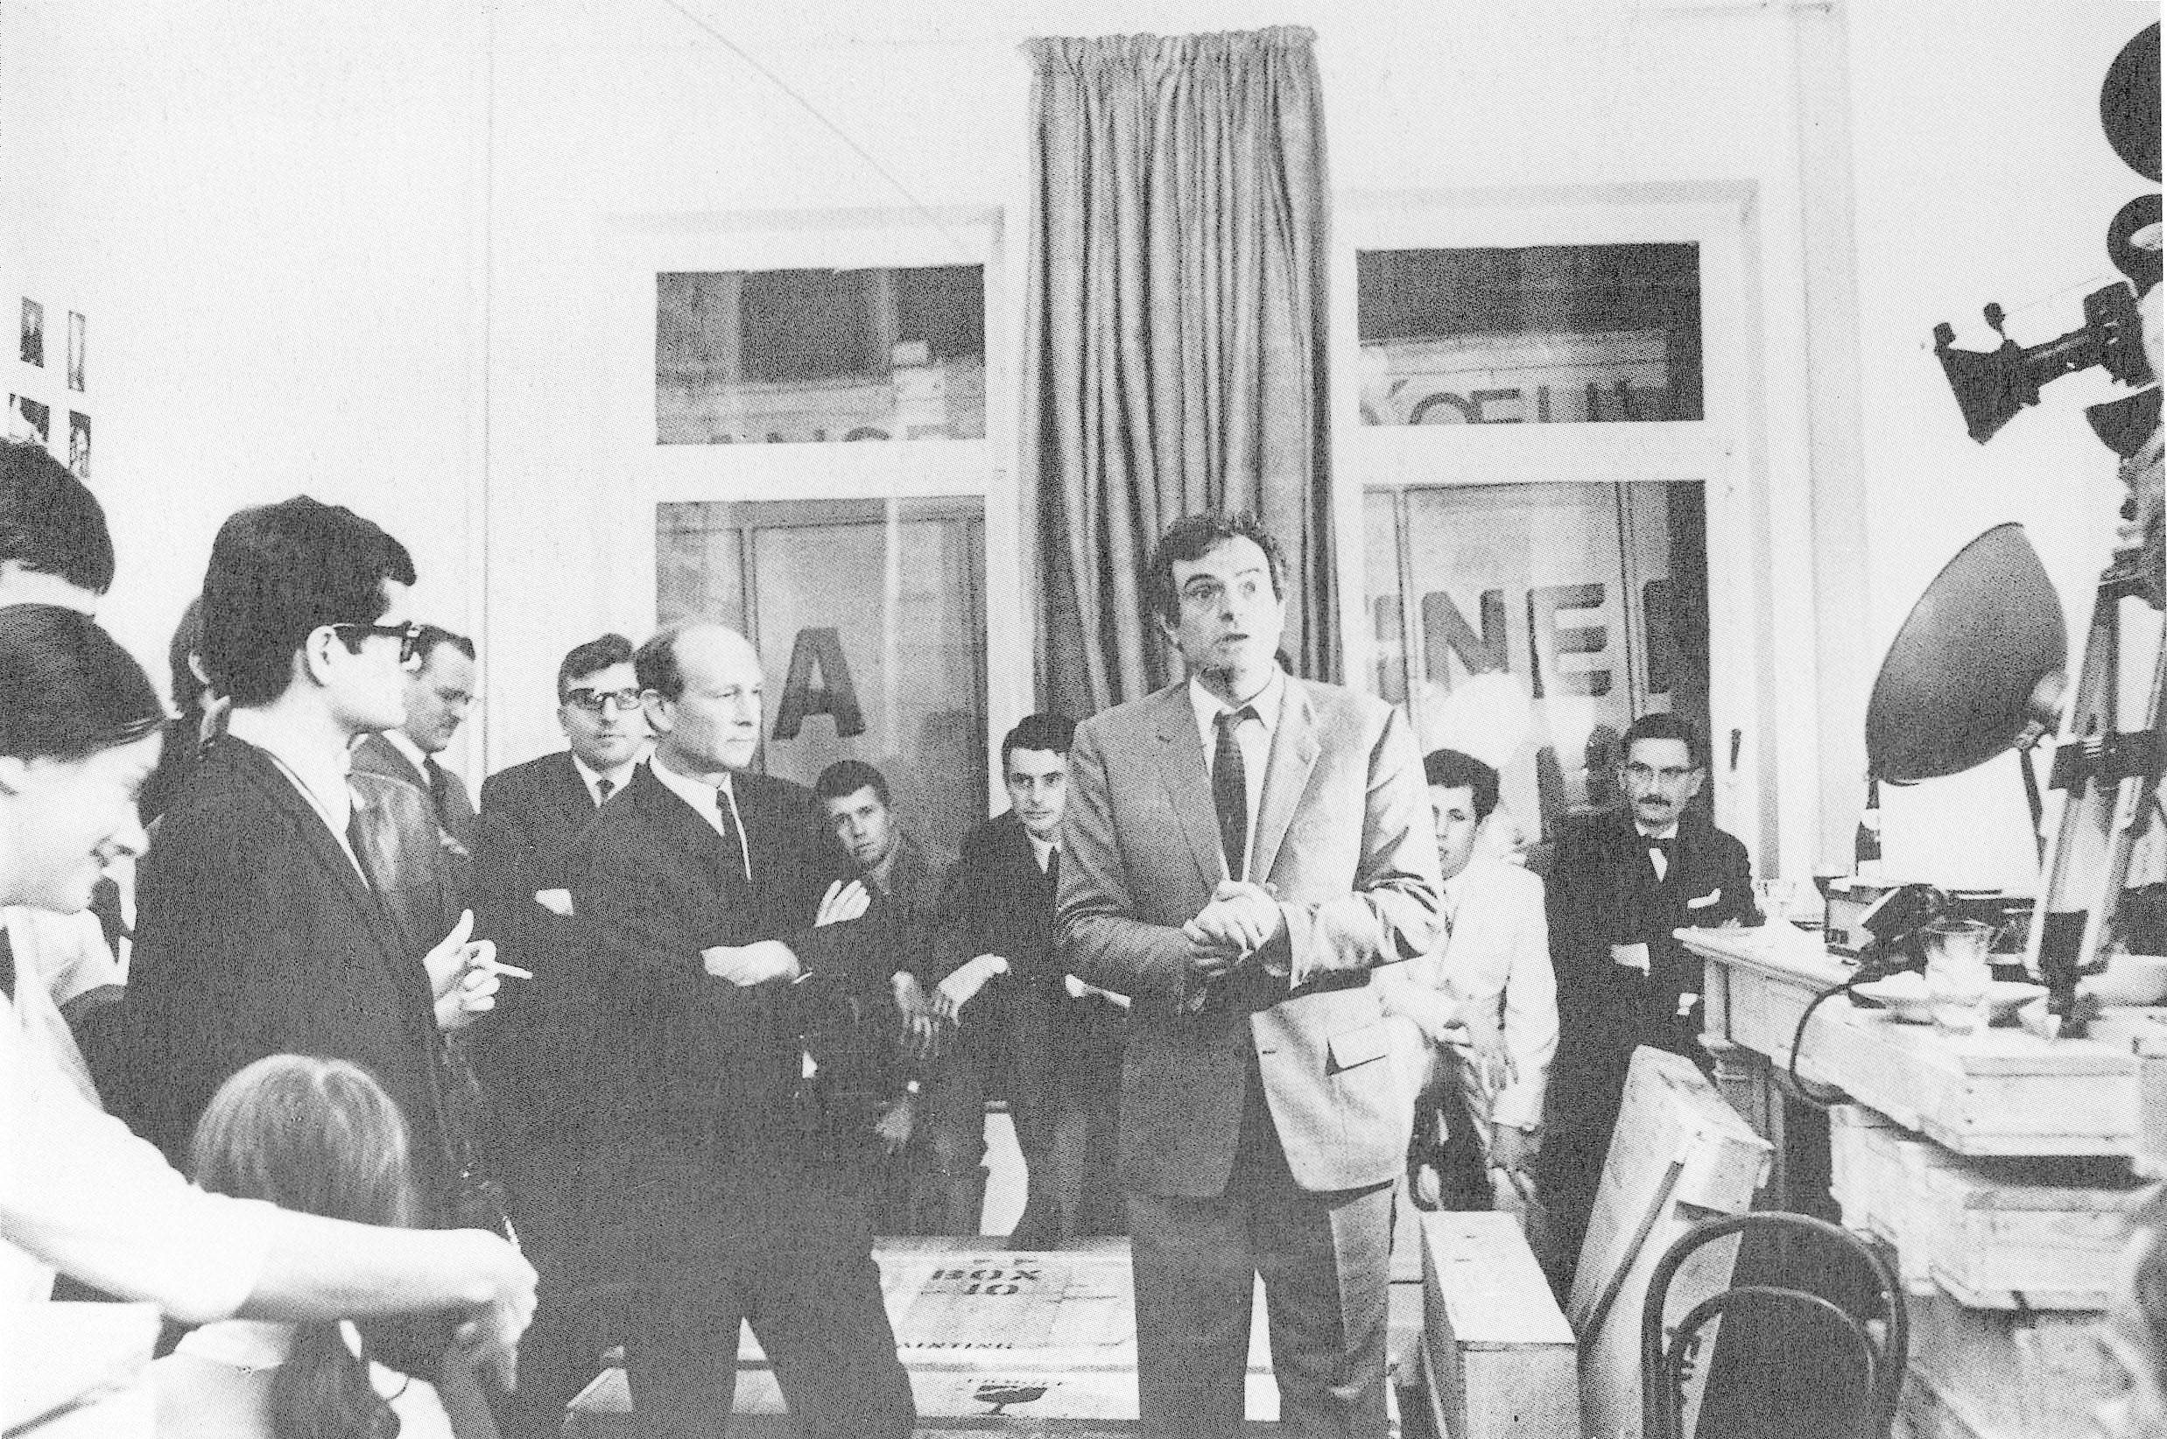
Marcel Broodthaers, Museum of Modern Art: Department of Eagles, 1968
Notes:
Marcel Broodthaers, Museum of Modern Art: Department of Eagles, 1968
1968 to 1971: Produced large-scale environmental pieces that reworked the very notion of the museum
1968: Creates a conceptual museum in his Belgium apt.
Museum of Modern Art: Department of Eagles
No collection
Exhibited reproductions of works of art, fine-art crates, wall inscriptions, and film elements
All the trappings of the museum, with none of the content
Investigates how museums bestow value on objects
The great legitimizers
Why?
This installation was followed by a further eleven manifestations of the “museum”

Slide 28
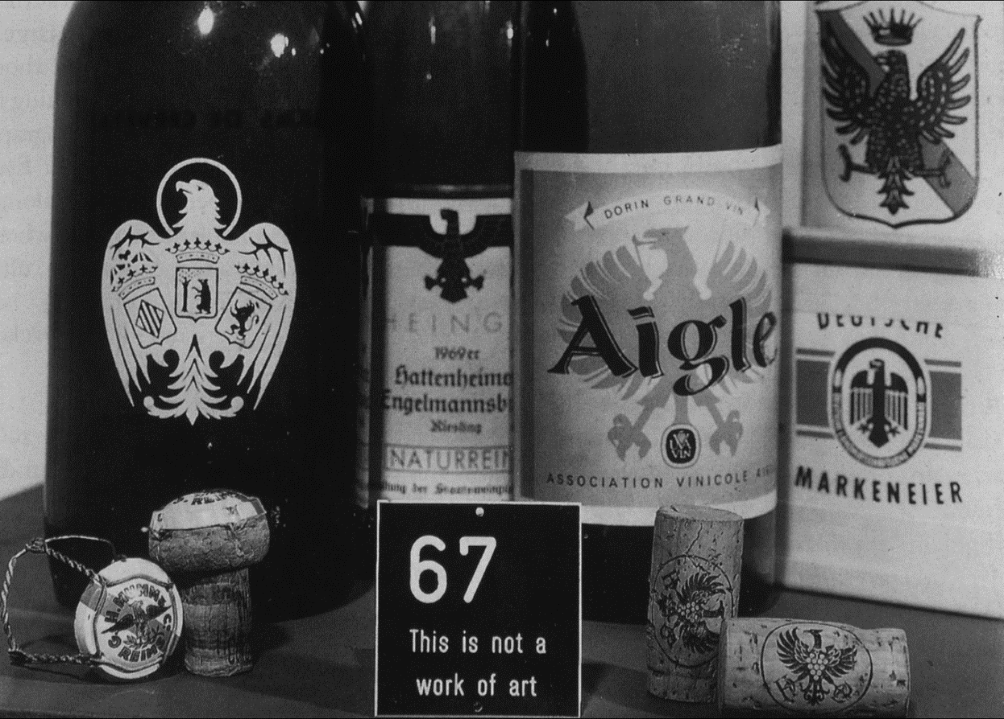
Notes:
Uses the language of the museum to question and subvert it
1970: Created the Financial Section
An attempt to sell the museum "on account of bankruptcy.”
The sale was announced on the cover of the Art Cologne fair catalogue in 1971 – no takers
Produced an unlimited edition of gold ingots stamped with the museum's emblem, an eagle, a symbol associated with power and victory
The ingots were sold to raise money for the museum, at a price calculated by doubling the market value of gold, the surcharge representing the bar's value as art
Wry comment on the arbitrarily inflated value of an object once it is deemed “art”

Slide 29
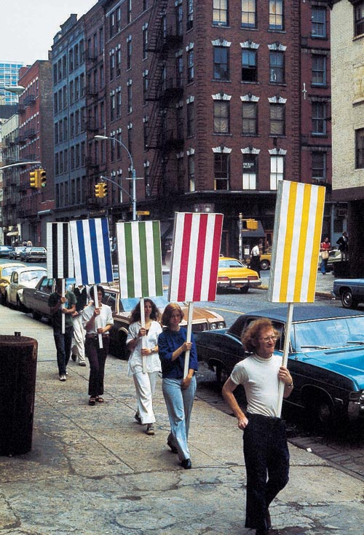
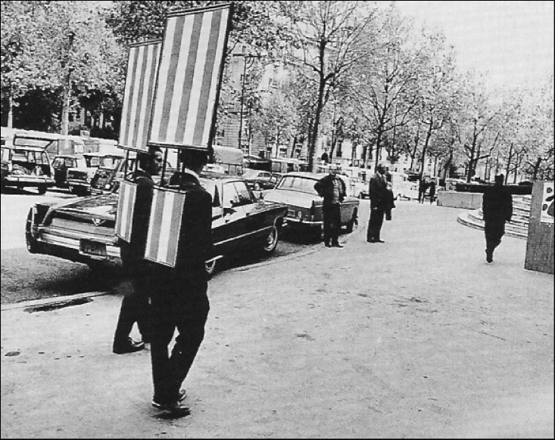
Daniel Buren, Sandwich Men, Paris, 1968
Notes:
Daniel Buren (1938- )
Institutional Critique and Conceptual Art
Can stripes be art? Why not?
Challenges conventions of display
Working within a set system – minimize choices for maximum
Mid-1960s: Joined with artists Olivier Mosset, Michel Parmentier and Niele Toroni to form the group BMPT
Seeking to make canvases that would exist solely as visual and material fact, each of BMPT's members selected a single, reductive motif
Employed in all of that individual's works
For Buren, this motif was a pattern, based on awning fabric, of alternating vertical stripes (each exactly 8.7 centimeters wide) of white and a single color
He has used it in his art ever since
Daniel Buren, Sandwich Men, Paris, 1968
Parisian sandwich men carrying placards of equal stripes
Stuck on all types of surfaces (walls, fences, display signs
“Every act is a political act and, whether one is conscious of it or not, the presentation of one's work is no exception.”

Slide 30
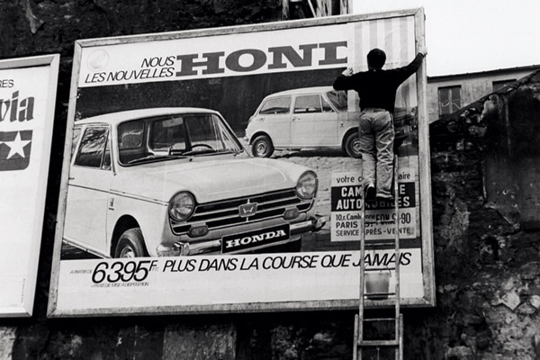
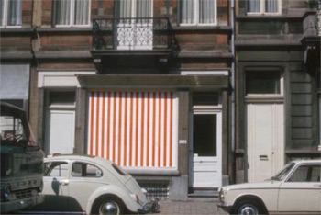
Daniel Buren, Photo Souvenirs, in situ work, Paris, 1969
Notes:
Best known for his use of contrasting stripes as a visual tool that reveals the specific features and dimensions of a site
Site specific!
Sees himself as an artist who “lives and works in situ”
Often temporary
Often transforms the environment for which the piece is specifically designed
He alters the perception and context of one’s surroundings by:
Modifying the navigation of space
Enhancing lighting
Obstructing viewpoints
Highlighting certain architectural features
Buren installs his in the architecture of both public and private
Subway platforms to prestigious museums
Situated work: “a work for the most part inspired by a particular location, but made with the intention that the very same elements of the original work can be reinstalled in different sites following a series of rules, changing each time in response to the given place. In turn, the site is changed by the work.”

Slide 31
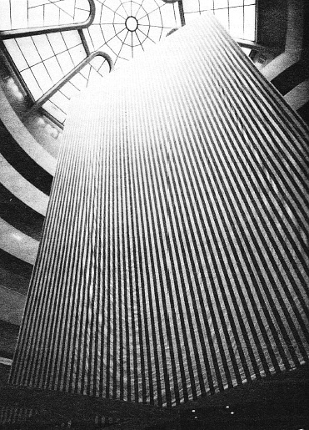
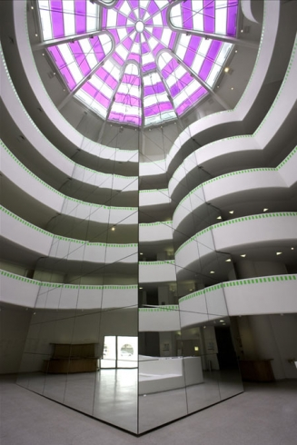
Daniel Buren, Photo-souvenir: Around the Corner, 2000–05, and The Rose Window, 2005
Guggenheim Museum
Daniel Buren, Sculpture Painting, 1971
Guggenheim Museum
Notes:
By the 1970s: Buren making art that drew attention away from the object and toward the daily operations and physical spaces of museums and galleries
Challenges their supposed neutrality
He began to use his signature stripes—in the form of pre-printed fabric or paper—to frame and pierce the facades and interiors of these institutions
Puts the focus on their architecture and, by extension, the network of social, cultural and economic forces affecting the perceived esthetic and monetary value of the objects therein
Daniel Buren, Sculpture Painting, 1971
Other artists in this exhibition at the Guggenheim protested
Took away sightlines and overpowered everyone’s work
It was removed prior to the opening
Daniel Buren, Photo-souvenir: Around the Corner, 2000–05
and The Rose Window, 2005
The Eye of the Storm, a retrospective of Buren’s work
Refers to the controversy from 1971
Placed colored gels over portions of the famous oculus
Mirrored column creates a pattern of lines with the architecture

Slide 32
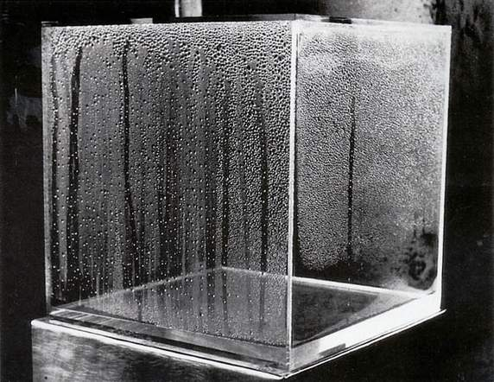
Hans Haacke, Condensation Cube, 1963
Notes:
Hans Haacke (1936- )
Born Cologne, Germany
A member of Zero (an international group of artists active in late 50s)
Aimed to re-harmonize man and nature and to restore art's metaphysical dimension
Sought to organize the pictorial surface without using traditional devices
Used non-traditional materials such as fire and water
Work focuses on systems and processes
Hans Haacke, Condensation Cube, 1963
A micro-environment
1961-62: Studies on a Fulbright Grant in US – Pennsylvania
Late-60s: Beings to work in real-time systems
Work takes on a critical, sociopolitical tone

Slide 33
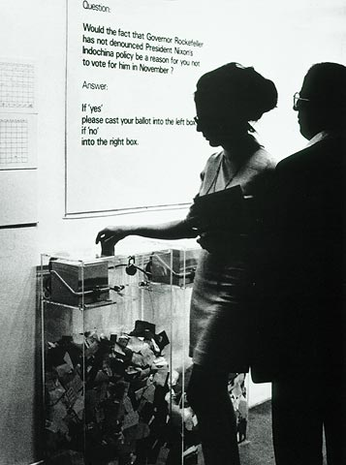
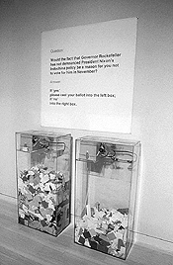
Hans Haacke, MoMA Poll, 1970
Notes:
Hans Haacke, MoMA Poll, 1970
Part of Information, an exhibition MoMA claimed to be the first conceptual art exhibition mounted by a U.S. museum
Haacke posited this SYSTEM as art: a query, a response algorithm, and its visual feedback
An early example of institutional critique
Question:
Would the fact that Governor Rockefeller has not denounced President Nixon's Indochina policy be a reason for you not to vote for him in November ?
Answer:
If 'yes' please cast your ballot into the left box If 'no' into the right box.
Ballots' were dropped into either of two Plexiglas ballot boxes (visitors chose "yes" twice as often as "no“)
Kept the specific question a secret until the night before the show opened
New York Governor Nelson Rockefeller was a member of the board of trustees of MOMA and planning a run for the U.S. Presidency at the time
Haacke (in an interview in 2004): “Two months before the opening of "Information," four students at Kent State University had been shot dead by the Ohio National Guard during nationwide protests. We saw a glaring conflict between the politics of museum trustees and our own liberal-left attitudes.”
Brings attention to the often-invisible interests running and institution
How do the politics of the trustees influence the curatorial programming?
What are the connections between the institutions of art and the politicians, corporate connections, and overall power-mongers of the city?
It was almost 30 years before he was invited back to MoMA

Slide 34
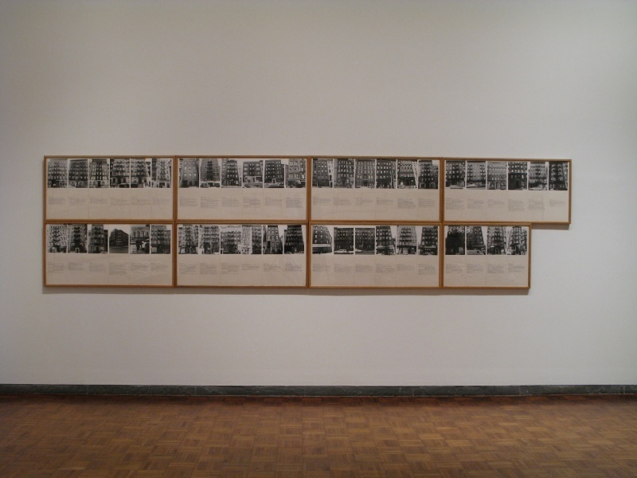
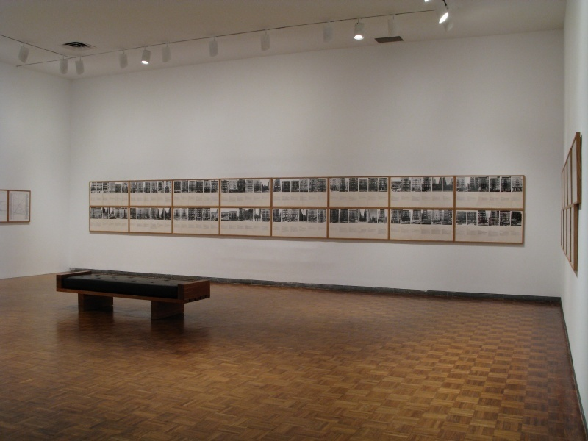
Hans Haacke, Shapolsky et al. Manhattan Real Estate Holdings, a Real-Time Social System, as of May 1, 1971, 1971 (partial installation view, Two Years, Whitney Museum of American Art, 2007–08). Two maps (photo-enlargements); 142 black-and-white photographs; 142 typewritten sheets; six charts, an explanatory panel, dimensions variable. Edition no. 2/2
Notes:
Hans Haacke, Shapolsky et al. Manhattan Real Estate Holdings, a Real-Time Social System, as of May 1, 1971, 1971
Politics becomes art, overtly!
It has always been political, to varying degrees (think of the 20th century!)
Controversial documentary installation
Harry Shapolsky, the key figure, who is well protected by influential friends, is guilty of an assortment of fraudulent practices of which the judicial system has been exceedingly forgiving
A searing indictment of Manhattan slumlord, Harry Shapolsky
Shapolsky had attracted Haacke's attention because he was the landlord who owned more slum properties than any other landowner in New York
Haacke's research—all culled from public records—reveals how Shapolsky's business worked
Different properties were held under different company names
INSTALLATION
142 photographs of facades of NY tenement buildings
Accompanied by typewritten data sheets
A biting indictment of the monopoly of one family of wealthy proprietors over NY slums
Maps of Harlem and the Lower East Side
Due to be displayed in an exhibition at the Guggenheim entitled Hans Haacke: Systems
The work was deemed ‘inappropriate’ by the museum’s management, and the Guggenheim decided to close down the exhibition
The curator, who defended the work, was fired
Artists occupied the premises in protest against this censorship
The piece becomes famous
Following the abrupt cancellation of his exhibition and the trouble it had caused with the museum, Haacke turned to other galleries and to Europe
His work was generally accepted there
1981: Has a solo exhibition at the New Museum, entitled Hans Haacke: Unfinished Business

Slide 35
Hans Haacke, A Breed Apart, 1978
7 photographs, black and white and color, on paper on hardboard
Notes:
Hans Haacke, A Breed Apart, 1978
Again, exposing systems of power and influence
Targets the former car manufacturer British Leyland
Leyland send cars to support the South African apartheid regime
Haacke highlights that shameful fact publicly
The contrasts between the brutal 'real' world and the glamourized realm of advertising draw out the double standards of British Leyland's involvement with the South African apartheid regime

Slide 36
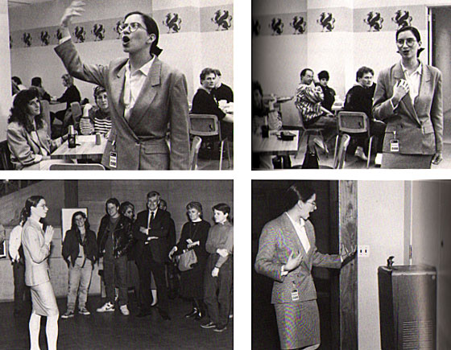
Andrea Fraser, Museum Highlights: A Gallery Talk, 1989
Notes:
Andrea Fraser (1965- )
New York-based performance artist, mainly known for her work in the area of institutional critique
Fraser made her name in the late 1980s leading gallery tours as faux-docent “Jane Castleton”
1998: Fraser stated that she would no longer impersonate museum guides; henceforth she would perform as an artist
1995: In Kunst muss hängen (Art Must Hang) Fraser re-enacts a 1995 speech by a drunk Martin Kippenberger, word by word (in German), gesture for gesture
Memorized it all (it took months)
Very much a performance
Andrea Fraser, Museum Highlights: A Gallery Talk, 1989
1986: Assumes the role of docent “Jane Castleton” at the New Museum
Applies “art speak” to base things like the restrooms, the cafeteria, and the store
Discusses corporate sponsorship and other economic elements (typically taboo)
Assumes the voice of institutional authority
She had to learn “museum lingo” and take on specific gestures and a posture
Rarefied, exclusive, and specialized group
Highlights the ideological function of museum curators, staff, and docents
Their job is the social and cultural re-education of the public
Meaning-makers
EXCERPTS
For example, in describing a common water fountain, Fraser proclaims "a work of astonishing economy and monumentality ... it boldly contrasts with the severe and highly stylized productions of this form!"
Upon entering the museum cafeteria: "This room represents the heyday of colonial art in Philadelphia on the eve of the Revolution, and must be regarded as one of the very finest of all American rooms.“
Declares that one could name the museum gift shop for a gift of $750,000

Slide 37
Adrian Piper, "Catalysis III," 1970
Notes:
Adrian Piper (1948- )
1969: Studies art, SVA
1970-74: BA in Philosophy, City College of NY
1977 and 1981: Masters and PhD, Harvard
Influenced by Sol LeWitt and Yvonne Rainer
1969: Works at Seth Siegelaub Gallery (conceptual hub!)
1971: Has work in MoMA’s Information, which included work by Hans Haacke and other conceptual and IC artists
---Feminism, Identity Politics, Institutional Critique---
Operates in two different fields
Art and psychology (PhD)
Known primarily for performance-based work
Had been doing conceptual work with maps, charts, and so forth for some time
Involved with the metaphysics of space and time
Interested in how perception changes
She had been doing documentations of her passage through space
Generates documentation and metaphysical questions
Performance was the next logical step
1970: Kent State killings / Nixon invades Cambodia
Had just started studying philosophy at City College, NY
It was shut down temporarily, black students shut it down to protest lack of open admissions
Gained a sense of the immediacy of these issues in her life
Needed to express her current concerns
Moves out into the world
More concrete and confrontational in her interactions with others through her work
Performance art and conceptual art were two sides of the same coin
Both rejected the aestheticized art object
Critique the meaning of art
Unsettling street performances
Rhetoric around race, gender, and how we encounter prejudice in daily life
Adrian Piper, "Catalysis III," 1970
Staged a number of public performances on the subway and city streets
Forced a confrontation between viewers and the artist’s body in various abject states
Rode the subway and Empire State Building elevator with a towel shoved in her mouth
Doused herself in a mixture of vinegar, eggs, milk, and cod liver oil and then spending a week moving around New York's subway and bookstores
Walked through the streets of New York and went shopping at Macy’s with “Wet Paint” painted on her clothing, among other experiments
These actions exaggerate and make explicit unconscious operations already in play in the here-and-now on the part of both the artist and the public in the moment of performance
Attention is directed to Piper’s process of self-presentation as an object
Also on the viewing public’s confusion, disgust, and fear at the scene of ambiguity, ‘racial’ and otherwise

Slide 38
Adrian Piper, Self-Portrait Exaggerating My
Negroid Features, 1981
Notes:
Adrian Piper, Self-Portrait Exaggerating My Negroid Features, 1981

Slide 39
Adrian Piper, "My Calling (Card) #1," 1989
Notes:
Adrian Piper, "My Calling (Card) #1," 1989
1986-1990
Calling Card performances
Piper handed this card to people she encountered in everyday life who made racist comments in front of her at dinners and cocktail parties
One part guerilla performance, one part social intervention
The series extends the practice of her 1970’s Catalysis works into an even more direct and intimate confrontation with social and interpersonal encounters at the scene of ‘racial’ recognition and its lapses

Slide 40
Notes:
Commentary of imbalanced gender relations
Male assumptions of female availability
Lack of female agency in society as a whole

Slide 41
Adrian Piper, Thwarted Projects, Dashed Hopes, A Moment of Embarrassment, 2012
Notes:
Adrian Piper, Thwarted Projects, Dashed Hopes, A Moment of Embarrassment, 2012
Calling attention to the construction of racial difference
From her website: Adrian Piper has decided to retire from being black. In the future, for professional utility, you may wish to refer to her as The Artist Formerly Known as African-American
There is an Adrian Piper Research Association Foundation (APRA)
The APRA Foundation Berlin was established in order to protect, preserve and offer public access to APRA, for the benefit of those students, scholars, curators, collectors, writers, and members of the general public who have a constructive curiosity or scholarly or professional interest in Piper's work and life
APRA is maintained as a document of Piper's activities in her three chosen areas of specialization: art, philosophy and yoga
The APRA Foundation Berlin supports research that exemplifies, models, analyzes, and/or theorizes the creative multi-disciplinary expressions of the self encouraged by globalization and cross-cultural journeying
An artist and a tenured professor in philosophy
1991: Became the first female black philosophy professor to receive academic tenure in the United States
In her writings, Piper talks through her logical process which eventually led to the instantiation of the Calling Card performances; she recounts the extreme discomfort she experienced in various other ways of handling the recognition/non-recognition of her blackness. The indexical present instantiated by her work seemed to act as a catalyst for social mindfulness, awareness of the here-and-now of interpersonal relations.

Slide 42
Fred Wilson, Mining the Museum, 1992
Metalwork 1793-1880
Notes:
Fred Wilson (1954- )
Grew up in a suburb of New York City
Only black kid in his school
Shunned, with no real connection to the black community
A very multi-cultural family – feels familiar with all ethnicities, though he realizes this is not always reciprocated by others
No longer has a strong desire to make things with his hands
Instead, he creates arrangements of objects
“I get everything that satisfies my soul from bringing together objects that are in the world, manipulating them, working with spatial arrangements, and having things presented in the way I want to see them.”
Asks: What is blackness? What is me and what is a societal construct?
Fundamentally interested in ethnic identity
How are identities constructed?
Who / what promotes them?
Wilson creates new exhibition contexts for the display of art and artifacts found in museum collections
Wall labels, sound, lighting, and non-traditional pairings of objects
His installations lead viewers to recognize that changes in context create changes in meaning
While appropriating curatorial methods and strategies, Wilson maintains his subjective view of the museum environment and the works he presents
He questions (and forces the viewer to question) how curators shape interpretations of historical truth, artistic value, and the language of display—and what kinds of biases our cultural institutions express
Fred Wilson, Mining the Museum, 1992
An intervention
Wilson transformed the Maryland Historical Society’s collection to highlight the history of slavery in America
See 18th and 19th century metalwork alongside slave shackles
What do these objects convey?
Why is one history privileged via display and one negated via neglect?
Interested in invisible processes in museums (see Andrea Fraser)
Who legitimizes objects and why?
Process
Meets museum staff
Investigates the collection
Considers the city and its history and location
Sees the museum as a palette
Creates a meta-narrative about museums and display
Uses display techniques (light, color, spatial relationships) to critique the notion of a museum
What meaning is created and put forth with a museum installation?

Slide 43
Fred Wilson, Mine/Yours, 1995
Notes:
Fred Wilson, Mine/Yours, 1995
Objects have an emotional and physical power (they have memories)
Juxtaposing objects can create new ideas
Collects and is given tchotchkes based on historical, denigrating stereotypes of African-Americans
“Black collectibles”
Wants them out of his life, so uses them in his work
Juxtaposes photography and ceramic memorabilia
Photo depicts a black family early in the twentieth century
The arrangement of figurines on the right closely mirrors the content of the photograph, providing each character with its three-dimensional counterpart
However, the quality of the two family portraits could not be more different
Left: a proud group of related individuals
Right: a mocking provocation
Inspired by racist conceptions of African Americans during slavery
A cartoonish saltshaker and decorative porcelain doll—all of which were once popular collectibles—translate into a discriminatory insult
Exaggerated features
Racist stereotypes
A sacred family document becomes a belittling farce

Slide 44
Judy Chicago, The Dinner Party, 1979
Mixed media
Collection Brooklyn Museum of Art
Notes:
Judy Chicago (1939- )
Challenges the institution of male-dominated art history
Born Judith Cohen in Chicago, July 20, 1939
She assumed the surname of her hometown in 1969 to assert her independence from the patrilineal convention which gives a woman the surname of a father or husband
The daughter of political activists, her father was a union organizer, and her mother was a professional in a time when women working outside of the home were rare
Studied at the Art Institute of California and later at the University of California at Los Angeles
1960s: First gains recognition as Judith Gerowitz
Creates large, highly crafted sculptures of simple geometric forms in a “minimalist” style
Uses a variety of materials: painting on porcelain, airbrush painting on automobile hoods, and using fireworks to make drawings in the air
Early-1970s: Focuses on feminist themes
Uses the motif of a flower or butterfly to symbolize a woman's sexuality
Incorporates conversational language written directly on the artwork
In addition to her artwork, Chicago taught college art classes, established the first feminist art programs and galleries, and began Womenspace, an all-female art collective
Chicago is best known for three ambitious projects— The Dinner Party, completed in 1979, The Birth Project, completed in 1985, and The Holocaust Project, completed in 1993
We will look at The Dinner Party
Judy Chicago, The Dinner Party, 1979
An icon of 1970s feminist art
Embodies her conviction that women have been left out of the telling of history
Chicago worked with teams of women artists and craftspeople in materials traditionally associated with women: quilting, needlework, china painting, and tapestry
Took two years of work with a crew of 400 people
A three-sided table forming a triangle along which were 39 place settings with plate, goblet, and embroidered cloth
Each setting symbolizes an illustrious woman from history or mythology ranging from a primordial goddess to the American painter Georgia O'Keeffe
On the floor inside the triangular table were the names of 999 more women
Each place setting contains symbols of that particular woman, often derived from a flower-motif suggesting a vagina
Opened at SF MoMA and toured the country
Met controversy and mixed critical response wherever it went, being variously described as visionary and Utopian or as obscene and overly didactic
Several museums withdrew offers to show the work in spite of record attendance rates, and Chicago drew criticism for perceived careerism and exploitation of her numerous volunteers
Now owned by the Brooklyn Museum of Art, Long-Term Installation, Elizabeth A. Sackler Center for Feminist Art
This permanent installation is enhanced by rotating Herstory Gallery exhibitions relating to the 1,038 women honored at the table

