Slide 1
Installation Art, Video Art, and New Media
Notes:
Installation Art
The everyday meaning of installation refers to the hanging of pictures or the arrangement of objects in an exhibition
The less generic, more recent meaning of installation is a site-specific artwork
In this sense, the installation is created especially for a particular gallery space or outdoor site
It comprises not just a group of discrete art objects to be viewed as individual works but an entire ensemble or environment
Installations provide viewers with the experience of being surrounded by art, as in a mural-decorated public space or an art-enriched cathedral
Precedents
Allan Kaprow’s “sets” for Happenings
Edward Kienholz’s tableaux
Red Grooms’s theatrical environments such as Ruckus Rodeo
Claes Oldenburg’s Store filled with his plaster renditions of consumer objects
Andy Warhol’s enormous prints in the form of wallpaper
The “crash” of the art market at the end of the 1980s leads to a reawakening of interest in Conceptualism
Early-90s: a proliferation of installations, often composed of salable parts
Today the term installation is sometimes applied to permanent, site-specific, sculptural ensembles created for corporate or public settings

Slide 2
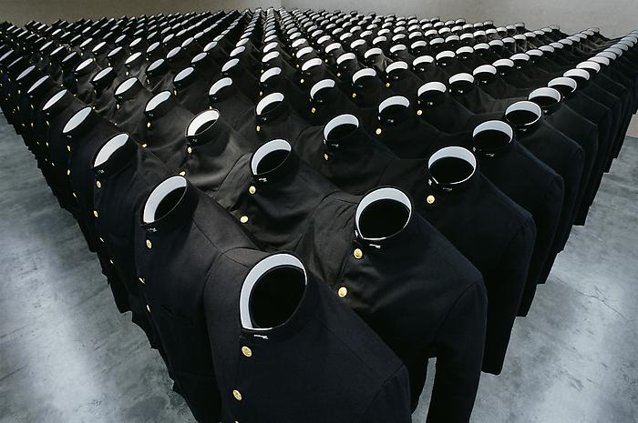
Do-Ho Suh, High School Uni-Form, 1997
fabric, plastic, stainless steel, casters 300 parts total:276 x 217 x 54 inches
Notes:
STRUCTURES
Do-Ho Suh
Born, Seoul, Korea (1962)
Many of Suh's most famed sculptures had reimagined his homes
Used translucent fabric or resin
Sometimes creates painstakingly detailed, oversize dollhouses—from his childhood in Seoul and his young adulthood in the United States
Explores the varying meanings of space, from the smallest territory we occupy – Clothing
Do-Ho Suh, High School Uni-Form, 1997
Issues of memory, history, displacement, identity and the body all come into play
What does a uniform represent?
Faceless – why?
In an age of exponentially increasing globalization, this is a consideration of what it means to belong
The semi-nostalgic sentiment hidden in High School Uni-Form is perhaps more clearly articulated in a complementary installation, a wallpaper project entitled Who Am We?.
Suh scanned approximately 37,000 portraits of schoolboys from his Korean high school yearbooks, reducing their size to the threshold of recognisability.
Then transferred to sheets of wallpaper
37,000 tiny faces are individually contained within oval frames
On walking into a room decorated with this wallpaper, one hardly notices the source of the ever-so-subtle undulation of muted sepia colours on its surfaces
It is only up-close that one discovers with surprise the uncanny faces that have taken over the room’s architecture, enveloping our gaze, awaiting recognition
A meditation on the tension between individual and collective identities
The grammatical disagreement between the ‘we’ and the ‘am’ in the title immediately announces this concern

Slide 3
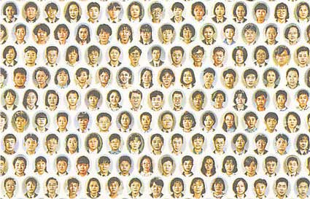
Do Ho Suh, Who Am We?, 1997

Slide 4
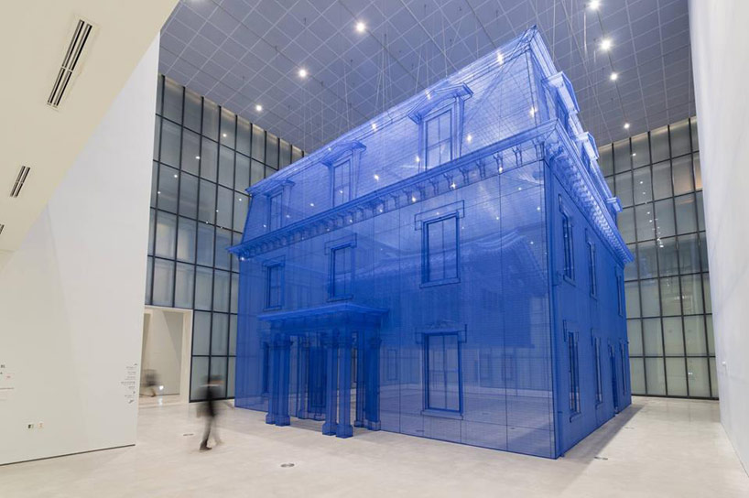
Do-Ho Suh, Home Within Home, 2014
Installation Museum of Modern and Contemporary Art, Seoul, Korea
Notes:
Do-Ho Suh, Home Within Home, 2014
1:1 scale replica of two houses the artist had previously lived in, one inside the other
Created his traditional Korean home in purple fabric
Enveloped and suspended within a more modern building (also purple fabric) -- his first apartment building in the US (Rhode Island)
Suh’s relocation to America as a student gave him a new concept of the home
Viewers are left to consider these interpretations over their own, and contemplate the ever-expanding concept of space and home
Is home a place? A memory? A space?
Do we take our various homes with us?

Slide 5
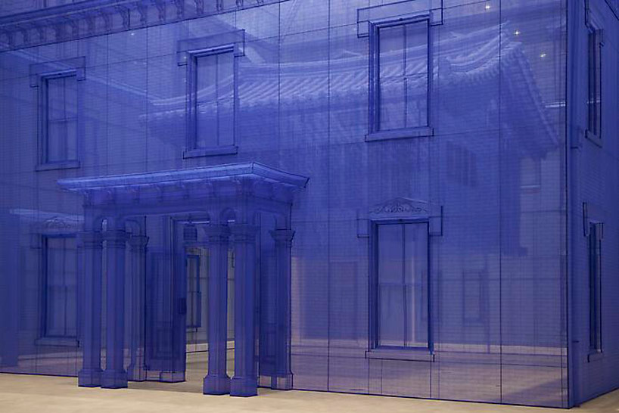

Slide 6
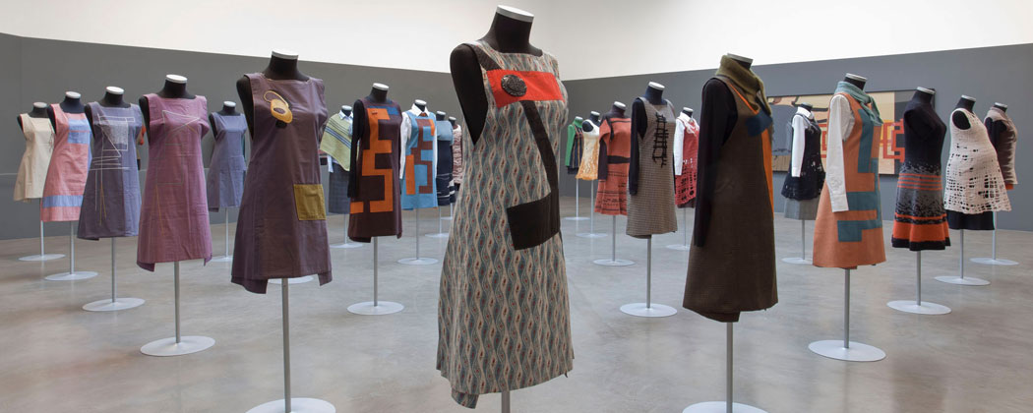
Andrea Zittel, Six Month Uniforms, variations, 1990s
Notes:
Andrea Zittel
Born Escondido, CA (1965)
Her projects examine our living spaces and tools (clothing, utensils, furniture)
All part, she writes, of an “ongoing endeavor to better understand human nature and the social construction of needs.”
“Rules make us more creative.”
Early-1990s: Zittel rented a $300-per-month storefront in Brooklyn, where she lived, bred chickens, and built special breeding habitats for the fowl.
“I started to become really conscious of the structure of my own life.”
“I realized that their lives were so much better organized than my own. And just as a personal project, I decided I should do the same with my own.”
As a SoCal woman, raised to have a huge wardrobe
1991: Begins making her “Six Month Uniforms,” plain black dresses that fit in well at her art gallery day job, and that she wore everyday for six months at a time

Slide 7
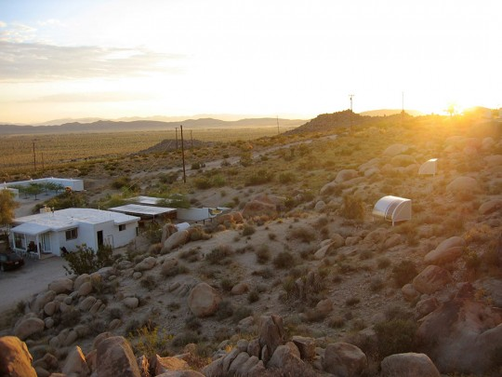
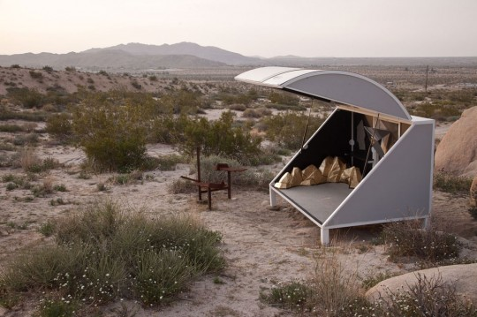
Andrea Zittel, A-Z Wagon Station at “A-Z West,” customized by Chuck Moffitt, 2003
Andrea Zittel, A-Z West, near Joshua Tree, CA
Notes:
1994: Purchased a Brooklyn building that she subsequently dubbed “A-Z East”
Made furniture and lived with it
When ready for a change, sold the set and made a new one
1998: Spontaneously moves to LA
He boyfriend was a large person and broke the furniture she’d made
Begins to release perfectionist tendencies and embrace human imperfection
“I was always trying to correct myself. I was always trying to create these structures that improved us somehow. I started to embrace human imperfection.”
1999: Moved to 1940s homesteader house near Joshua Tree National Park
Begins developing “A-Z West,” a “testing grounds” for her “designs for living.”
“The motive of ‘A-Z West’ was to make a place where work can be born, live and die in a single location. … Instead of making my art feel more real, my life started to feel more staged and artificial.”
Begins to think of art less as an imitation of life and more as a conduit through which life can function
Andrea Zittel, A-Z Wagon Station at “A-Z West”
Title a play on station wagons, which is the smallest possible space she could imagine being comfortable in.

Slide 8
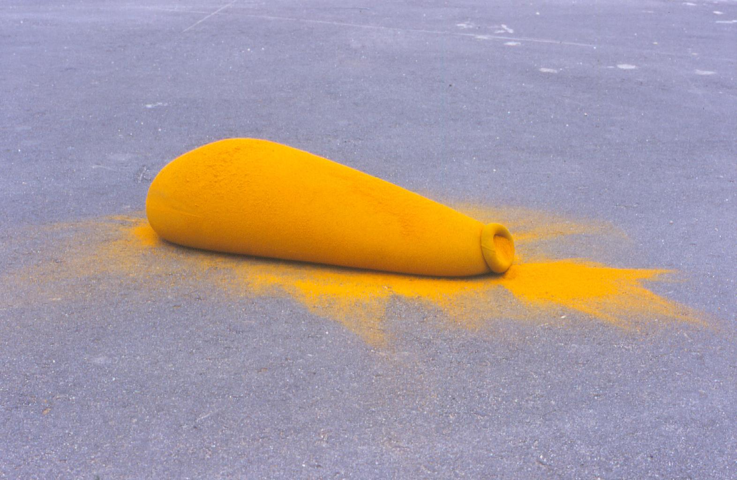
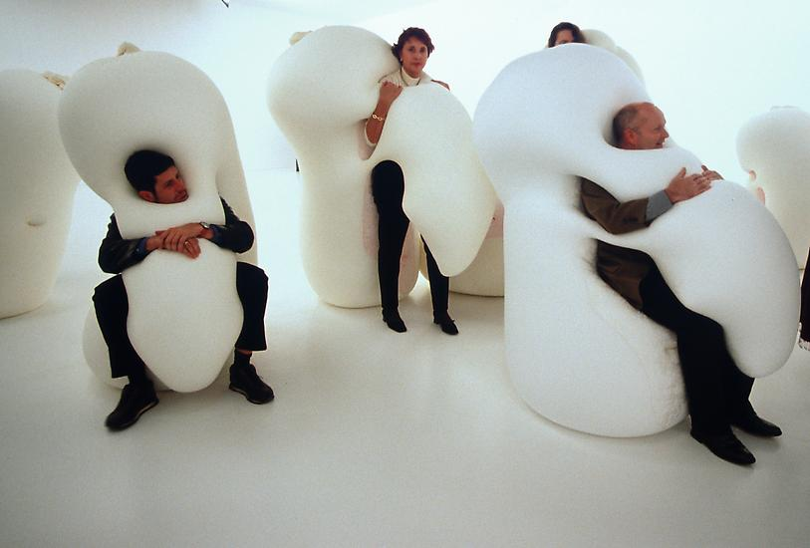
Ernesto Neto, Humanoids Family, 2001
Polyamide fabric, velvet, lavender, Styrofoam 6 elements, dimensions variable
Ernesto Neto, PUFF (turmeric), 1997
Notes:
Ernesto Neto
Born Rio de Janeiro, Brazil (1964)
Influenced by Brazilian Neo-Concrete artists of 1960s
Like many artists seeking to re-define visual practices in the 1960s, these artists tended to focus on color, simplicity, and sensation in their work
Sought to combine the structured approach of Minimalist and Constructivist styles with a deeper communication of feeling
Aimed to connect with viewers on an instinctive level
Encouraged personal interaction and multiple interpretations
Neto builds upon their ideas in his innovative sculptural installation projects
Known for his use of Lycra as well as his mutable, touchable works
1989: he filled Lycra nets with lead balls and Styrofoam pellets, creating flexible groups of amorphous objects
By the mid-90s, he was filling his Lycra forms with organic materials, including pungent spices, which oozed through the material and filled the space with intermingled scents and colorful pigments (see above)

Slide 9
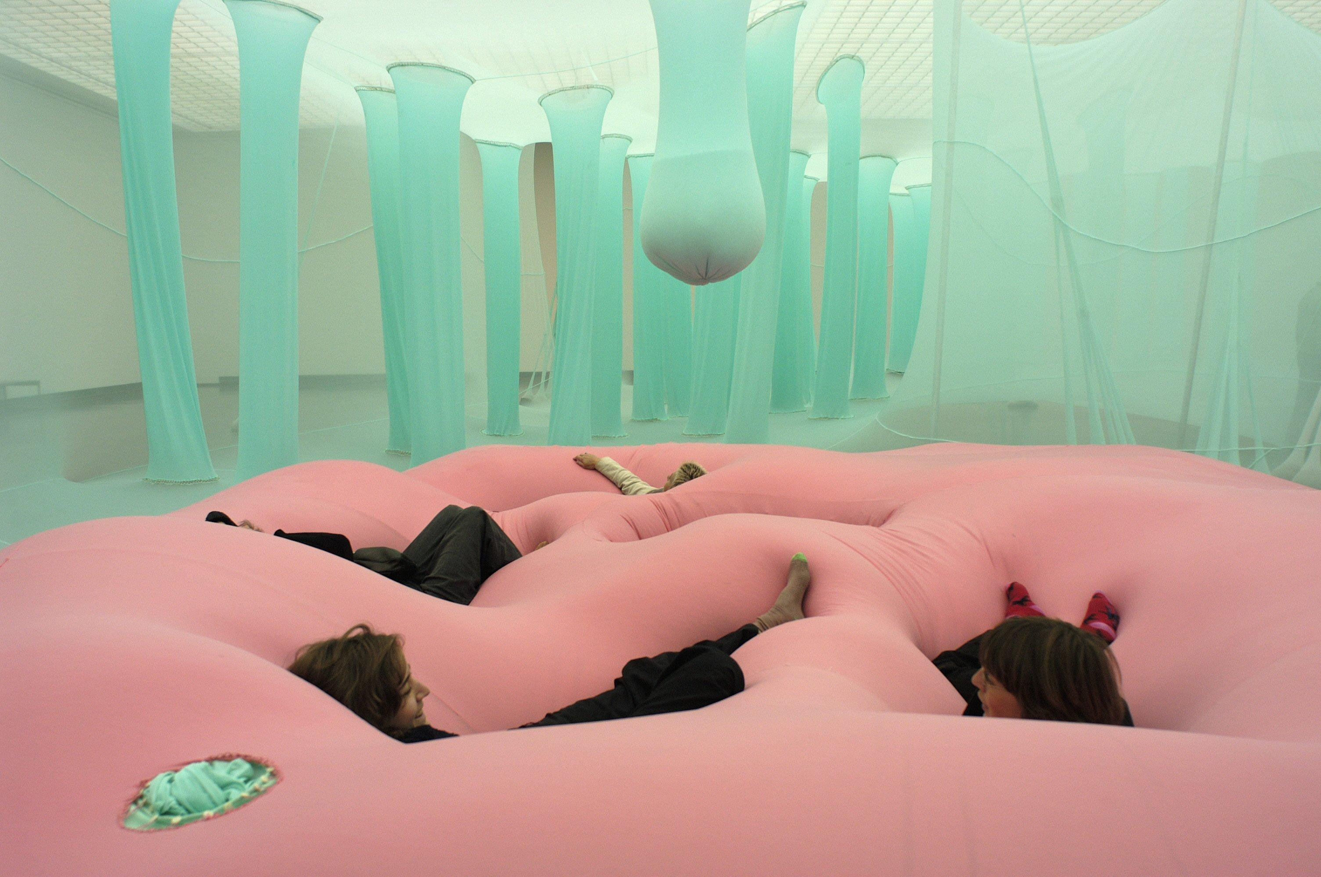
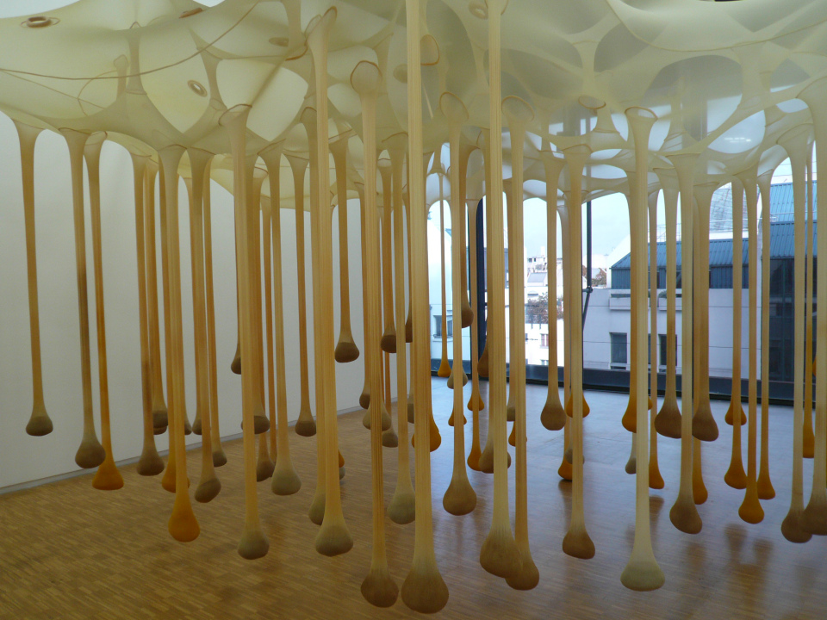
Ernesto Neto, Celula Nave, 2004
Ernesto Neto, We Just Stopped Here at the Time, 2002
Notes:
Plush, malleable sculptural environments
Often used spices – adds another sensory element

Slide 10
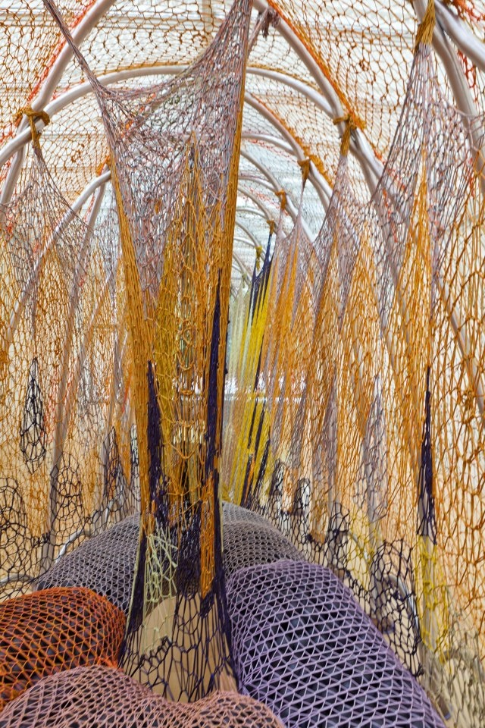
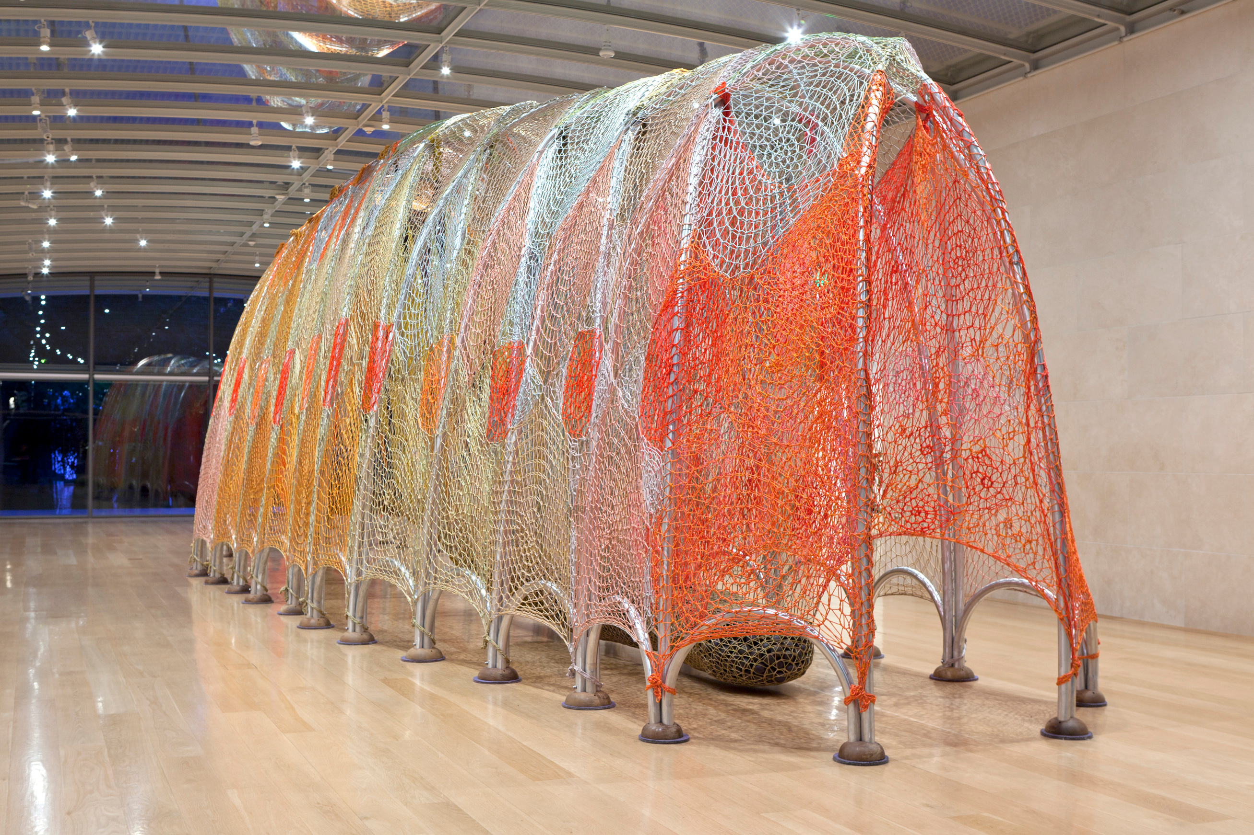
Ernesto Neto, Kink, 2012
Installation Nasher Sculpture Center, Dallas
Notes:
Ernesto Neto, Kink, 2012
Completely immersive environment
Explain experience…

Slide 11
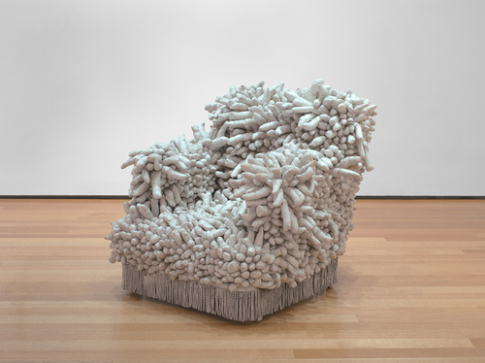
Yayoi Kusama, No. F, 1959
Oil on canvas, 41.5 x 52”
Yayoi Kusama, Accumulation, 1962
Sewn, stuffed fabric, paint, and chair fringe
Notes:
IMMERSIONS
Yayoi Kusama
Born Matsumoto, Japan (1929)
Has worked in a wide variety of media
Well known for her use of dense patterns of polka dots and nets
Creates intense, large-scale environments
1957: Comes to UA
A man’s world – difficult to break through
Yayoi Kusama, No. F, 1959
Began painting nets (they got quite large, up to 33 ft. long)
Begin to expand off the support, onto the wall – environments created!
Pattern is paramount
Takes away the ability to focus
Sets up infinite environments with lights and mirrors
Space envelops the viewer
Yayoi Kusama, Accumulation, 1962
“Accumulation is how the stars and the Earth don’t exist alone.”
Accumulation is seen in the piece on the right
She says “obsessions, phallus obsessions, and obsessions of fear propel” her art
1973: Exhausted from obsessively painting
Returns to Tokyo and begins anew

Slide 12
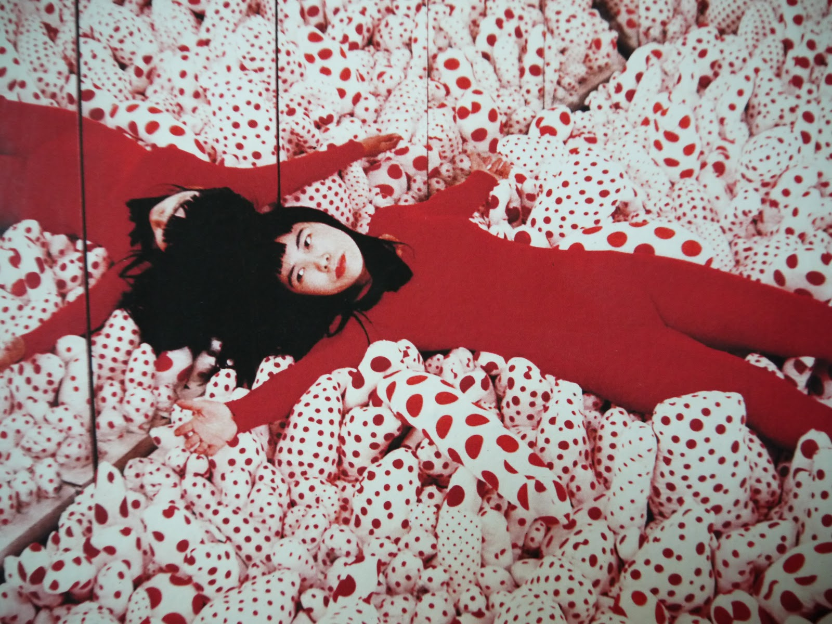
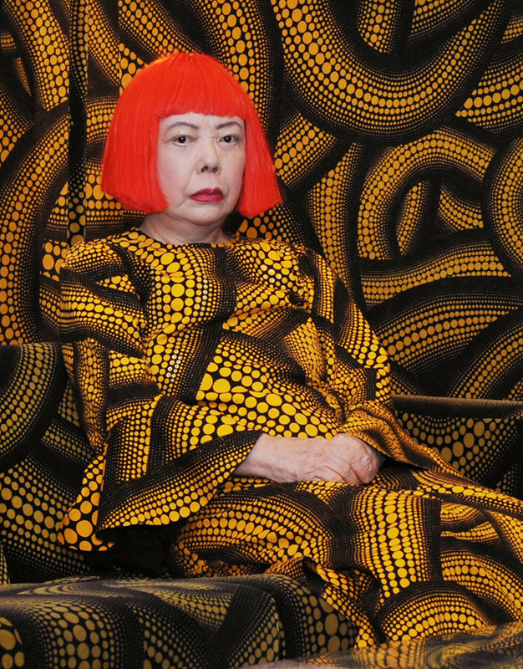
Notes:
Polka dots are her calling card
They come out in most of her work

Slide 13
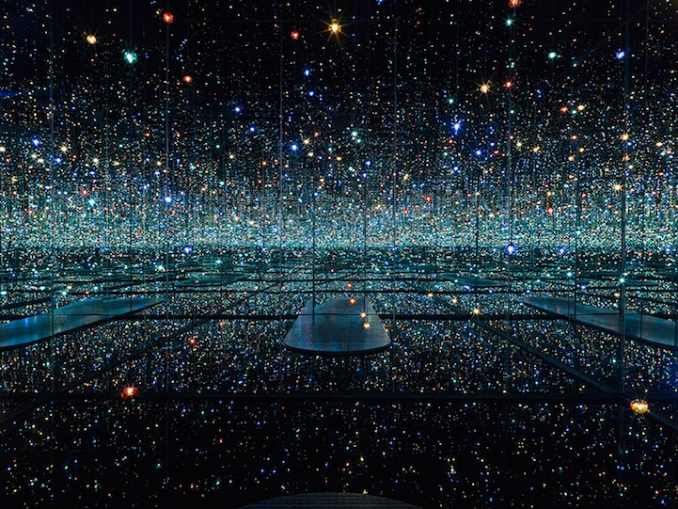
Yayoi Kusama, Infinity Mirrored Room – The Souls of Millions of Light Years Away, 2013
Notes:
Yayoi Kusama, Infinity Mirrored Room – The Souls of Millions of Light Years Away, 2013
Her later installations use lights and mirrors to create boundless environments
Uses hundreds of multicolored LED lights, suspended at different heights and dangling from floor to ceiling, transformed a room into what feels like eternity
The cube-shaped, mirror-paneled room had a shallow reflecting pool as its floor and the lights flickered on and off in a strobe-like effect
An iteration of an installation that has been shown in many locations

Slide 14
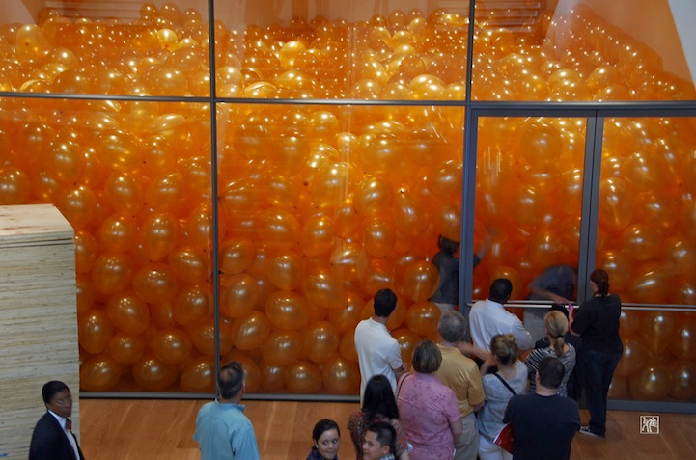
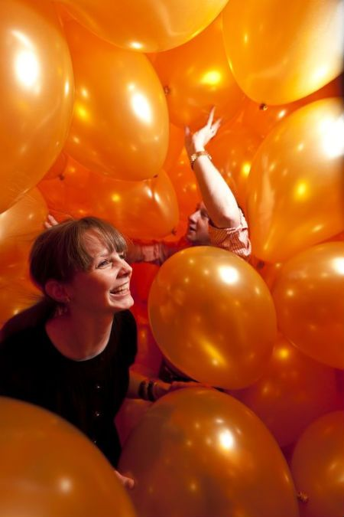
Martin Creed, Half the Air in a Given Space, 2011
Nasher Sculpture Center, Dallas
Notes:
Martin Creed
Born Wakefield, England (1968)
English sculptor installation artist
Work plays on definitions of art, using techniques reminiscent of those employed by Marcel Duchamp in his presentation of objects and ideas
Martin Creed, Work #200–202 known as Half the Air in a Given Space, 1998
One of his best-known visual works, consists of a gallery half-filled with balloons
Creates a physical experience for the visitor of what that volume of air actually feels like

Slide 15
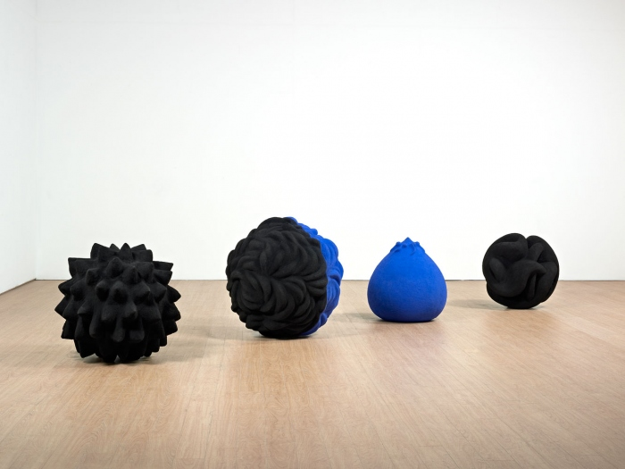
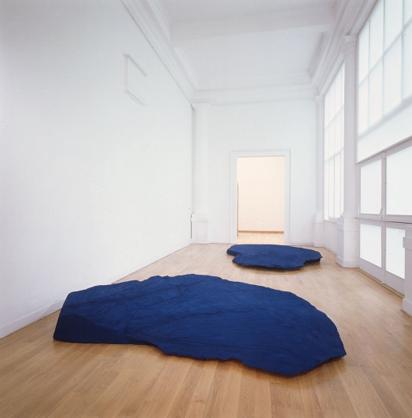
Anish Kapoor, The Chant of Blue, 1983
Pigment and mixed media
Anish Kapoor, A Wing at the Heart of Things, 1990
Slate and pigment
Venice Biennale, 1990
Notes:
Anish Kapoor
Born Mumbai, India (1954)
Part of a generation of British-based sculptors who become established in the international arena during the 1980s
He has acknowledged a bearing on his art of both Western and Eastern culture
The powerful spiritual and mythological resonances of his sculptures arise in part from frequent return visits to India
Anish Kapoor, The Chant of Blue, 1983
Natural materials such as sandstone, marble and slate are impregnated with raw powdered pigment of vivid hues
Enhances a feeling of inner radiance
Somewhat of an alchemical process
Anish Kapoor, A Wing at the Heart of Things, 1990
Earth slabs coated with brilliant blue pigment become signs for sky and water
Disparate materials in meditative structures
Focuses attention on qualities of interior balance and well-being
Can I believe what I see?
Can I believe what I made?
Does my making have truth?

Slide 16
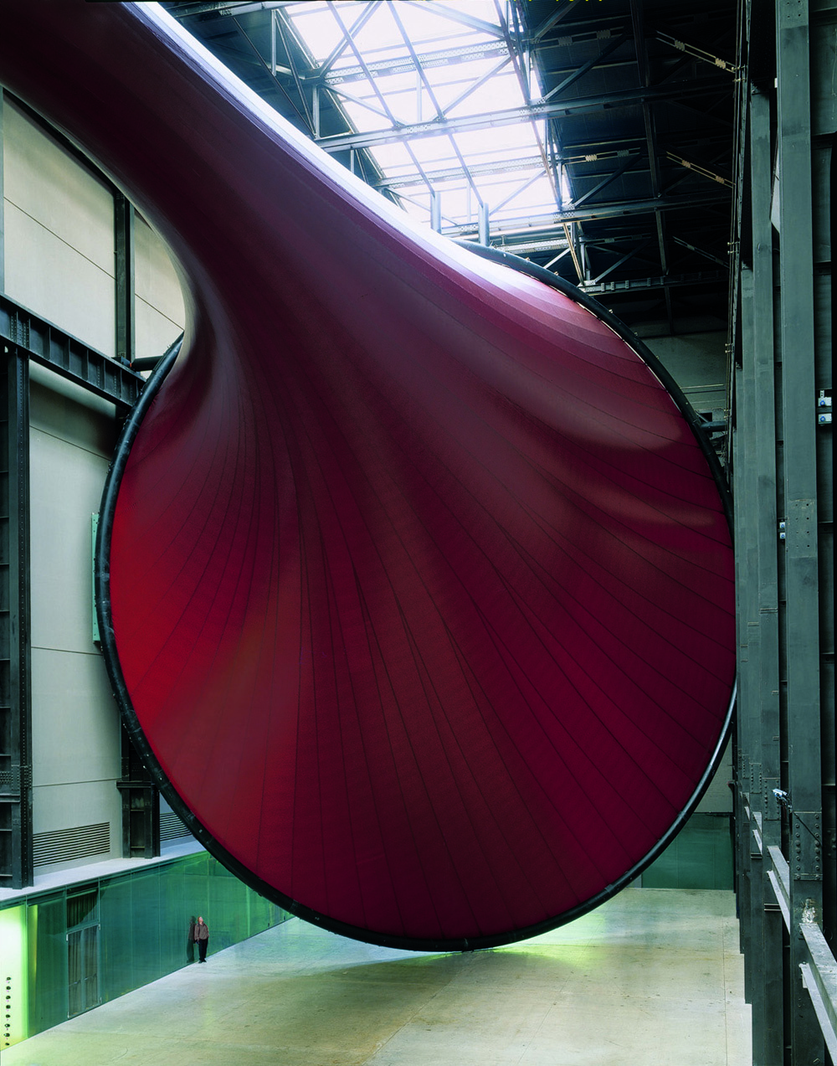
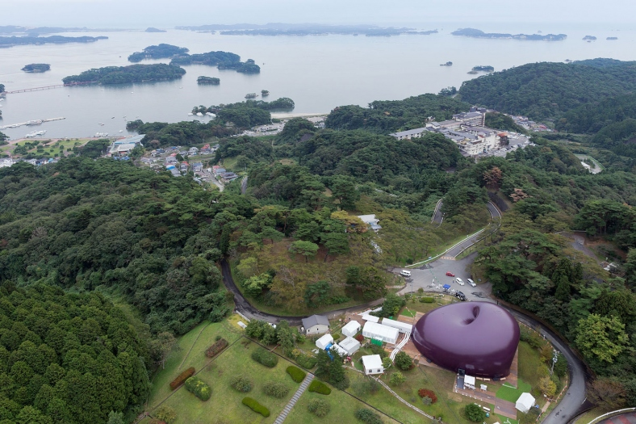
Anish Kapoor, Marsyas, 2002
PVC and steel
Turbine Hall, Tate Modern, London
Anish Kapoor, Arc Nova, 2013
PVC, 18×29×36 m Lucerne Festival, Matsushima, Japan, 2013 Lucerne Festival, Sendai, Japan, 2014
Notes:
Work get larger – monumental
Sculpture becomes installation
Organic forms from a variety of materials

Slide 17
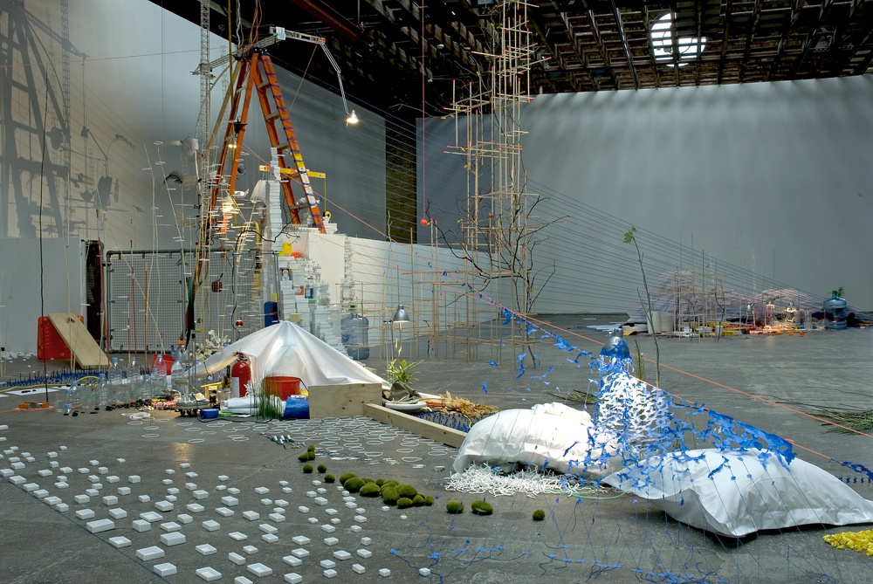
Sarah Sze, Tilting Planet (centerpiece), 2006-07 Mixed media, 421.58 x 492.5 x 208.82 in
Notes:
Sarah Sze
Born Boston, MA (1969)
Intricate, materially-heavy installations
Each element is carefully chosen and often refers to other elements
Color, form, and line are created with existing materials
Sarah Sze, Tilting Planet (centerpiece), 2006-07
“In both drawing and sculpture I’m interested in the depiction of gravity and weightlessness as both an operative and a disorienting force. I’m thinking about floating, sinking, rising, drifting, and the resulting fragility, disorientation, and instability.”
Aims to navigate and model the ceaseless proliferation of information and objects in contemporary life
Incorporates elements of painting, architecture, and installation within her sculpture
Sze investigates the value we place on objects and explores how objects ascribe meaning to the places and times we inhabit

Slide 18
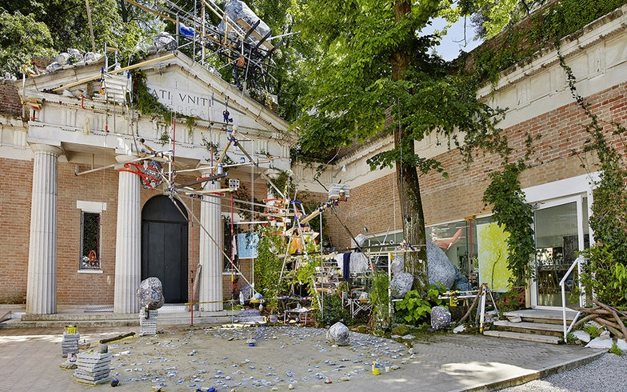
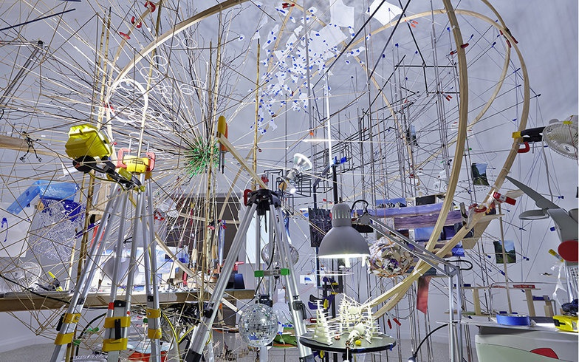
Notes:
Explain experience of the work…

Slide 19
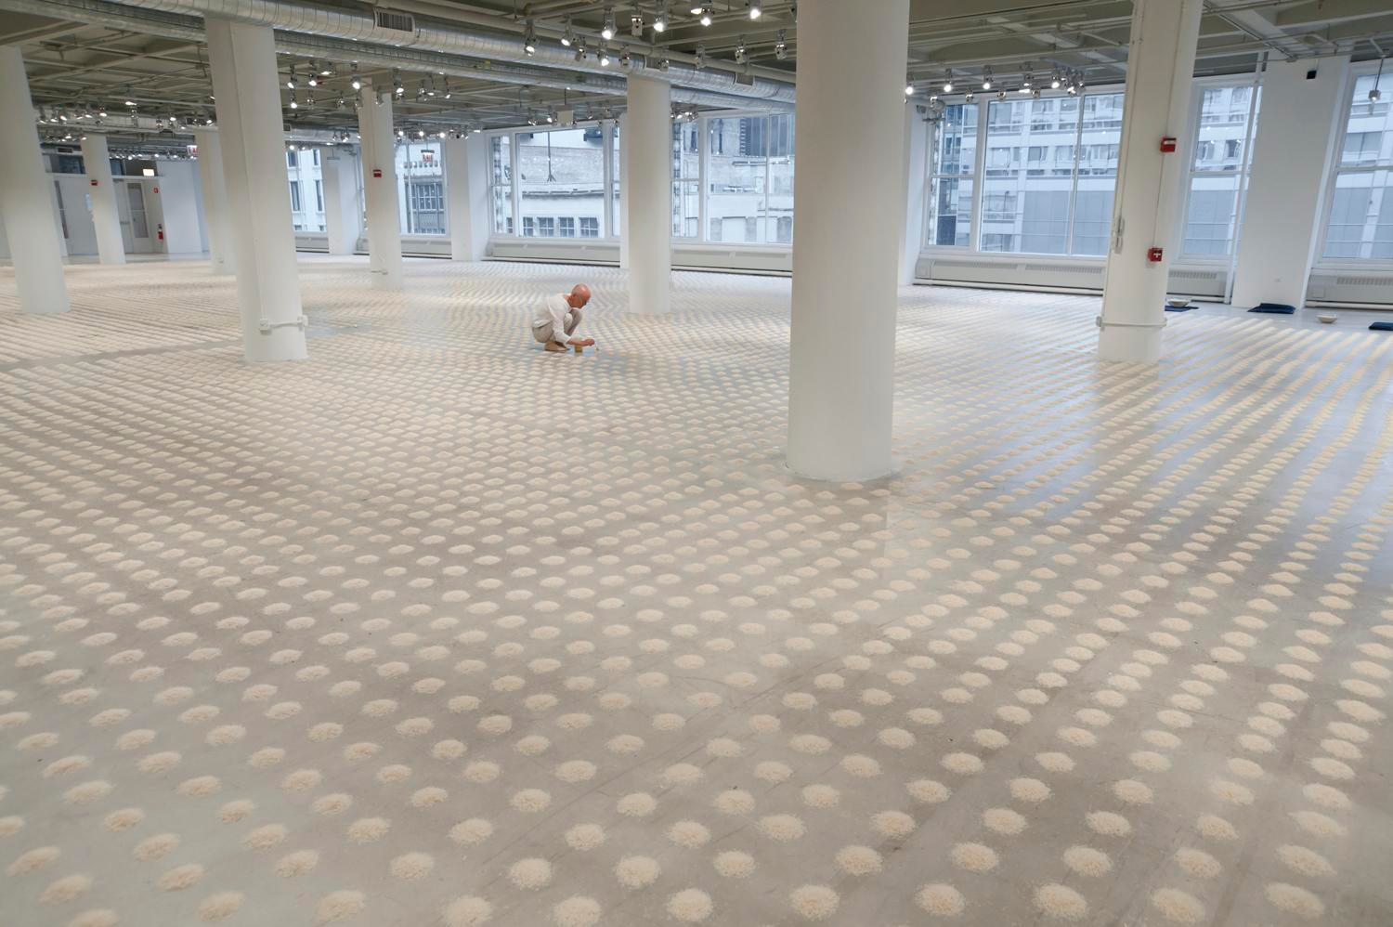
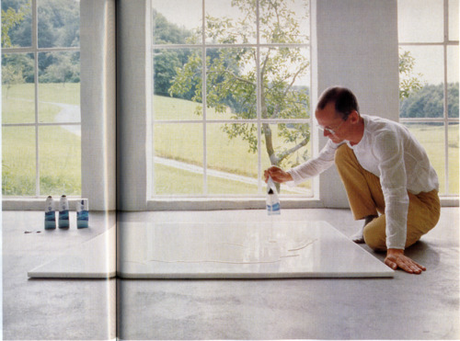
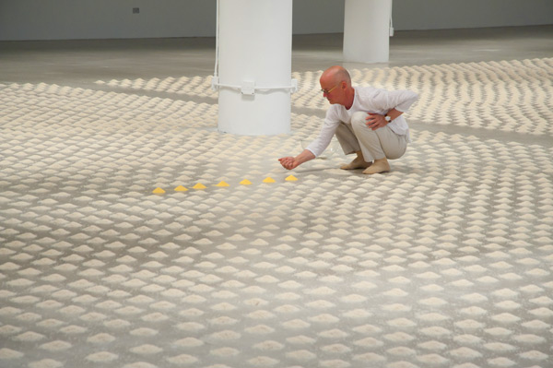
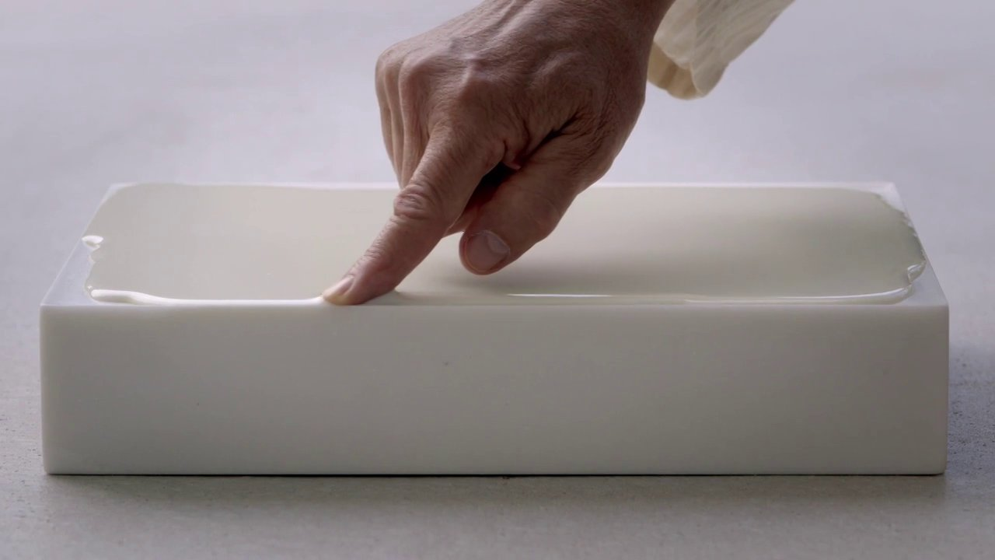
Wolfgang Laib, Unlimited Ocean, 2011
30,000+ piles of rice and seven piles of pollen
Wolfgang Laib, Milkstone, various dates
Marble and milk
Notes:
Wolfgang Laib
Born Metzingen, Germany (1953)
Mid-1970s: Sculptures and installations marked by a serene presence and a reductive beauty
These works are often made from one or a combination of two materials, accumulated from natural elements
Milk, marble, pollen, rice, and beeswax
Selected for their purity and symbolic associations
Installations amplify the intrinsic materials and processes found in nature
Early-70s: Studies medicine with a dissertation on the cleanliness of drinking water
Turns his focus to his interests in Art, Zen Buddhism and Taoism
Often grouped with Land Art and Process Art
An emphasis of minimalist influences.
1975: Begins making milkstones
These works consist of a rectangular marble brick
The top surface is sanded to create an almost unnoticeable embossing
The impression is filled with milk, creating the illusion of a solid object where the viewer doesn’t notice the material being both liquid and solid – it is seen as one material

Slide 20
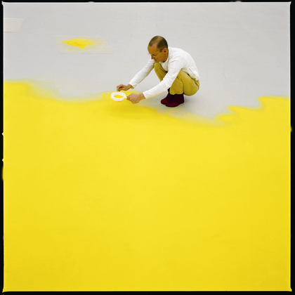
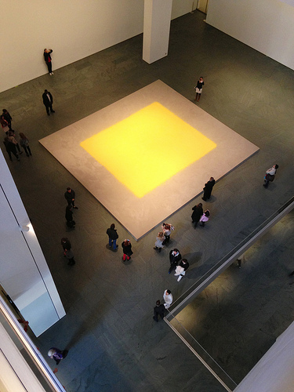
Wolfgang Laib sifting hazelnut pollen at MoMA, 2013
Wolfgang Laib, Pollen from Hazelnut, 2013
Notes:
“Pollen is the potential beginning of the life of the plant. It is as simple, as beautiful, and as complex as this. And of course it has so many meanings. I think everybody who lives knows that pollen is important.”
The pollen works are also exhibited in glass jars or small piles
In addition, the pollen is sold to collectors and institutions in glass jars, without any stipulations as to how it should be exhibited
The idea being the pollen is the artwork, not the process of collecting it or presenting it sifted on the floor or in jars
Pollen collected by Laib from the natural environment around his home and studio, in a small village in southern Germany, since the mid-1990s
Wolfgang Laib, Pollen from Hazelnut, 2013
Infuses the space with a yellow luminosity
Takes the site into account
Laib perceives the Marron Atrium as the Museum’s inner sanctum, its womb, and has created this work especially for the site
His largest pollen installation to date, measuring approximately 18 x 21 feet

Slide 21
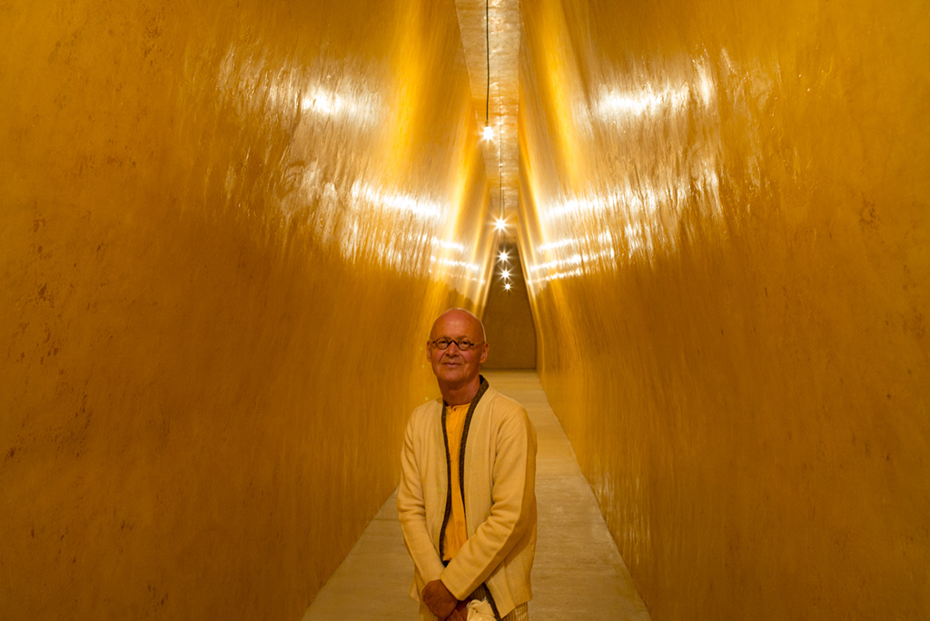
Notes:
He also creates room covered in beeswax
Describe the experience

Slide 22
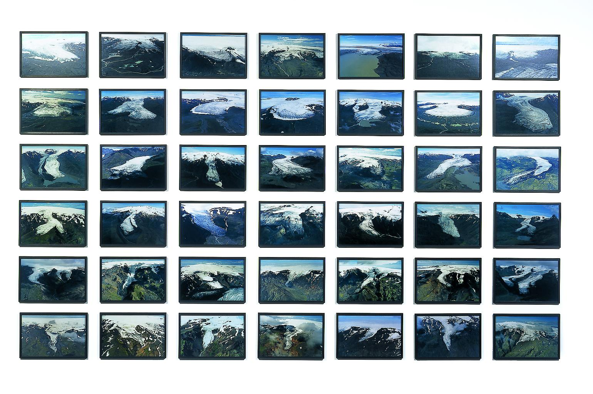
Olafur Eliasson, The Glacier Series, 1999
42 color photographs, each 12 3/5 x 18 9/10”
Notes:
Olafur Eliasson
Born Copenhagen, Denmark (1947)
Danish/Icelandic
Creates immersive environments
Light projections and multipart photographic series
Looks at what it means to see
Like Light and Space artists, uses simple technical devices (colored bulbs, mirrors, kalaidesopes, prisms)
Makes visible the mechanics of his works
We see the hand behind the illusion
Early-1990s: takes photos on hiking trips in Iceland
These served as studies for concepts explored in his installations
Recontextualizes outdoor phenomena
Inspired by the terrain of his native Scandinavia
Visitors stand within his works, not in front of them
They become an active part of each piece

Slide 23
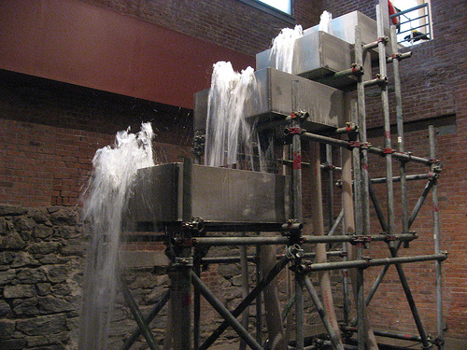
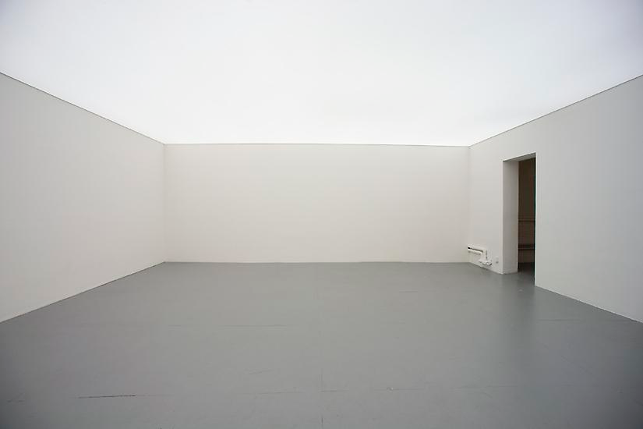
Olafur Eliasson, Reversed Waterfall, 1998
Mixed media
Olafur Eliasson, The Natural Light Setup, 2008
Fluorescent lights, projection foil, Control unit, dims variable
Notes:
Olafur Eliasson, Reversed Waterfall, 1998
A system of pumps reverses the natural flow of water
Olafur Eliasson, The Natural Light Setup, 2008
The ceiling, a light box, emits different hues of white light in a pre-programmed rhythm.

Slide 24
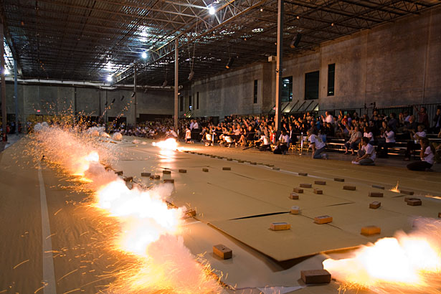
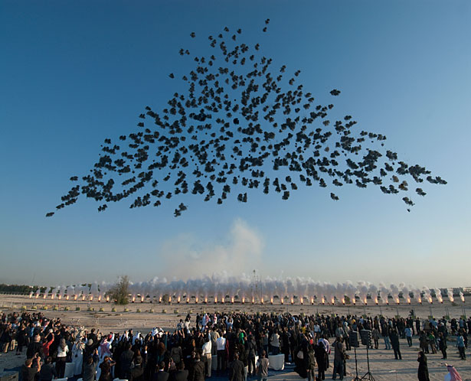
Cai Guo-Qiang, Ignition of gunpowder drawing Odyssey, Houston, October 6, 2010
Cai Guo-Qiang, Black Ceremony explosion event. Commissioned by Mathaf: Arab Museum of Modern Art, Doha, Qatar, 2011
Notes:
Cai Guo-Qiang
Born China (1957)
Draws from ancient mythology, military history, Taoist cosmology, extraterrestrial observations, Maoist revolutionary tactics, Buddhist philosophy, gunpowder-related technology, Chinese medicine, and methods of terrorist violence
Cai’s art is a form of social energy, linking what he refers to as “the seen and unseen worlds.”
1986: Moved to Japan
Masters the use of gunpowder to create his signature gunpowder drawings and the related outdoor explosion events
These practices integrate science and art in a process of creative destruction
Reflects the philosophy that conflict and transformation are interdependent conditions of life, and hence art
Cai Guo-Qiang, Ignition of gunpowder drawing Odyssey, Houston, October 6, 2010
At once intuitive and analytical
Site specific, ephemeral, time based, and interactive—performance art

Slide 25
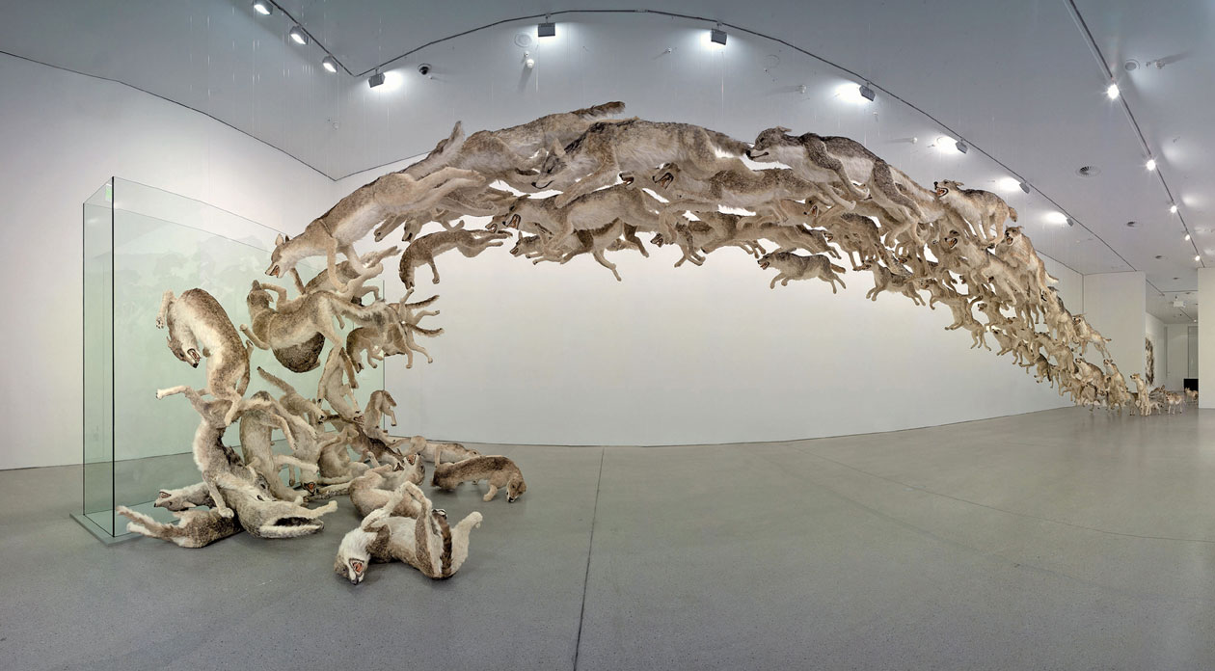
Cai Guo Qiang, Head On, 2006
99 life-sized replicas of wolves
Notes:
Cai has lived in New York since 1995
Major participation in the global art system of biennials, public celebrations, and museum exhibitions around the world
Cai Guo Qiang, Head On, 2006
Originally created for the Guggenheim Museum in Berlin
Features 99 wolves hurling themselves through the air, only to hit a glass wall before returning to the beginning
A metaphor for humanity’s willingness to repeat its own mistakes

Slide 26
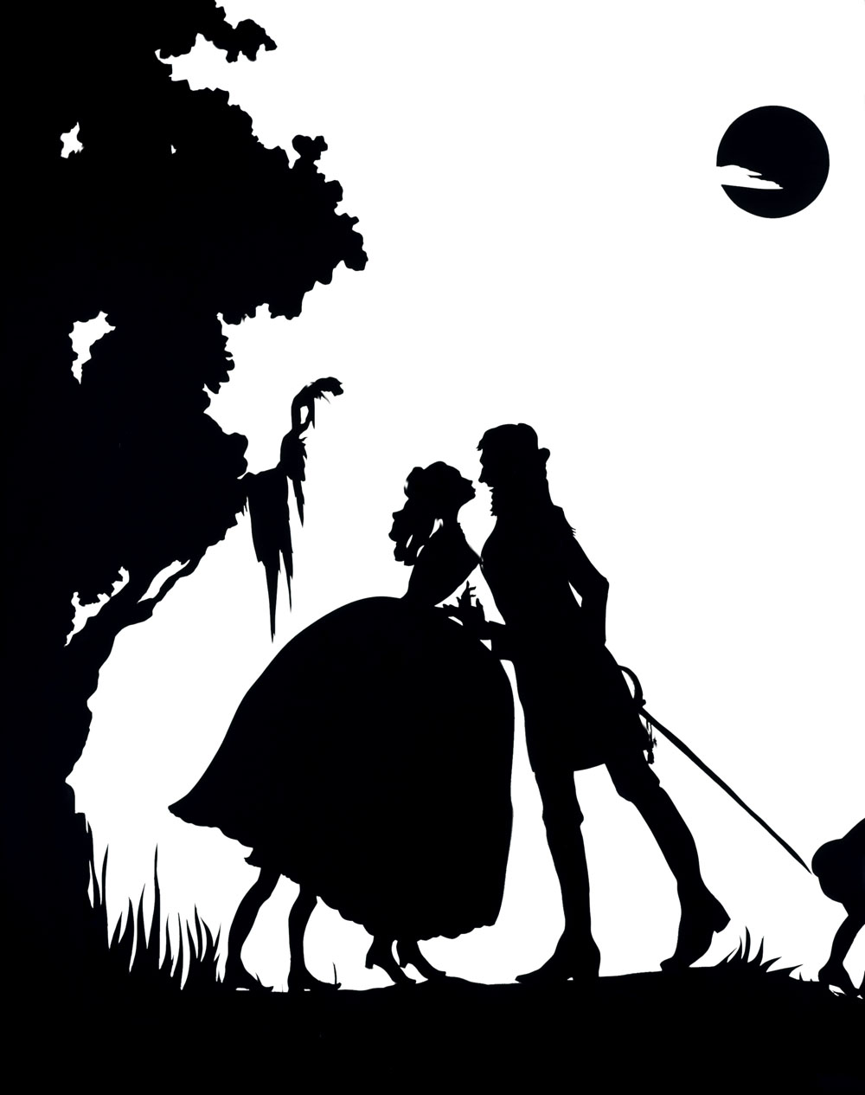
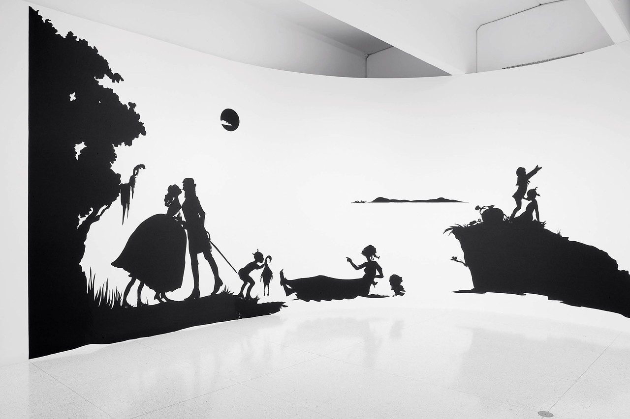
Detail from Gone, An Historical Romance of a Civil War as it Occurred between the Dusky Thighs of One Young Negress and Her Heart, 1994 Cut paper (21 paper silhouettes) original and templates w/signed certificate 180 x 600 inches
Notes:
Political Installations
Kara Walker
Born Stockton, CA (1969)
Work explores race, gender, sexuality, violence and identity
Best known for her room-size tableaux of black cut-paper silhouettes
Deal directly with legacy of slavery in America
Sexually deviant behavior a metaphor for the unbelievably dysfunctional power structures in America during (and after) slavery
Creates videos, drawings, paintings, and immersive installations from cut paper
Detail from Gone, An Historical Romance of a Civil War as it Occurred between the Dusky Thighs of One Young Negress and Her Heart, 1994
Discuss the WSJ reading
Thoughts from the class?

Slide 27
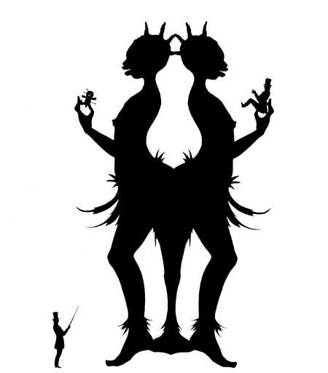
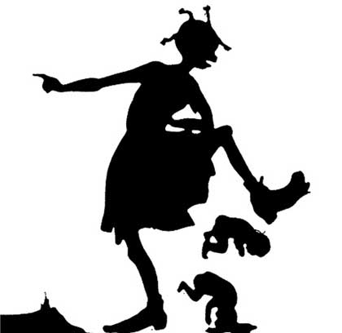
Notes:
Retains a love of drawing
The silhouettes were the result of her drawing practice
A removal, rather than an addition
Likes the dialectic between positive / negative
Watch this video: https://www.youtube.com/watch?v=5QbXdPv-O1g

Slide 28
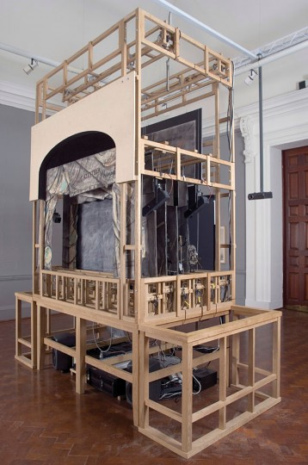
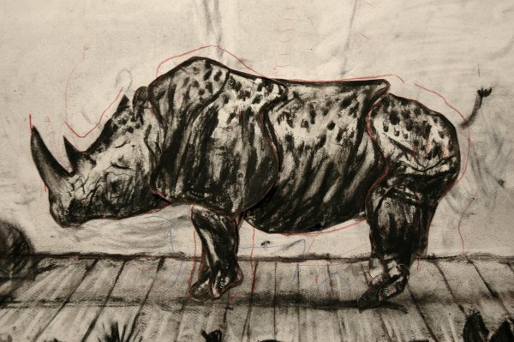
William Kentridge, Black Box / Chambre Noir, 2005
Model theater with drawings, mechanical puppets
Notes:
William Kentridge
Born Johannesburg, South Africa (1955)
After drama school, Kentridge was active in theater and television production in the 1970s and 1980s
1990s: Coinciding with the abolishment of apartheid in South Africa—Kentridge's live theater work and the stop-motion animated films he developed from charcoal drawings found an increasingly international audience
Work deals with apartheid and the realities of a post-apartheid South Africa
As a white man, he is both critical and complicit
Very personal iconography (the rhinoceros stands in for South Africa)
DRAWING-BASED work
Videos often displayed as installations

Slide 29
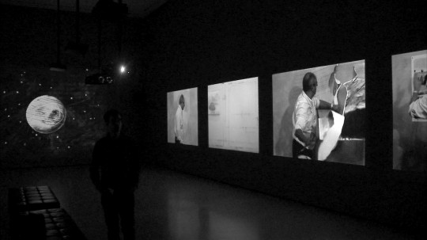
William Kentridge, 7 Fragments for Georges Méliès, 2003
Video installation
Notes:
William Kentridge, 7 Fragments for Georges Méliès, 2003
Makes his own art practice a subject
According to the artist, many of these projects are meant to reflect the "invisible work that must be done" before beginning a drawing, film, or sculpture
A large-scale multiscreen projection
Homage to the early French film director, who, like Kentridge, often combined performance with drawing
The suite of seven films—each depicting Kentridge at work in his studio or interacting with his creations—forms an intimate portrayal of the artist's process
Like being inside the artist’s imagination!

Slide 30
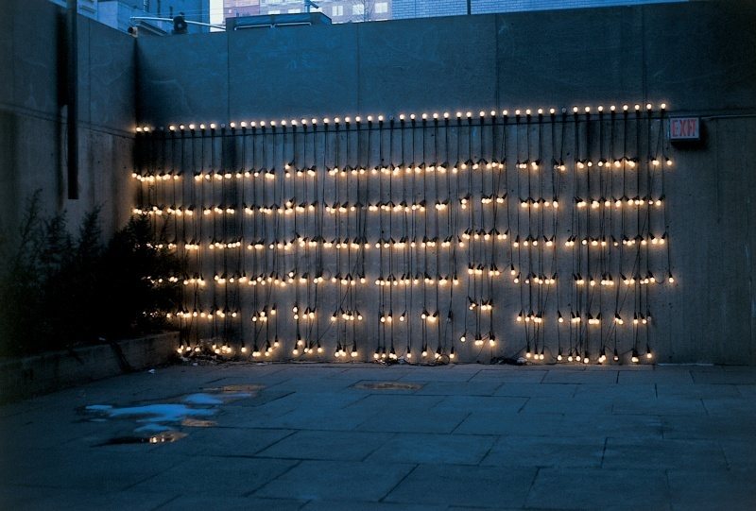
Felix Gonzalez-Torres, Untitled (America) 1994-95
Twelve light strings, each with forty-two 15-watt light bulbs and rubber sockets, dimensions variable
Notes:
Felix Gonzales-Torres
Born Cuba (1957-1996)
One of the most influential artists of his generation
He produced works of uncompromising beauty and simplicity—including light strings, candy spills, paper stacks, beaded curtains, and text-based portraiture
Transforms the everyday into profound meditations on love and loss
Felix Gonzalez-Torres, Untitled (America) 1994-95
Elegant forms evoke the precedent of Minimalist sculpture
Imbued with poetic intimacy
The artist aimed to make his works open-ended and invited viewers to participate in their realization
This generosity is tinged with melancholy
Light bulbs and candy evoke festive celebration but here are also metaphors for mortality—bulbs burn out, candy is consumed
The fact that Gonzalez-Torres emerged as an artist at a time overshadowed by the global tragedy of AIDS informs his work
Perpetually renewed and relevant -- universal

Slide 31
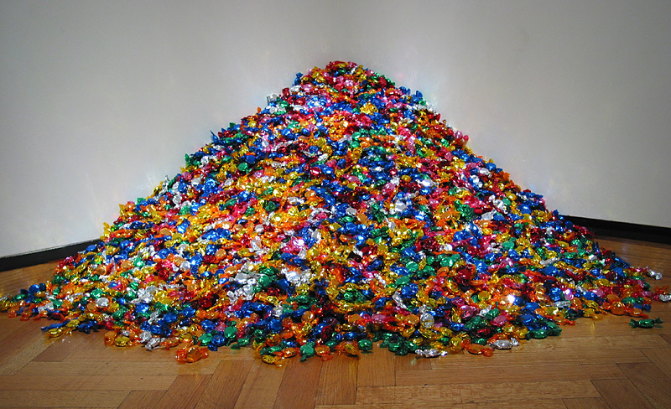
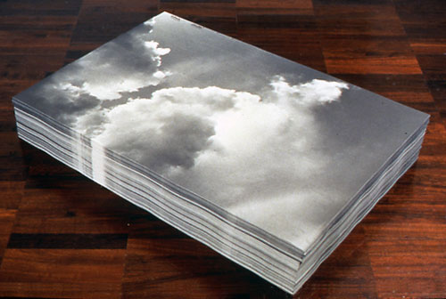
Felix Gonzalez-Torres, Untitled (Portrait of Ross in L.A.), 1991 Candies individually wrapped in multicolored cellophane, endless supply, Overall dimensions vary with installation, ideal weight: 175 lb.
Felix Gonzalez-Torres, Untitled (Aparicion), 1991
Offset print on paper, endless copies, 29.7 x 44.8 x 8”
Notes:
Felix Gonzalez-Torres, Untitled (Portrait of Ross in L.A.), 1991
Ross Laycock was Félix’s partner, and when he was diagnosed with HIV his doctor set his ideal weight at 175 pounds
175 pounds of candy set in a pile
The candy is unguarded, the purpose being for the viewer to take some of it from the mound
Each and every day, the remaining candy is removed, weighed, and more is added until it weighs exactly 175 pounds
Removal of candy
Loss of individual lives
Loss of community, society ignored the epidemic (still do)
Sweetness of the candy and the brightly colored wrapper elicit joy
Viewer complicit in the diminishment of the candies (life)
Ross died of AIDS-related illnesses in 1991, as did Félix in 1996
Memorial to a loved one
Radical idea of what art can be
His loss and sadness are taken and made lighter by the sharing
Felix Gonzalez-Torres, Untitled (Aparicion), 1991
One of his many stacked paper pieces
Gallery-goers are free to take a poster
1989: Makes his first stack sculpture
Comprised of sheets of paper piled neatly into a cubic form on the gallery floor
Both an homage to and a critique of Minimalist art
Appropriated the term stack from Donald Judd
In opposition to what Gonzalez-Torres perceived as Minimalism’s static, monolithic forms, these works encourage people to touch, dismantle, and even use the work
The artist thus advanced a kind of subversive generosity, tinged, as always, with sadness
As sheets are taken, the form disappears; they are replenished, and the piece thereby endures despite its continual dematerialization

Slide 32
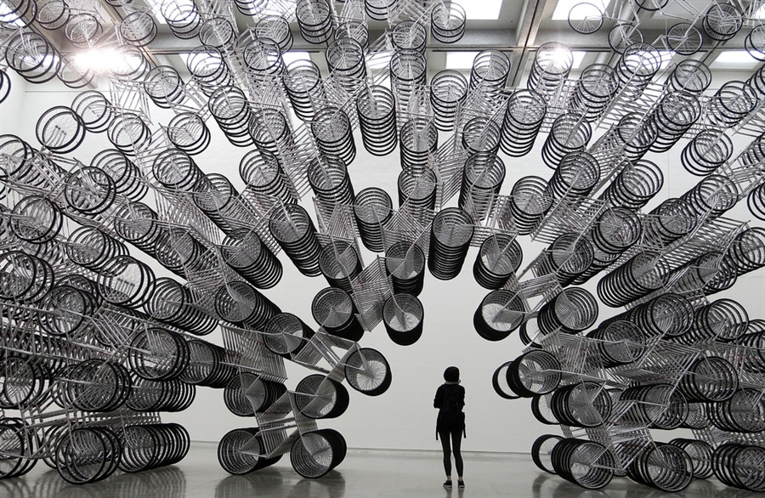
Ai Weiwei, Forever Bicycles, 2003
1,200 bicycles installed in a 10-meter high space
Ai Weiwei, Bang, 2013
installation view of the German contribution
in the French pavilion Venice 2013
Notes:
Ai Weiwei
Born Beijing, China (1957)
1981-93: Lived in NY
1966: China’s Communist leader, Mao Zedong, launched what became known as the Cultural Revolution
Aimed to reassert his authority over the Chinese government
Ai addresses this violence and government oppression in his work
A very outspoken opponent of Chinese government
Has been arrested and ill-treated
Uses social media (Twitter) to connect with the global community
Recall your reading…quite an art world personality
Ai Weiwei, Forever Bicycles, 2003
Made for his first large-scale solo exhibition to be held anywhere in the ethnic Chinese world: Taipei Fine Arts Museum's
1,200 bicycle units
“Forever” brand bikes
Since the company's establishment in China in 1940, these bicycles have become the most iconic brand in China
The use of the bicycle as an object of art recalls Duchamp's Readymade Bicycle Wheel (1913)
Like much of his work, retains the structure of an object while eliminating its original function and reformulating it into something new
Retains the external form of the bicycle, formerly China's most widespread mode of transportation, while eliminating its function
The bicycles's raison d'etre is being made obsolete by the automobile in Chinese society
The monumental sculpture of bicycles interlinked in a circle elicits questions of harmony, eternity and equality in a rapidly changing society
“A moving abstract shape that symbolizes the way in which the social environment in China is changing.”
Ai Weiwei, Bang, 2013
Returns to China and begins researching its artistic and cultural traditions
Collected and studied Chinese antiques
Prohibited since the cultural revolution
Begins to integrating these objects and furniture into his art
Addresses the export of cultural values and historical knowledge
In China, every family typically has at least one stool which serves a range of purposes
Passed down through the generations
After the cultural revolution, the production of the simple objects dropped and metal and plastic became standard materials for furniture construction. for the 2013 venice art biennale, ai weiwei’s work ‘bang’ employs 886-three legged wooden stools made by traditional craftsmen whose expertise is now something that is rare to find, and has installed an expansive rhizomatic structure which speaks of the increasing volumes of organisms in our world’s megacities. the single stool can be interpreted as a metaphor for the individual, and its relation to an overarching and excessive system in a postmodern world which is developing faster than it can keep up with.

Slide 33
Ai Weiwei, Sunflower Seeds, 2010
Tate Modern, London
Notes:
Ai Weiwei, Sunflower Seeds, 2010
Made up of millions of small works, each apparently identical, but actually unique
These life-sized sunflower seed husks are in fact intricately hand-crafted in porcelain
Each seed has been individually sculpted and painted by specialists working in small-scale workshops in the Chinese city of Jingdezhen
Far from being industrially produced, they are the effort of hundreds of skilled hands
Poured into the interior of the Turbine Hall’s vast industrial space, the 100 million seeds form a seemingly infinite landscape
A representation of the nation, with each ceramic seed standing in for 13 people
When the artist was a child, Mao Zedong was often depicted as the sun and his followers were rendered as sunflowers
He is keen that his works should not be read in just one way. “I don't want to force people to think something political,” he says. “That is not so interesting.”
Porcelain is almost synonymous with China and, to make this work, Ai Weiwei has manipulated traditional methods of crafting what has historically been one of China’s most prized exports
Invites us to look more closely at the ‘Made in China’ phenomenon and the geo-politics of cultural and economic exchange today

Slide 34
Damián Ortega, Cosmic Thing, 2002
Suspended automobile components, cable Dimensions variable
Notes:
Components
Damián Ortega
Born Mexico City, 1967
Began his career as a political cartoonist for Mexican magazines and newspapers
Humor and wit are key in his work -- pointed political commentary
A sculptor and installation artist
Works speak to fragility through literal dismantling and hanging of component parts
Also works with architecture
Currently works in Berlin
Both cities feature prominently in his work
He cites Berlin’s transitional urban landscape as a major influence
Deals directly with architecture and its function
Damián Ortega, Cosmic Thing, 2002
Student of Gabriel Orozco
Very connected with the group of artists that took part in the Friday Workshop
ICA Chicago in 2002 - first museum exhibition
Exploded view technical diagram
All car parts hung from ceiling by steel wires
Followed diagrams in the repair handbook to dismantle his own Bug
An extended and humorous meditation on a potent symbol of Westernization and mass production: the Volkswagen Beetle
The “people’s car” (Alÿs's work)
VW = a material symbol of the promise of modernity, especially in Mexico
Dismantling and inspection of utopian consumer culture?
This piece shown at 50th Venice Biennale in 2003
Part of the “Beetle Trilogy” – also dragged a car with a rope and buried one outside a VW factory in Mexico

Slide 35
Helio Oiticica, Homage to Mondrian,
Lygia Pape, Book of Architecture, 1959-60
Notes:
Lygia Pape, Book of Architecture, 1959-60, tempera on cardboard
Helio Oiticica, Homage to Mondrian,
Organic and geometric abstraction strong in Latin America
The Brazilian Neo-Concrete movement was powerful, and remains so (most active 1959-61)
Artists such as Lygia Pape (Lee-gia Pop-aa), Lygia Clark, and Helio Oiticica (Oy-ta-seeka)
“Texture is a product of intelligence, rarely one of intuition.” -Oiticica
Certainly known by the Mexican artists of the early-90s

Slide 36
Architecture without Architects, 2010
Mixed media
Dimensions variable
Notes:
Architecture without Architects, 2010
Mixed media
Dimensions variable
Delves into the theme of architecture, deconstructing and investigating it
What is its purpose? Role in society?
Title a nod to the practice of autoconstrucción, lively within Mexico
Makes clear the interior of spaces normally obscured by walls
Metaphorically, strong sense that transparency is important (civically, governmentally, personally)
“Buildings form us.”
A fundamental interest in how things work, how they are constructed
Whether homegrown building projects or large and complex societies, what is the glue?

Slide 37
Teresita Fernandez, Stacked Waters, 2009
Cast acrylic site-specific installation
Blanton Museum of Art, Austin
Notes:
Teresita Fernandez
Born Miami (1968)
Sculptor Teresita Fernández creates work in response to nature
Installations are reminiscent of clouds, rainstorms, waterfalls, and stars in the night sky
The forms shimmer, float, and undulate before our eyes
As she has put it, “What I’m after is a lingering, ephemeral engagement. Slow, quiet, and with enough depth kinesthetically to be recalled by the viewer after the work is no longer in front of them.”
Teresita Fernandez, Stacked Waters, 2009

Slide 38
Teresita Fernández, Starfield, 2009
Mirrored glass cubes on anodized aluminum
Approximately 14’ 6” x 31’ 8”
Collection AT&T Stadium
Notes:
Teresita Fernandez, Starfield, 2009
Made with mirrored glass cubes on anodized aluminum
Located in the West OC Elevator lobby of the Owner’s Club, AT&T Stadium

Slide 39
Mona Hatoum, Current Disturbance, 2010
Notes:
PSYCHOLOGICAL
Mona Hatoum
Poetic and political oeuvre is realized in a diverse and often unconventional range of media
Hatoum started her career making visceral video and performance work in the 1980s that focused with great intensity on the body
Since the beginning of the 1990s, her work moved increasingly towards large-scale installations that aim to engage the viewer in conflicting emotions of desire and revulsion, fear and fascination
In her singular sculptures, Hatoum has transformed familiar, every-day, domestic objects such as chairs, cots and kitchen utensils into things foreign, threatening and dangerous
Mona Hatoum, Current Disturbance, 2010
Current Disturbance is a singular installation that fills a room at the Whitechapel Gallery in London, the third in a series of four displays from the Daskalopoulos Collection in Greece. Using Marcel Duchamp’s infamous “Fountain” as a starting point, “Keeping It Real: An Exhibition in 4 Acts” seeks to explore the line between art and reality and the relationship between the artist and the tactile world. British – Palestinian artist Mona Hatoum‘s light-filled creation was first shown in 1996 at the Capp Street Project, San Francisco and is now being shown through March as a part of Whitechapel Gallery’s initiative to open private collections for public viewing. The installation is comprised of stacked wire cages, a multiplicity of light bulbs and the amplified sound of the electric currents coursing through the enclosed system. The interminable low buzz emitting from the structure, combined with the arbitrary flickering of light bulbs conveys a certain sense of discomfort and oppression that provides an open-ended commentary much in keeping with Hatoum’s widely political body of work. - See more at: http://artobserved.com/2011/02/go-see-%E2%80%93-london-mona-hatoum-current-disturbance-at-whitechapel-gallery-through-march-6th-2011/#sthash.LYQqY9Jz.dpuf

Slide 40
Robert Gober, Untitled, 1992
Multimedia installation
Robert Gober, Untitled, 1991
Wood, beeswax, leather, fabric, and human hair, 13 1/4 x 16 1/2 x 46 1/8 inches
Background: Forest, 1991
Notes:
Robert Gober
b. 1954
Rose to prominence in the mid-1980s
Early in his career he made deceptively simple sculptures of everyday objects—beginning with sinks before moving on to domestic furniture such as playpens, beds, and doors
1990s: his practice evolved from single works to theatrical room-sized environments
Themes: Childhood, sexuality, illness, religion
Handmade wax and plaster objects
Disembodied legs or of a flour sack with human breasts
Reinscribed personal histories and deep emotion into American sculpture
As with painting, this comes after decades of rejecting anything that smelled of narrative
Gober’s most arresting sculptures from the 1980s are plaster sinks, mounted relatively low on the gallery walls
They are not readymades, like Duchamp’s upturned urinal of 1917
They are painstakingly crafted sculptures of sinks
Fragile, delicate, and handmade
Where the faucets should be are only two little holes, and drains are absent too
Turns the sinks into surprisingly anthropomorphic sculptures: a torso with two nipples and a bellybutton
Robert Gober, Untitled, 1992
Inside and outside get scrambled
There are windows, but they’re barred, like in a prison
“Stacked against the walls are yellowing newspapers, the Times and the Post, bearing headlines from 1992: “Vatican Condones Discrimination Against Homosexuals”. A GOP convention featuring Pat Buchanan, Pat Robertson and other “Merchants of Hate”. Legal abortion survives at the supreme court, barely. Dan Quayle’s wife aims to shore up the women’s vote. Woody, Mia, Soon-Yi. And lead in the water supply – fatal.” – NYTimes review, Dec. 2014
His work also recalls Catholic worship – Gober was an altar boy in his youth
Looks at the suffering of people with HIV/Aids, among them many of Gober’s friends
One critic writes: “I have often looked to Gober’s art as a collection of memento mori, of burning relics from an era when boys like me didn’t know if they’d live another year.”
Robert Gober, Untitled, 1991
Melancholy and surreal
Candles in the legs a memorial to loss of life
Forest?
Robert Gober: The Heart Is Not a Metaphor Museum of Modern Art, New York, through January 18, 2015

Slide 41
Vanessa Beecroft, VB35, Performance, Guggenheim Museum, 1998
Notes:
Vanessa Beecroft
Born 1969, Genoa
Performance / installation artist
Uses humans as her subject (*usually young women)
The daughter of an Englishman and an Italian professor of literature
When her parents separated, she went to live with her mother near Lake Garda in northern Italy
She later studied classical art, architecture and stage design in Genoa and Milan
For her first exhibition in Milan's Galerie Inga Pinn, in 1993, Beecroft showed watercolor drawings and excerpts from a diary that described her struggle with an eating disorder - while thirty specially chosen young women mingled with the guests. This staged installation established the boundaries of her work
In subsequent performances, she refined and varied her technique
She hired long-legged models of perfect proportions and installed them wearing designer lingerie and high heels
Wearing wigs and make-up, her models all looked similar and anonymous
Highlights the artificiality of their performance
The artist instructed them to avoid eye contact with the spectators, not to speak and to remain motionless whenever possible
Creates uncomfortable situations for gallery-goers
Vanessa Beecroft, VB35, Performance, Guggenheim Museum, 1998
Women appear in performances either scantily clad or naked
“I regard them as subjects of a painting. There is a design of the performance before it happens, made by colors and numbers... The girls always change it during the four to five hours' time they are installed. I get disappointed, but it is the gap between what I'm expecting and what happens that I'm interested in.”

Slide 42
VIDEO ART & NEW MEDIA
Nam Jun Paik, TV Buddha, 1974
Bruce Nauman, Bouncing in the Corner, No. 1, 1968
Video, 0:59:48 | United States | English | B&W | Mono
Notes:
Video Art
http://www.moma.org/collection/theme.php?theme_id=10215
Early Experimenters
Nam Jun Paik
Andy Warhol
Bruce Nauman, Bouncing in the Corner, 1968
Nauman is seen standing and leaning back in a corner of his studio
Just as he bounces back to a standing position, his body falls again, momentarily collapsing, only to spring forward once more
This action places his body in an intermittent space, occupying a position halfway between standing and leaning, halfway between the wall and the room
Recording very basic activities as art

Slide 43
Bill Viola, The Greeting, 1995
Video, sound installation
Collection MAMFW (one of five editions)
Notes:
Bill Viola
Born 1951, Queens
Viola grew up looking closely at ecclesiastical painting from the Renaissance
As you can see in this video, he has remained enraptured with the medium’s power to observe human facial expressions with the same overwhelming attention and care practiced by the Old Masters
https://www.youtube.com/watch?v=Dg0IyGUVXaQ
Bill Viola, The Greeting, 1995, Collection MAMFW
This version is sped up, but you get the gist
One notices the subtle changes due to slowed speed of the action
A connection to Warhol’s epic films of banal subject matter (sleeping, eating, etc)
Inspired by a painting of the Visitation (1528-29) by the Italian artist Pontormo
A video image sequence involving the interactions between three women that is projected onto a screen mounted to the wall of a dark room
In an industrial urban landscape, two women are engaged in conversation when they are interrupted by the arrival of a third woman
The new woman greets the older of the two, apparently her friend, while ignoring the other
She then whispers an urgent message in her friend's ear, further isolating the other woman
With an underlying awkwardness, introductions are made and pleasantries exchanged between the three

Slide 44
Installation of Pipilotti Rist’s video work
(The humans are viewers, not part of the piece)
Notes:
Pipilotti Rist
Makes giant, room-sized installations with video
The immersive effect is designed to overwhelm the viewer, which can be hard to reproduce on a computer screen
Work helps us to perceive the moving image differently
From a 2011 interview with Rist
https://www.youtube.com/watch?v=uKR-QhjOz-o

Slide 45
Stills from Matthew Barney’s Cremaster Cycle 3, The Order, 2002
Five feature-length films
Notes:
Matthew Barney
Matthew Barney, Cremaster Cycle, 1994-2002
Critic Michael Kimmelman called him the “most important artist in the world.”
A series of five feature-length films, together with related sculptures, photographs, drawings, and artist's books
The Cremaster Cycle was made over a period of eight years (1994–2002) and culminated in a major museum exhibition organized by Nancy Spector of the Solomon R. Guggenheim Museum in New York City,
Barney's longtime collaborator Jonathan Bepler composed and arranged the soundtracks for the films
Its conceptual departure point is the male cremaster muscle, the primary function of which is to raise and lower the testes in response to temperature
The project is filled with anatomical allusions to the position of the reproductive organs during the embryonic process of sexual differentiation
Cremaster 1 represents the most "ascended" or undifferentiated state
Cremaster 5 the most "descended" or differentiated
The five films progress from a state of undifferentiated gender (a fully ascended cremaster muscle, represented by the floating Goodyear Blimps and other symbols), through the organism’s struggle to resist gender definition, to the inevitable point where maleness can no longer be denied (complete descension of the cremaster and release of the testes).
As the cycle evolved over eight years, Barney looked beyond biology as a way to explore the creation of form, employing narrative models from other realms, such as biography, mythology, and geology
The films were not made in numerical order (1–5), but rather in the order 4, 1, 5, 2, 3
They can alternatively be viewed in any order, as different views of a set of themes and preoccupations.
The films are significantly different in length; the longest (and last-made) is #3, at over 3 hours, while the remaining four are approximately 1 hour each, for a total of approximately 7 hours
Almost no dialogue present
The films reference each other
Each has a cast of characters (come repeat)
Barney himself is in all but Cremaster 1
The films communicate in a highly-symbolic language and the storylines can be hard to follow on the first viewing
Feels like watching the inside of an alien culture’s memory

Slide 46
Hubbard and Birchler, Falling Down, 1996
1 of 8 C-Print Photographs
each 80 x 120 cm (31.5 x 47.25 in)
Hubbard and Birchler, Falling Down, 1996
1 of 8 C-Print Photographs
each 80 x 120 cm (31.5 x 47.25 in)
Notes:
Hubbard and Birchler
Teresa Hubbard was born in Dublin, Ireland, in 1965; Alexander Birchler was born in Baden, Switzerland, in 1962
Live and work in Austin, Texas, as life partners and artist-collaborators
Both received MFAs from the Nova Scotia College of Art and Design, Halifax
Hubbard and Birchler make short films and photographs about the construction of narrative time and space
Without the context of a traditional story line
Their open-ended, enigmatic narratives elicit multiple readings
They began their collaboration in the mid-1990s, making sculpture, installation, photography, and performance-based work
In an early photographic series, they created film-still-like images of people interacting with objects and architecture in ways that questioned simplistic narrative resolution
Their interest in the construction and negotiation of space, architecture, and the function of objects in three dimensions still plays a primary role in their work
In the video installations "Detached Building" (2001) and "Eight" (2001), the camera moves in and out of buildings in seamless loops, blurring the physical and chronological borders between here and there, before and after
INFLUENCES
Their productions reveal a strong sense of carefully constructed mise-en-scène that owes as much to natural-history-museum dioramas as to cinematic directorial techniques
These works seem to be spliced from a larger narrative, but the artists are unwilling to lead the viewer toward any specific apprehension of what that story might be
Hubbard and Birchler cite as influences Hitchcock, Malick, Mamet, Kafka, Flaubert, and Hopper—all of whom are notable for use of the psycho-spatial dimension

Slide 47
Hubbard and Birchler, Grand Paris Texas, 2009
High Definition Video with Sound, Duration: 54min, (English with German and Spanish subtitles)
Single Channel Projection , Aspect Ratio 16:9 NTSC, Stereo
Installation dimensions variable
Collection MAMFW (commissioned 2009)
Notes:
Synopsis
'Grand Paris Texas' interweaves the physical and social space of a dead cinema, a forgotten song and the inhabitants of a small town. The Grand, a long abandoned movie theater in downtown Paris, serves as the main protagonist in a narrative that explores Paris as a meta-location constructed through celluloid and soundtrack, made famous by Wim Wenders's 1984 film that used the town's name, but was not shot in Paris, Texas.
The video follows three narrative threads: a film crew filming the bird-infested interior of the Grand theater, interviews with Paris, Texas residents who reflect on cinema, the local resonance of Wenders's film and a partially-erased video tape of his film discovered at the local video store.
With the decaying Grand theater as a central character, the artists connect three seminal movies of the southwest: Wim Wenders's 'Paris, Texas' (1984), Bruce Bereford's 'Tender Mercies' (1983), and King Baggot's classic silent film, 'Tumbleweeds' (1925).

Slide 48
Photoshop Gradient Demonstration Bedsheets (SRF-011), 2014
For sale at coryarcangel.com, $500
Cory Arcangel, Photoshop CS: 84 x 66”
300 DPI, RGB, square pixels, default gradient “Spectrum,” mousedown y=22100 x=14050, mouseup y=19700 x=1800,
2010, from the series Photoshop Gradient Demonstrations, 2008
Notes:
Cory Arcangel
Born 1978, Buffalo, NY
Part of a group of contemporary video artists that work with an “8 bit” aesthetic
All born in late 1970s
Cory Arcangel, Photoshop Gradient Demonstrations
Large, colorful prints produced using the gradient tool built into the popular image-processing software Photoshop
The title of each of these works describes the process by which it was made. For example, one 2008 work is titled Photoshop CS: 110 by 72 inches, 300 DPI, RGB, square pixels, default gradient "Spectrum", mousedown y=1098 x=1749.9, mouse up y=0 x=4160.[14]
With these instructions, any Photoshop user can reproduce Arcangel's abstract images exactly on their own computer
Cory Arcangel, Super Mario Clouds, 2002
Arcangel's best known works are his Nintendo game cartridge hacks and reworkings of obsolete computer systems of the 1970s and 80s
This piece is a modified version of the Super Mario Bros. video game for Nintendo's NES game console in which
All of the game's graphics have been removed, leaving only a blue background with white clouds scrolling slowly from right to left
https://www.youtube.com/watch?v=fCmAD0TwGcQ
Cory Arcangel, Paganini’s 5th Caprice, 2011
Demonstrating his characteristic use of the super-fast-paced spirit of contemporary media, Arcangel devised this supercut from videos of amateur guitar players
He pasted them together to form a single performance of the famously chaotic solo composed, originally for the violin, by the early-19th-century composer Niccolò Paganini
https://www.youtube.com/watch?v=JjVIwJJPGws

Slide 49
Stills from Christian Marclay’s The Clock, 2010
Notes:
Christian Marclay
Born 1959, California – raised in Switzerland and now lives in London
1979: Began his exploration into sound and art through performances with turntables
Known for making work that stiches together numerous photo or filmic images that have something in common
For his ‘Body Mix’ series (1991-92), he stitched together album covers into works to create strange phantasms of music and culture – such as Deutsche Grammaphon conductors with the slender legs of Tina Turner – that bring to mind Surrealist ‘Exquisite Corpses’
This transformation of musical instruments or objects to create visual puns is an essential component of Marclay’s work
Virtuoso (1999), for instance, features an accordion with its bellows elongated to more than seven meters. This playfulness with sound and image is also a feature of his ‘Snapshots’, an ongoing, informal series of photographs that depict elements of sound and onomatopoeia that the artist discovers in everyday situations.
The Clock, 2010
A montage of recognizable moments from TV and movies that feature clocks or watches
Uses thousands of edited fragments
Creates a 24-hour, single channel video
https://www.youtube.com/watch?v=xp4EUryS6ac
Examines how time, plot and duration are depicted in cinema
The video is also a working timepiece that is synchronized to the local time zone
At any moment, the viewer can look at the work and use it to tell the time
Yet the audience watching The Clock experiences a vast range of narratives, settings and moods within the space of a few minutes, making time unravel in countless directions at once
Many historians have read these types of videos as a harbinger of this kind of a super cut tribute to the history of cinema

Slide 50
Stills from Omer Fast’s 5000 Feet is Best, 2011
Video installation
Notes:
Omer Fast
Born 1972, Jerusalem (grew up in Israel and NY)
His multichannel video installations blur the boundaries between documentary, dramatization, and fantasy
Frequently generate viewers' confusion
Fast often anchors his narratives with a conversation between two people—whether subjects recounting their own stories or actors playing roles of interviewer and interviewee
As dialogues escalate in tension, portraits of carefully calibrated identity emerge
Through repetition and reenactment, multiple takes of given scenes build shades of interpretation as a story is told, retold, and mythologized
Stories of origin, trauma, and desire mutate into one another, forming blended genres that confound expectations and disrupt narrative conventions
Projected into space or unfolding simultaneously on multiple screens, the work resonates with characters—whether a drone pilot, worker in the adult film industry, or a wife talking to her husband—who seem to express the elemental complications and disparities of their own identities
Omer Fast, 5,000 Feet Is Best, 2011
Draws on interviews from former drone operators in the US military
A former drone pilot deals with psychological difficulties as a drone operator in Afghanistan and Pakistan
Reveals why 5,000 feet is the optimum flying height for a combat drone
It means he can make out a person's shoes and facial hair, and watch a cigarette flare like a beacon
His words take on an eerie nature as the camera tracks a cycling child from the same height
This documentary commentary on the rising use of unmanned drones pairs with a theatrical piece of narrative about a group of civilian victims
He cast the family using white actors
http://www.theguardian.com/artanddesign/video/2013/jul/25/drone-iwm-contemporary-omer-fast-art-video

