Slide 1
Postwar Art in Europe and Abstract Expressionism in America
Notes:
Today we begin to look at work that is in our collection!
We collect art since 1945
Simple way to break up large, unwieldy sections of history
Given we are in our territory, I’ll add suggestions for Tour Techniques as we look at pieces in our collection
A way to get you thinking about how YOU would tour these works…

Slide 2
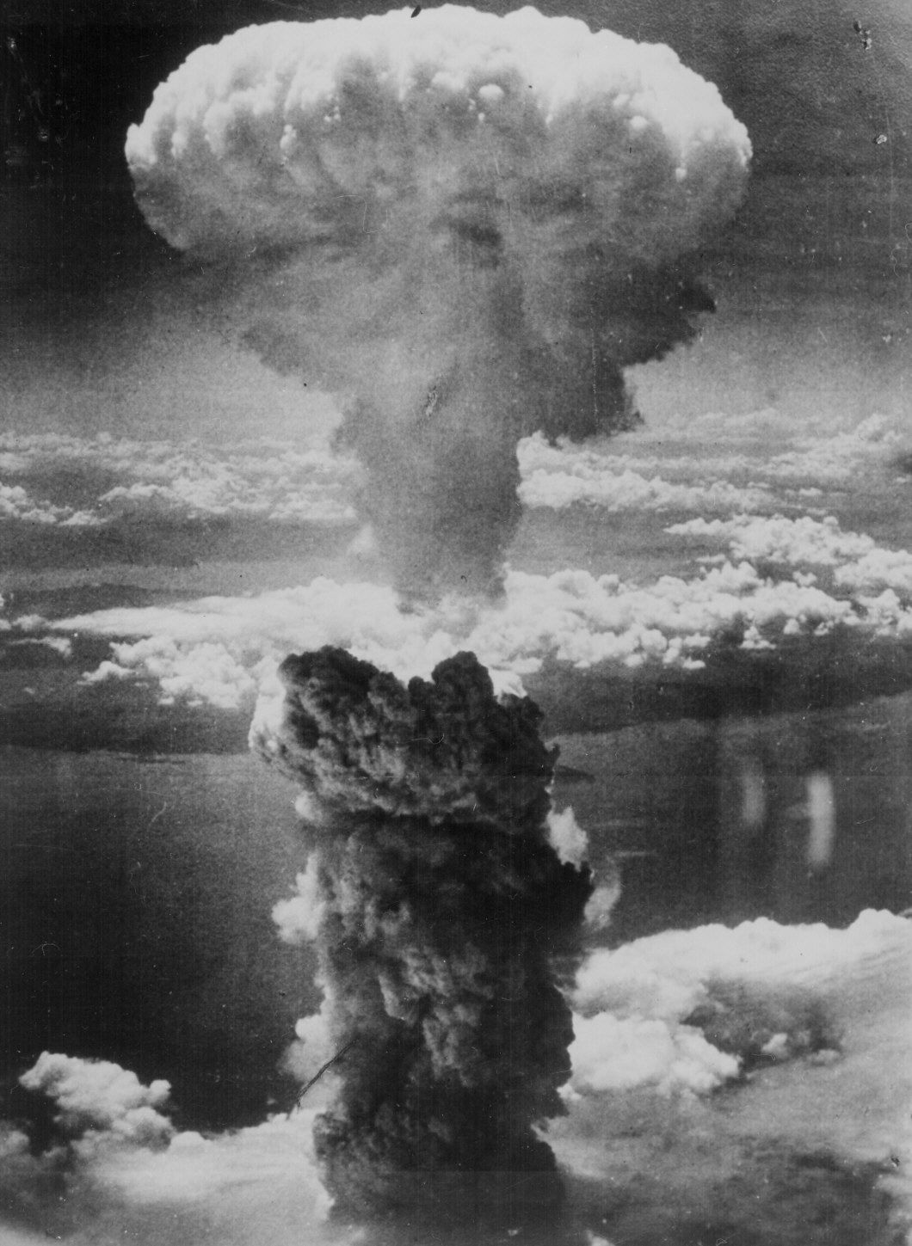
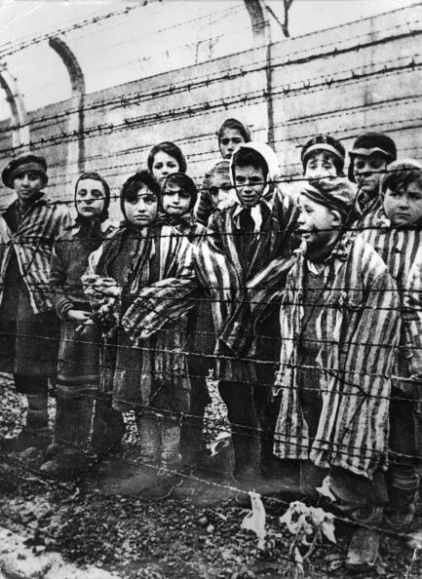
Notes:
We’ve looked at many artists making work in response to the social crises of the 20th century
World War I
Great Depression
Mexican Civil War
Spanish Civil War
World War II
What is the role of art in all of this death and destruction?
As Winston Churchill described: “What is Europe now? A rubble heap. A charnel house, a breeding ground of pestilence and hate.”
What does art do after humanity falls apart?

Slide 3
Notes:
FAILED UTOPIAN VISIONS
We can see, in hindsight, that the utopian fantasies of the early-20th century didn’t work
Futurism’s call to war left only mass destruction
Suprematism, De Stijl, and the Bauhaus aimed for clarity and utopia, but were subsumed by war
Dada a way to rise above the absurdity of war with absurdity as a tool
We will see the glimmers and sparks of this approach as we move forward in art history
As we will see in the first portion of the morning, European artists continue to make work
Many of the great lights of the pre-war years have left for America
We will see the flourishing of the New York School in the second half of this morning’s lecture

Slide 4
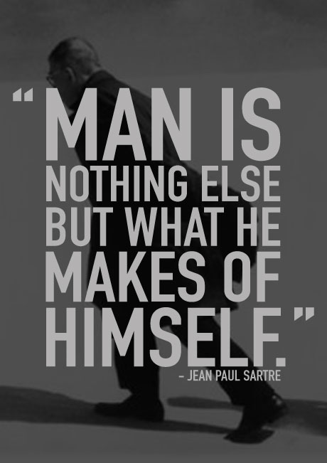
Notes:
In Europe, no unifying sense of utopia or great social change
They seem to be working through the trauma of their existence up to this point
They no longer meet at cafes and write manifestos
We do find loose groups with common attitudes/life outlooks
EXISTENTIALISM
Influenced by 19th century philosopher’s Kierkegaard and Nietzsche
1940s and 50s” Martin Heidegger, Jean-Paul Sartre, Albert Camus, and Samuel Beckett
We live in an irrational world – no superstructure to offer meaning (science, religion, etc.)
Obviously atheist
Search for meaning / purpose:
Each person finds her own path
Create one’s own meaning
This philosophy influences a generation we look at this morning
Open-ended works
No didactic meaning
If religion, science, and logic do not offer answers, how can art?
Art begins to incorporate a new level of self-reflection
You will see that most of the European work we look at this morning retains a reference to the figure
Americans move exceedingly toward pure abstraction

Slide 5
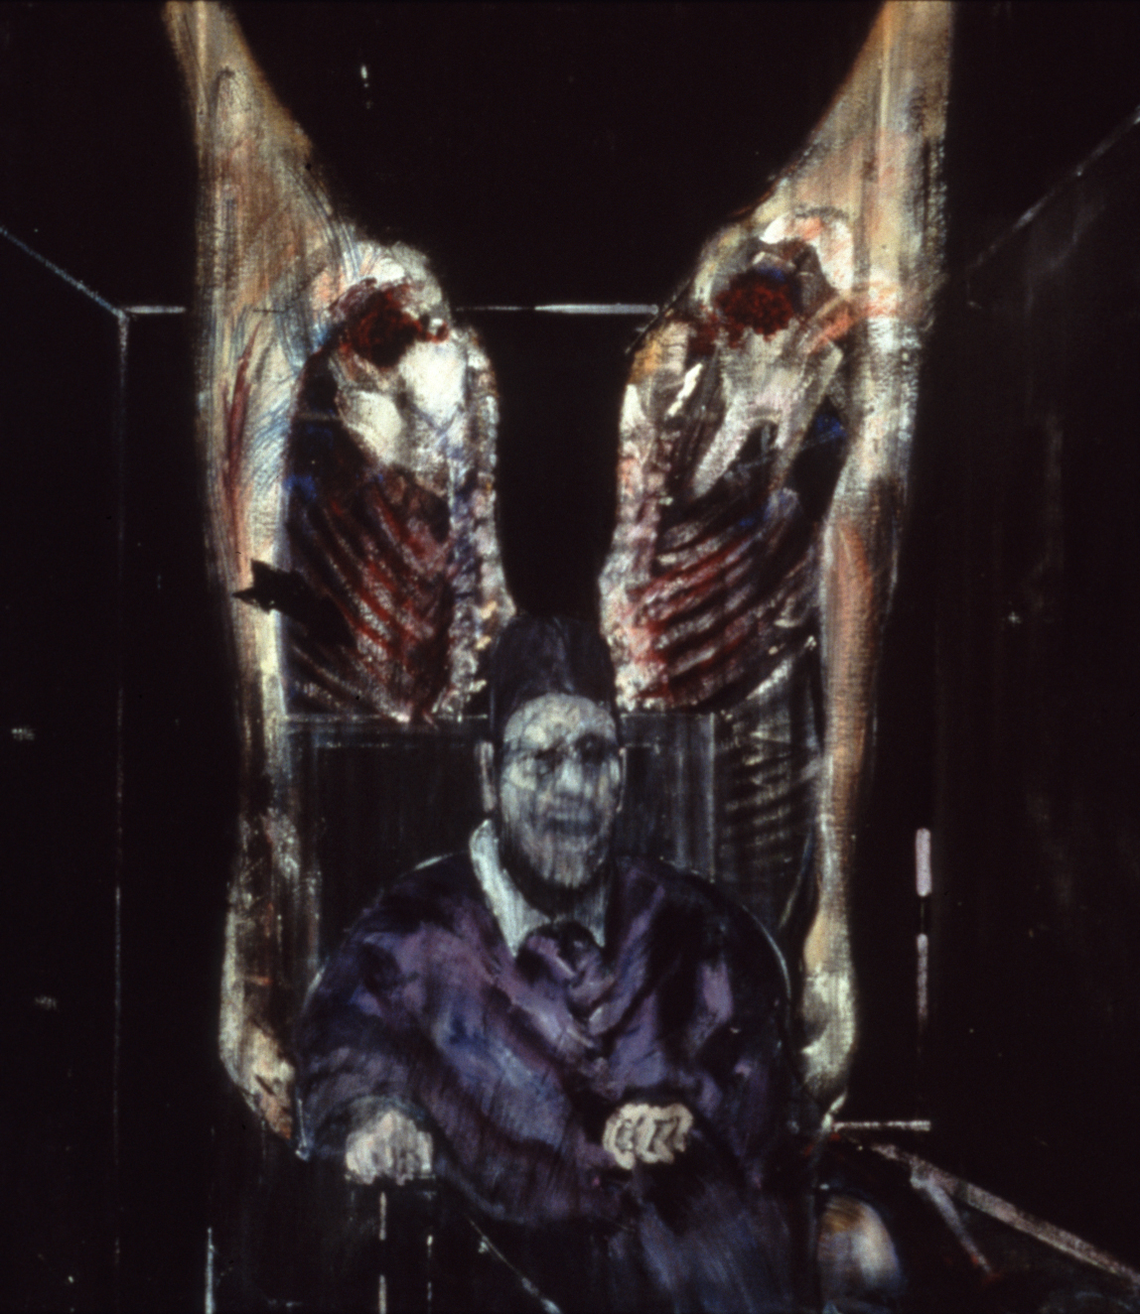
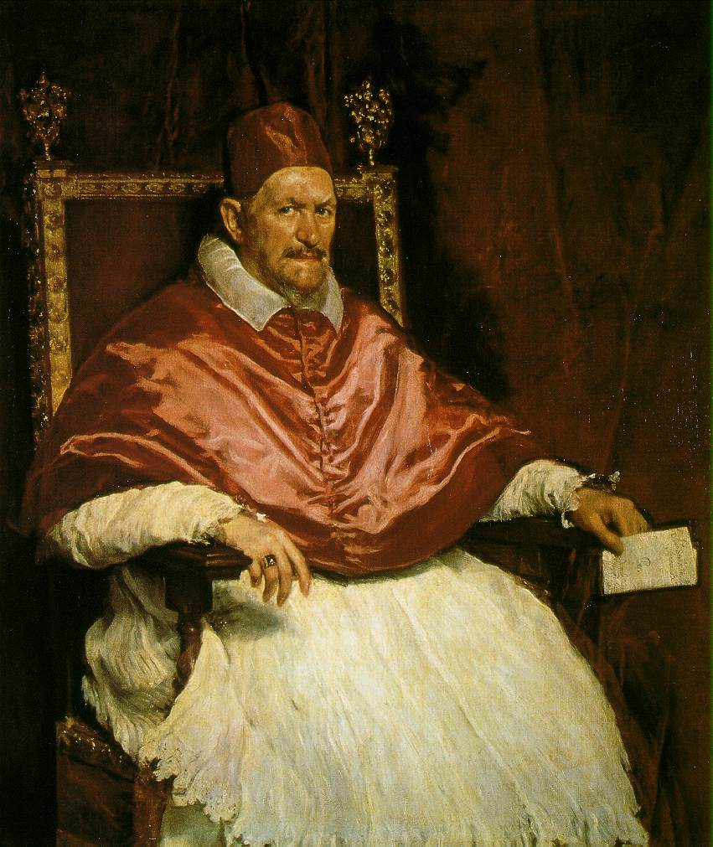
Diego Velazquez, Innocent X, ca. 1944
Francis Bacon, Figure with Meat, 1954
Oil on canvas, 50.75 x 48”
Collection The Art Institute of Chicago
Notes:
This morning we look at what happens in the European art-center of Paris after the German occupation and the end of WWII
The mass exodus of much of the artistic talent to NYC has a huge influence on the cultural hegemony of NY
In Europe, abstraction and figural painting are equally important
We will begin there, looking at England, France, Italy, and America
Then we will shift our focus to the new center of the art world, New York
Remember that the artists working post-war have lived through BOTH world wars, and the Great Depression
We see the undeniable effects of this in their work
First, England:
FRANCIS BACON (1909-1992)
British painter, born in Ireland
His existential outlook summed up as “We are born and we die, but in between we give this purposeless existence a meaning by our drives.”
Bacon intended his paintings to remind viewers that the human condition is fragile—that, as he explained, “we are potential carcasses.”
The specter of war, external and internal, is never far from his work
Francis Bacon, Figure with Meat, 1954
Belongs to a large series of works (25) that Bacon based on reproductions of Diego Velázquez’s Portrait of Pope Innocent X
In this version, Bacon depicts the Pope flanked by sides of beef
A motif drawn from his childhood fascination with butcher shops
Also an homage to the haunting images of raw meat made by Rembrandt and Chaim Soutine
As we will see in our own Bacon, he preferred to glaze his paintings with glass
This works to heighten the sense of isolation in the work, a theme he explored thoroughly
Saw the glass as a barrier between the picture and the viewer
Furthers the sense of distance and remoteness in his work
BUT, you can see yourself in the reflection, which is haunting and disturbing…

Slide 6
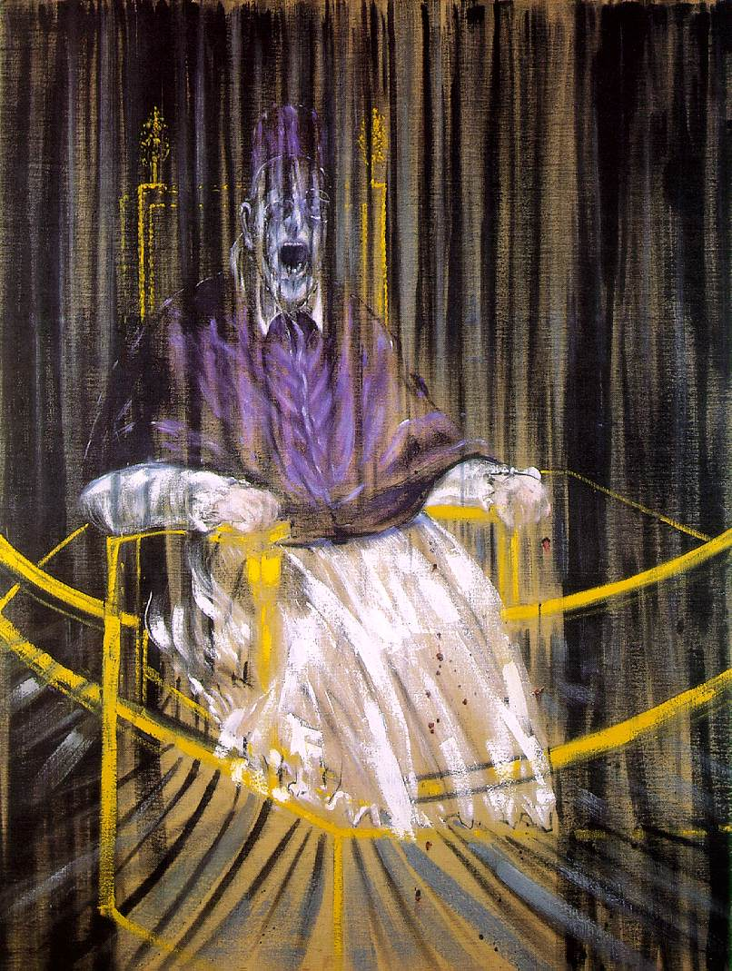
Francis Bacon, Study After Velazquez’s Portrait of Pope Innocent X, 1953
Oil on canvas
Des Moines Art Center, Iowa
Notes:
Francis Bacon, Study After Velazquez’s Portrait of Pope Innocent X, 1953
Again, Bacon knew of the Velazquez only via reproduction
1644-55: Pope Innocent X
Also included characteristics from the Pope at the time, Pope Pius XII
Not simply symbols of the Church
Emphasizes their humanity – anxiety and vulnerability
Bizarre distortion happening here
Confusing space – open, yet claustrophobic
Intense, like you can almost hear his hysterical shrieking
If you’ve spent any time with our Self-Portrait, you know that Bacon does not let you leave his images without taking on some of their energy
Cites Picasso and Cubism as a major influence
Dissolved the figure without erasing it totally
He approaches it in a more expressive way
Again, humans seen as vulnerable slabs of meat

Slide 7
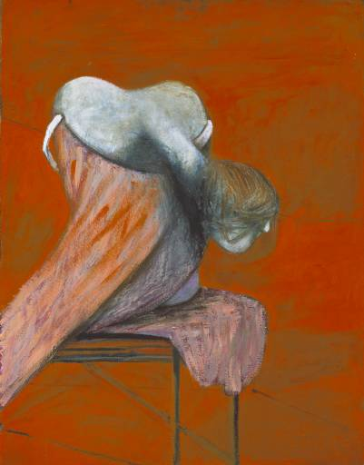
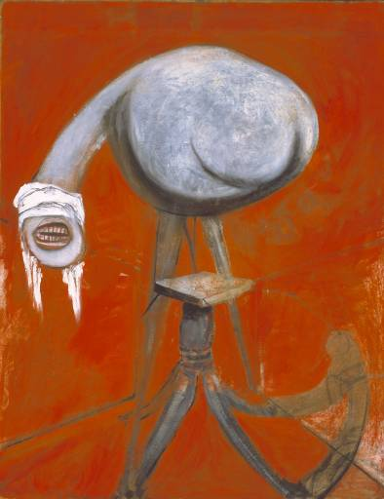
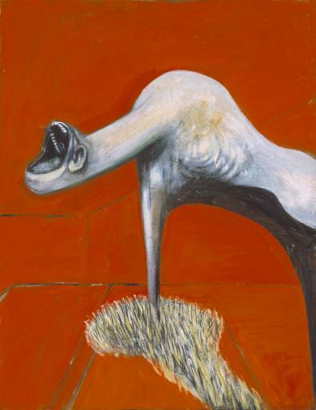
Francis Bacon, Three Studies for Figures at the Base of a Crucifixion, 1944
Oil on canvas,
Notes:
Francis Bacon, Three Studies for Figures at the Base of a Crucifixion, 1944
Another religious theme, remixed
Biomorphic creatures – half human / half animal??
Note “a” crucifixion, not “the”
Not just something done to Jesus – crucifixion has been essentialised

Slide 8
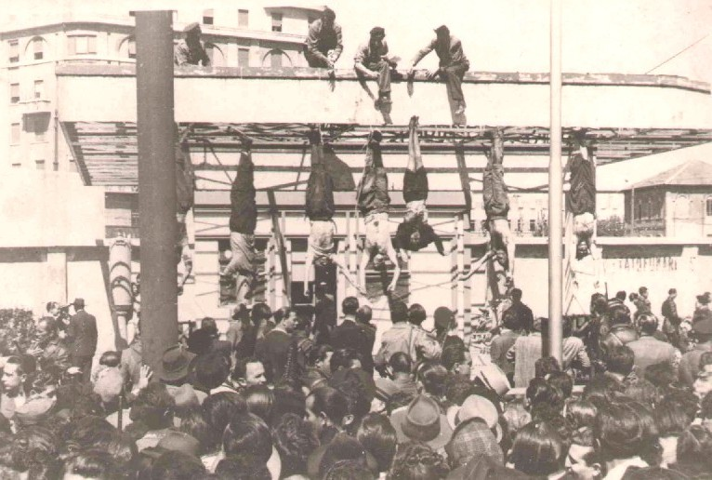
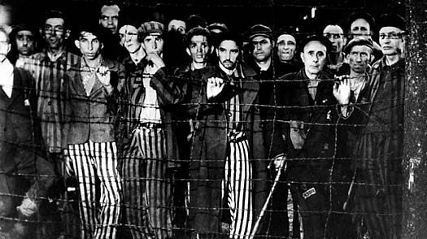
Notes:
Consider the images that emerge immediately following the war
Mussolini hanging upside down from a meat hook
Hitler’s bunker
Release of death-camp survivors
Humanity is a dismal state
These figures seem to be moving and wailing
Alone in a blood-red environment
The separation of the canvases enhanced that sense of utter isolation

Slide 9
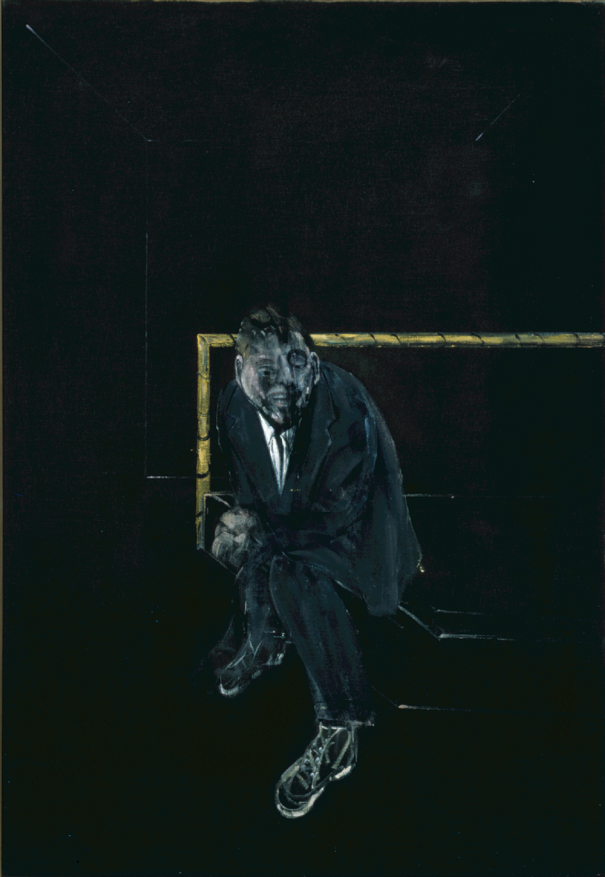
Francis Bacon, Self-Portrait, 1956
Oil on canvas,
Collection MAMFW
Notes:
Francis Bacon, Self-Portrait, 1956
This is his earliest surviving SP
Note the strange, ambiguous space
Darkened room…on a bed, a bench?
Private or public space
When you stand before it, notice yourself in the image (reflection) – recall, that was his decision!
Face smeared and hysterical
Hands wringing themselves – almost not a part of the body
Sense of deep isolation and imbalance
Bacon homosexual at a time when it was illegal to be so (up until 1967)
Raised in a very conservative, religious home (who wasn’t then?)
Though an artist’s sexuality is not always fodder for a tour, many have made excellent arguments that his is relevant to his work.
“People always seem to think that in my paintings I’m trying to put across the feeling of suffering and the ferocity of like, but I don’t think of it at all that way myself. You see, just the very fact of being born is a ferocious thing, just existence itself as one goes between birth and death. It’s not that I want to emphasize that side of things – but I suppose that if you’re trying to work as near to your nervous system as you can, that’s what automatically comes out…life…is just filled, really, with suffering an despair.”
Okay, time for a Prozac break…!
TOUR TECHNIQUES
Children: what is a SP? What colors would you use to paint yours? What is this figure feeling? Why do you say that?
Older children: All of the above, plus discussion about WWII and Existentialism
Adults: All of the above, just on a higher level – their memories of the years following the war, if applicable. How current conflicts affect their lives? What are this man’s demons?
If a super knowledgeable group, dive into his biography more extensively – sexuality, etc.

Slide 10
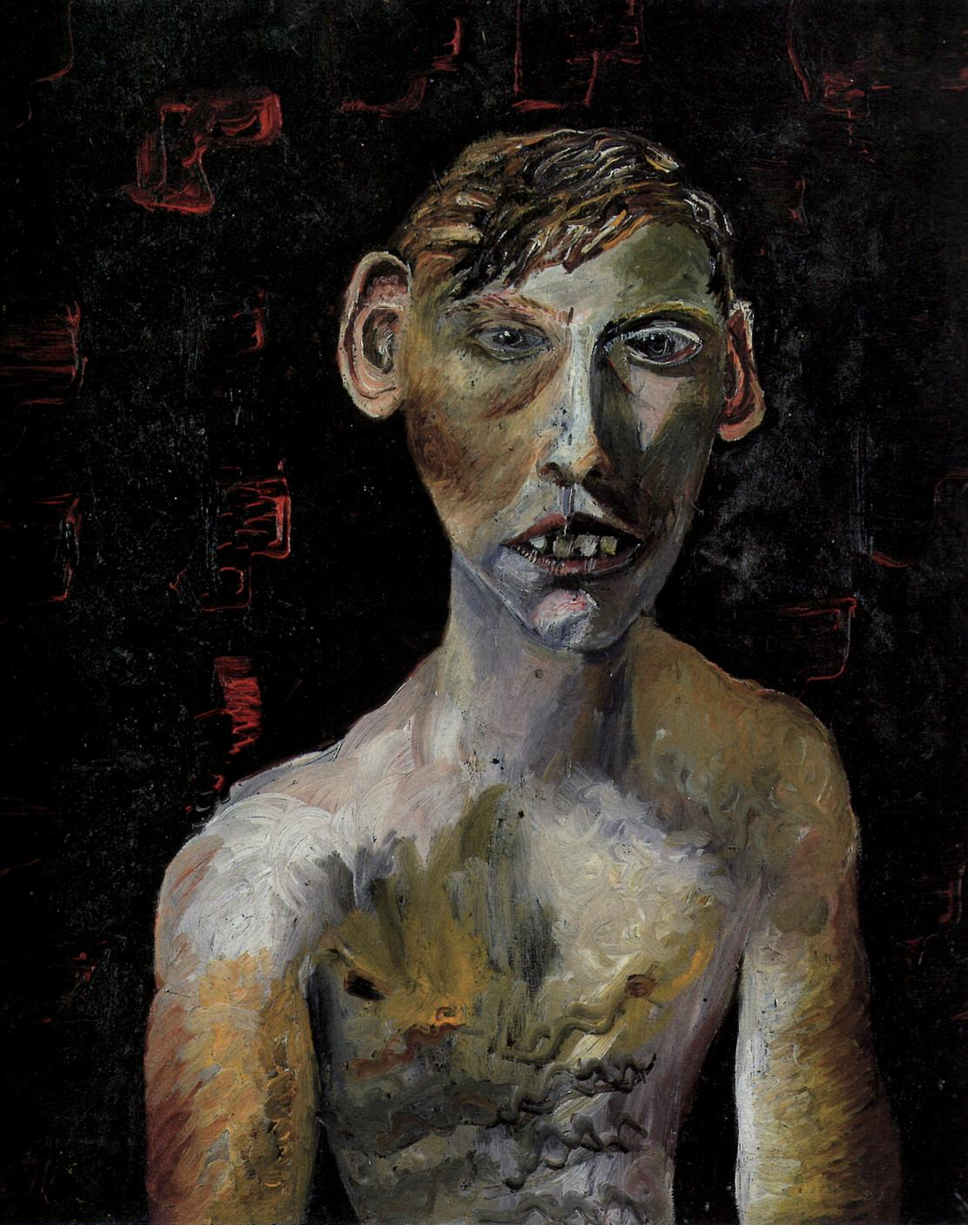
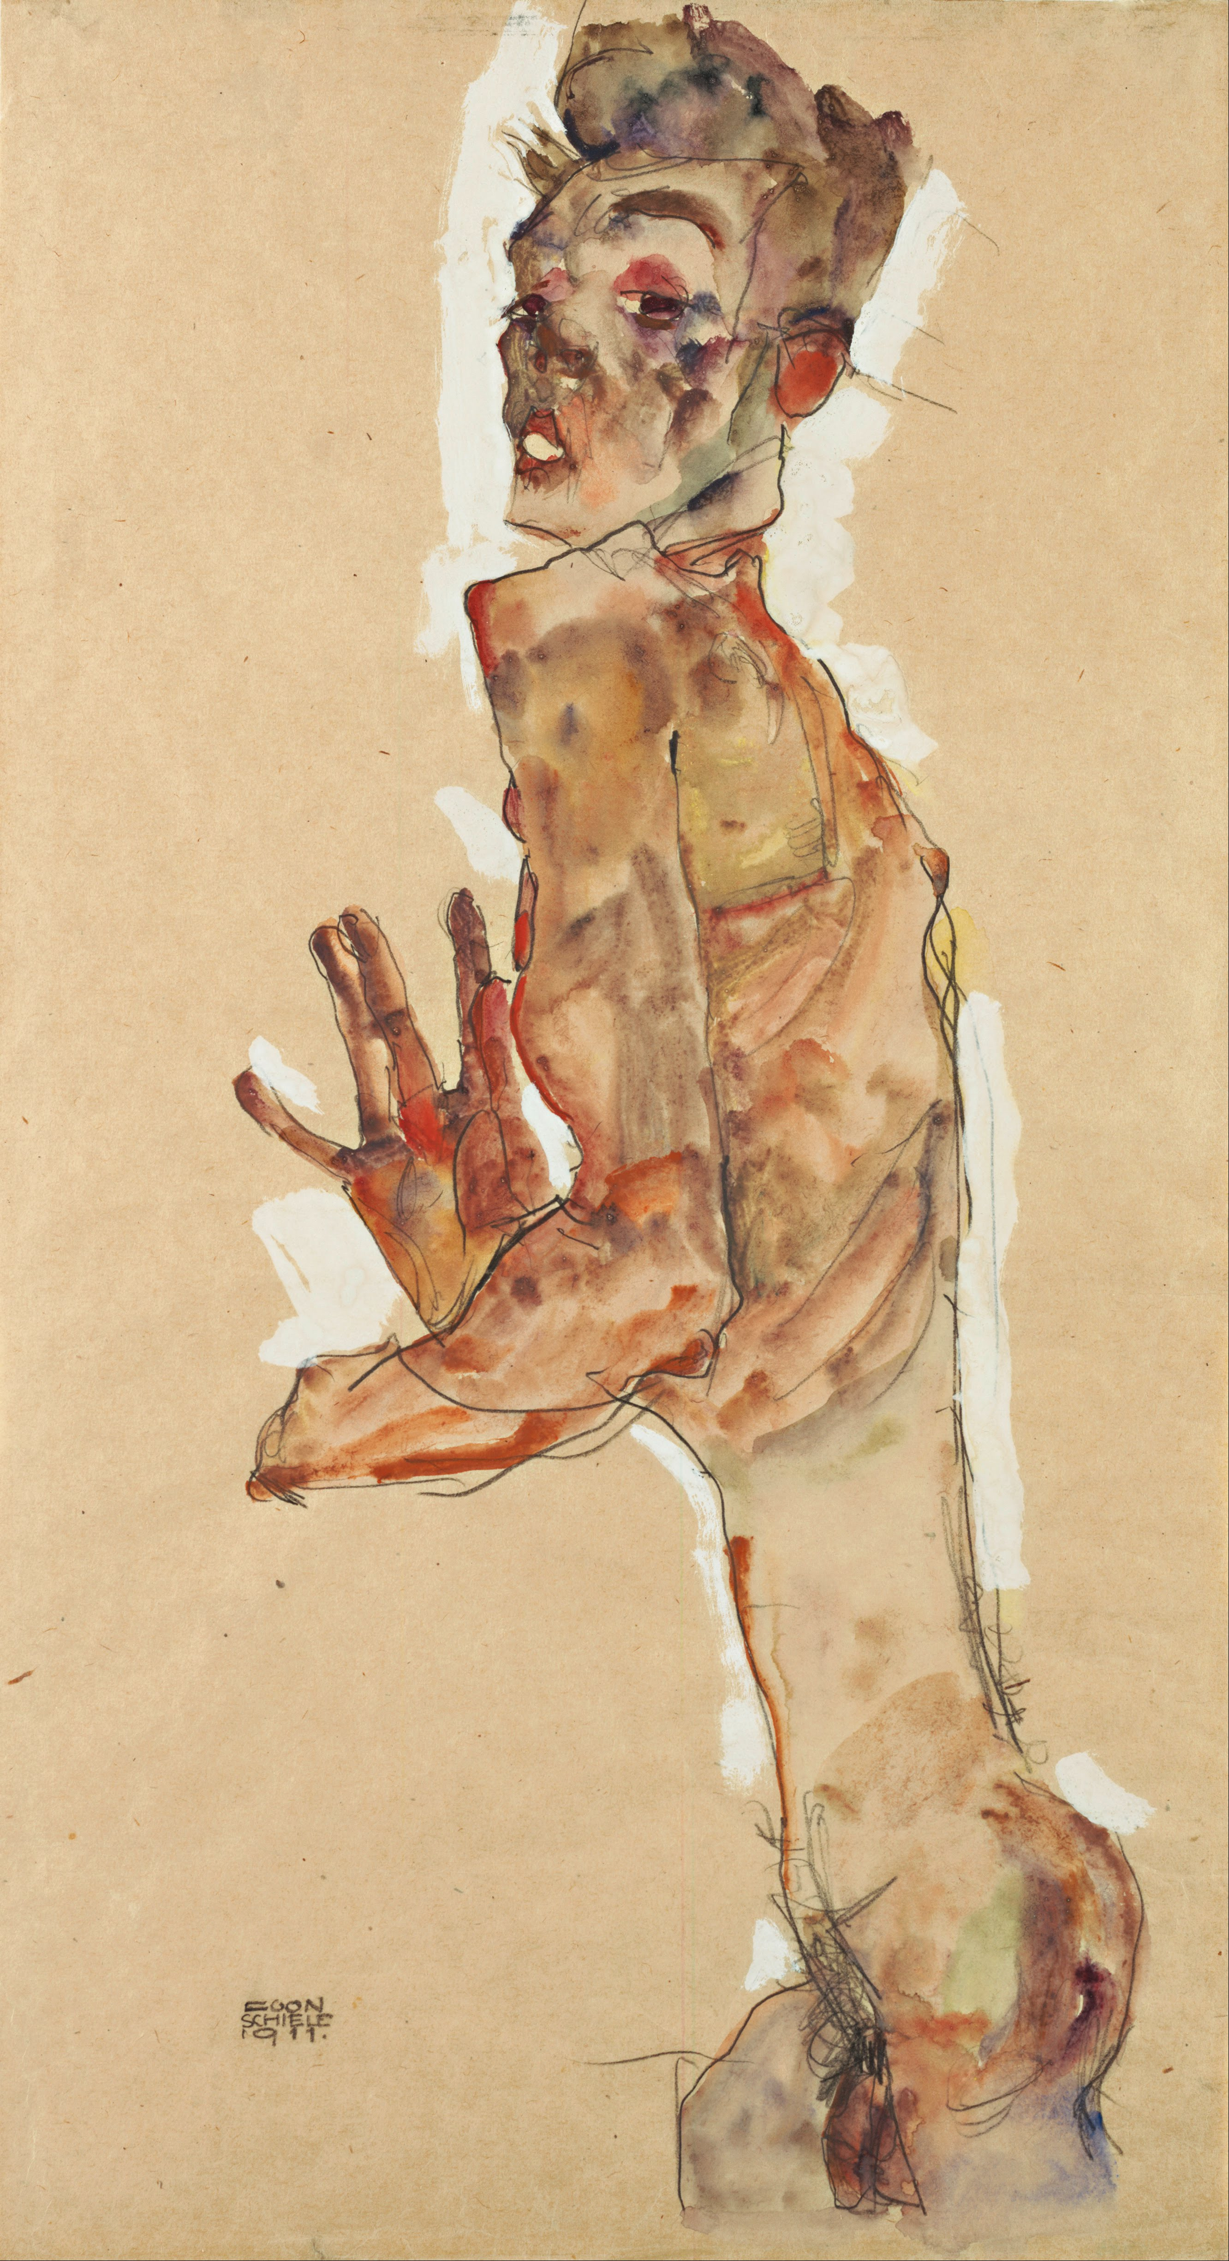
Lucian Freud, Evacuee Boy, 1942
Oil on canvas
Private Collection
Egon Schiele, Self-Portrait with Splayed Fingers, 1911
Notes:
LUCIAN FREUD (1922-2001)
Lucian Freud, Evacuee Boy, 1942
Freud and Bacon are contemporaries, and good friends
Freud’s career spanned over 60 years
Who had the chance to see his retrospective we had a couple of years ago?
Excellent overview of his varied career
German-born, British painter
Grandson of Sigmund Freud
1933: Moves to London with family to escape rise of Nazism
Known as a portraitist
2009: Died at age 88
Known as Britain’s “greatest living painter” up to that point
Greatest portrait painter of the 20th century
His work is his autobiography
"Everything is autobiographical and everything is a portrait, even if it's a chair.”
Notorious for working directly from a live model - often one painting takes MONTHS
Heavily built-up surfaces
Portraits capture to essence of the sitter, if not always their likeness
Early portraits indebted to German Expressionism
Lucian Freud, Evacuee Boy, 1942
You see this with the dark, thick paint application
Somewhat distorted figure of the young boy
Similar to Austrian painter Egon Schiele’s twisted, expressive figure from 1911
Intense scrutiny of the human psyche
Like the German Expressionists, Freud often used sexuality or psychologically charged body language to deliver a point
Lays bare the human interior

Slide 11
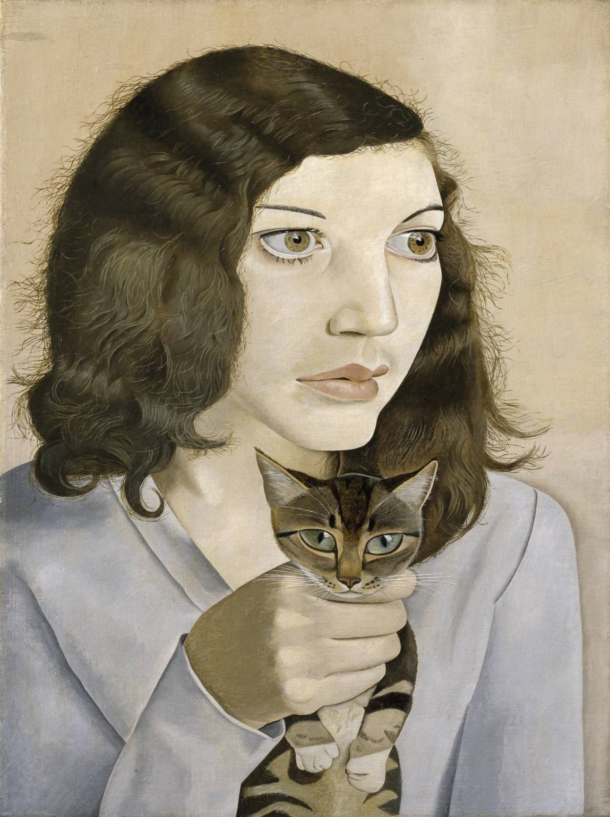
Lucien Freud, Girl with a Kitten, 1947
Oil on canvas,
Collection
Notes:
Lucien Freud, Girl with a Kitten, 1947
One of eight portraits that Lucian Freud made of his first wife, Kathleen Garman between 1947 and 1951
Closely cropped composition
Famous for his intense scrutiny of the sitter at this point in his career
Every little hair is accounted for
Connected to the German group Neue Sachlichkeit (New Objectivity)
Sharp, unsentimental style from the 1920s
Used a fine sable brush on finely woven canvas
His style does change after a few years
Much more expressive and open brushwork
Often exaggerated certain features he found interesting
Her eyes!
Often made his models uncomfortable
A sort of visual aggression
“I would sit very close and stare. It was uncomfortable for us both.”
We see a strange scene
Why is she tightly gripping the kitten’s neck?
Why is the kitten seemingly oblivious, yet staring out at us?
Garman went by “Kitty”
A double portrait of his wife?
Both have enormous eyes
The kitten is much more present – she seems out to lunch

Slide 12
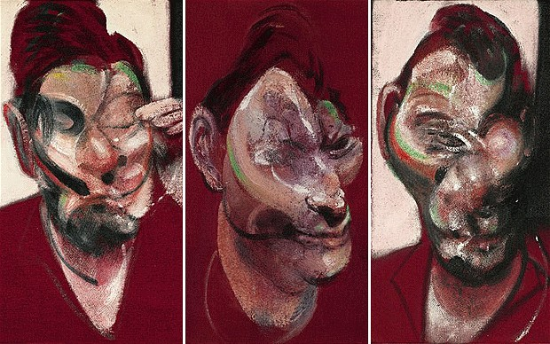
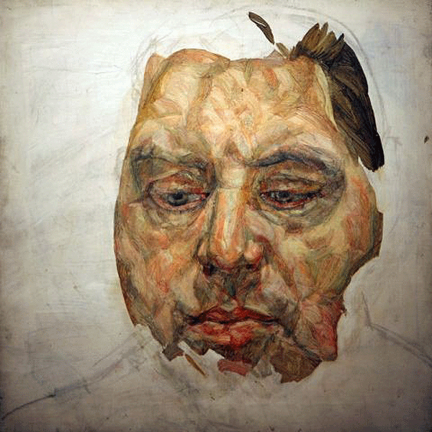
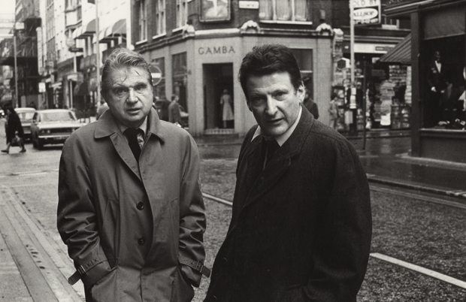
Francis Bacon, Three Studies for Portrait of Lucian Freud, 1964
Lucien Freud, Portrait of Francis Bacon, 1956-57
Notes:
Francis Bacon, Three Studies for Portrait of Lucian Freud, 1964
Distortion continues
Not a physical likeness, but perhaps a psychological one
Lucien Freud, Portrait of Francis Bacon, 1956-57
An unfinished portrait of Bacon
Shows Freud’s working process
Worked from the inside, out
Mature style – mottles paint
How to be true to human skin?
Bacon’s inner self on display here
The two had a close friendship and often discussed their work with one another

Slide 13
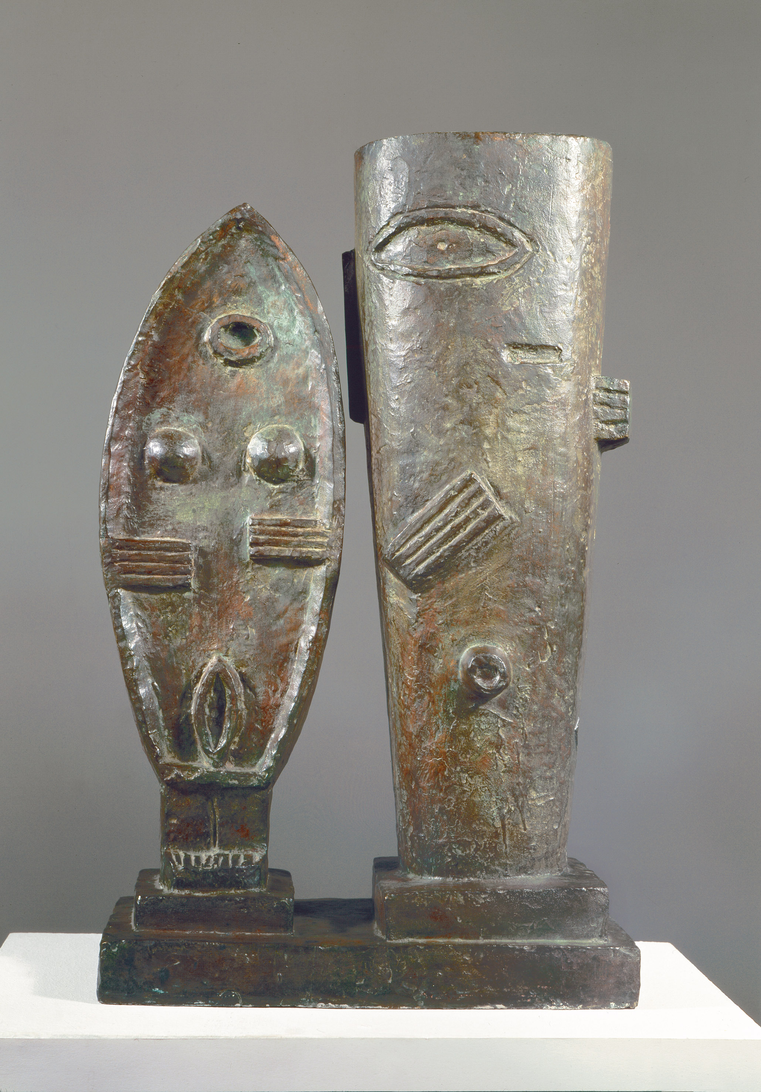
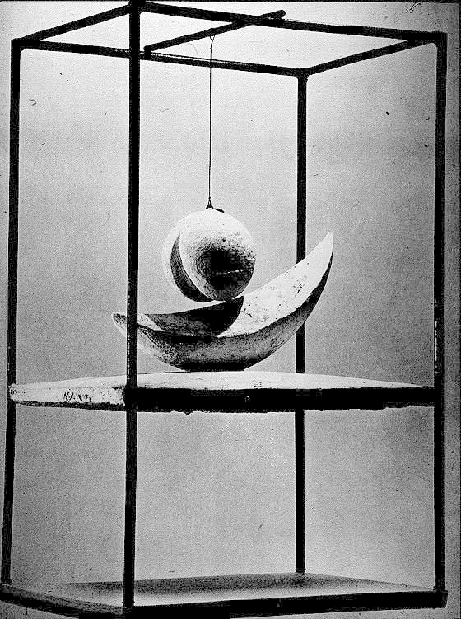
Alberto Giacometti, The Couple, 1926
Bronze. 23.5 x 14.5 x 7”
Collection MoMA, NY
Alberto Giacometti, Suspended Ball, 1930-31
Mixed media, 23.5” (height)
Collection Tate Modern, London
Notes:
ALBERTO GIACOMETTI (1901-1966)
A Swiss sculptor, painter, draughtsman, and printmaker
Father a well-known post-Impressionist painter
1901: Born
To give you a time context, Picasso paints Demoiselles when he is six
1922: Moves to Paris
Studies under an associate of Rodin
Here he experiences Cubism and Surrealism
Regarded as one of the lead Surrealist sculptors
Works alongside Miró, Ernst, Picasso, and others
Friends with Existentialist philosophers such as Sartre
Here we see two early works with clear Surrealist ties
Alberto Giacometti, The Couple, 1926
Influenced by African art he sees in Paris
African art translated by French artists is not new
Giacometti sees it with fresh eyes
Sees that you can use abstract shapes to represent the figure
Sums the sexes through their sexual organs
Alberto Giacometti, Suspended Ball, 1930-31
From his Surrealist period
Drawn to the erotic – more genitalia
A suspended ball with a slit, which lines up with a banana-shaped object below
When swung the ball would never actually touch the banana – frustrated desire??
Ties to Surrealism's interest in chance and the unconscious
Breton sees this piece in a gallery when it was first shown
Buys it for his collection
Asks Giacometti to join the movement
Mid-1930s: Giacometti becomes interested in the figure
“Absolute resemblance”
Breton casts him out of the movement

Slide 14
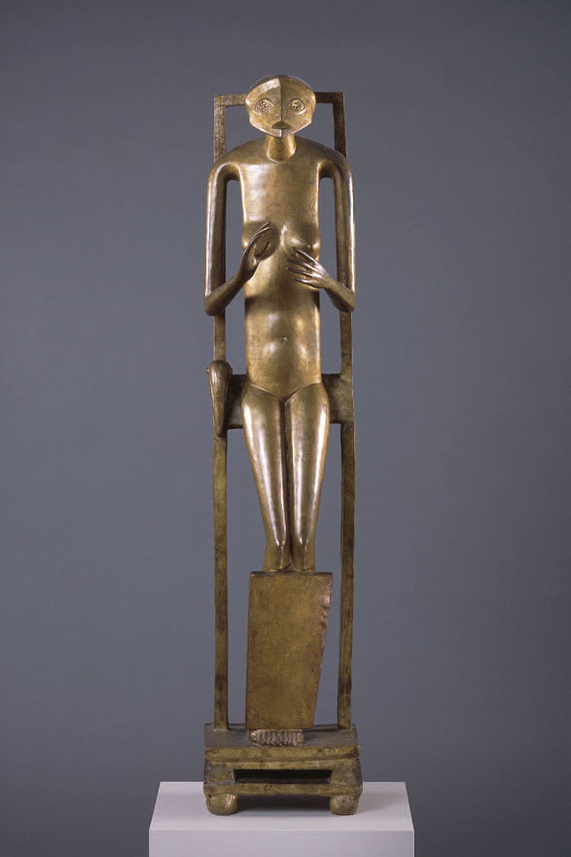
Alberto Giacometti, Hands Holding the Void (Invisible Object), 1934
Bronze, 60 x 13 x 10”
Collection MoMA, NY
Alberto Giacometti, Tall Figure, 1949
Painted bronze, 35.5 x 6.5 x 13.5”
Collection MoMA, NY
Notes:
Alberto Giacometti, Hands Holding the Void (Invisible Object), 1934
Large-scale, anatomically complete yet highly stylized female figure
Balances on a cage-like throne
Together with the slab-like board covering her shins, both supports and restricts movement
The figure's hands, positioned as if holding or offering something, are empty, as confirmed by the work's title
Much like his contemporary, Picasso, Giacometti modeled the figure's head and face after a protective metal mask found at a Paris flea market he visited with Surrealist leader André Breton
If you’ll recall from our last class, Breton held that every desire has a distinctive object that chance would deliver
This is the last major work Giacometti makes within the orbit of Surrealism
A sense of mystery to the figure
Simplified forms and delineated facial features tie it to primitive masks and effigies from other cultures
Some scholars believe it evokes a lost object, forever sought and never recovered
Alberto Giacometti, Tall Figure, 1949
1936-40: Concentrates on sculpting the human head
Used models (his family, or fellow-artists)
His female figures begin to elongate
Focuses on creating sculpture true to his unique view of reality
Carved until the figures are as thin as nails
Many very tiny, only inches high
As a friend of the artist recalled, “He would make your head look like the blade of a knife.”
Strived to capture the figure’s totality, sans distractions
As part of his process, he would view a figure from across the room
This helps to eliminate detail
When seen in person, they do seem distant
Post-1946: Sculptures become larger, but they grow even thinner
Professed that the final look of these works represent the sensation he felt when looking at a woman

Slide 15
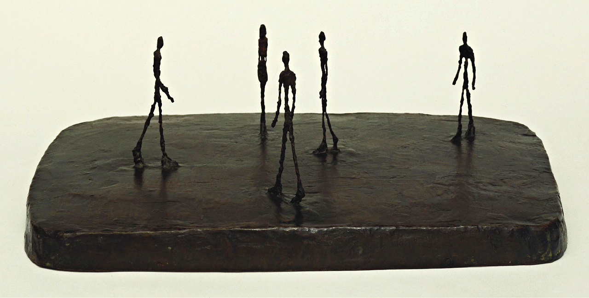
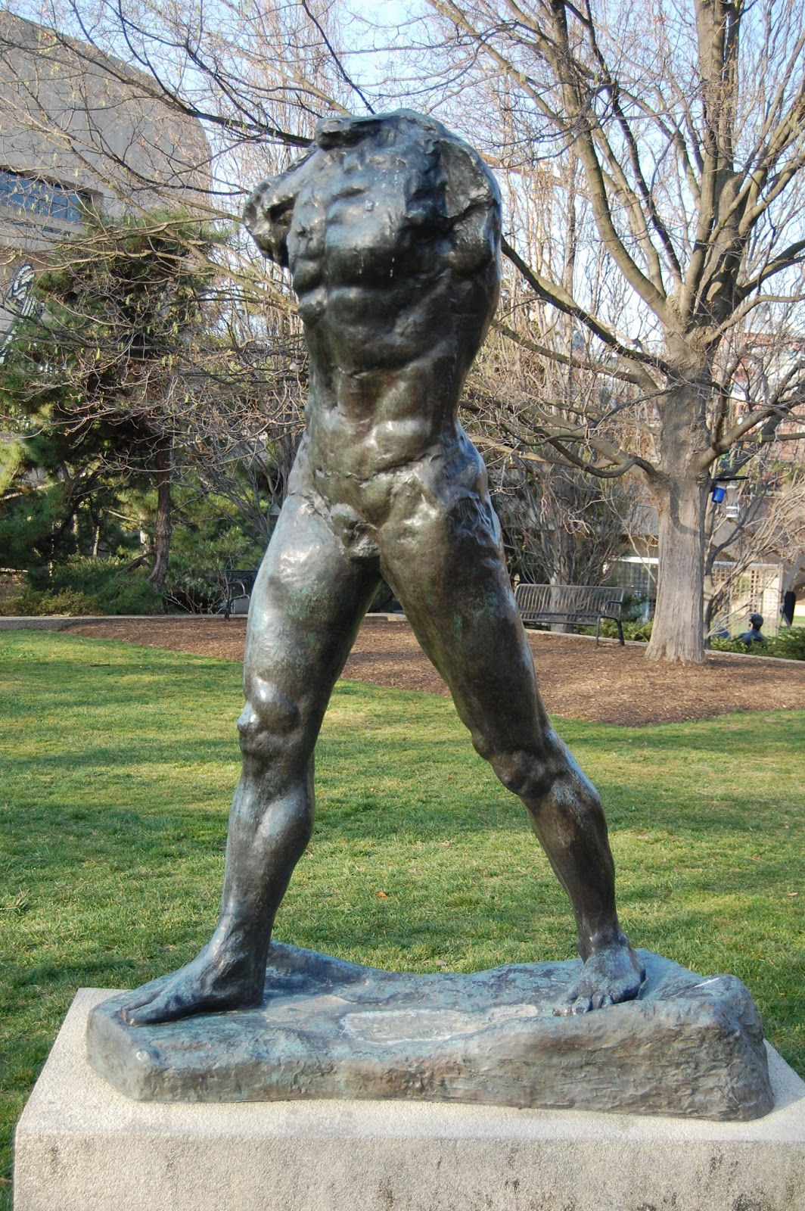
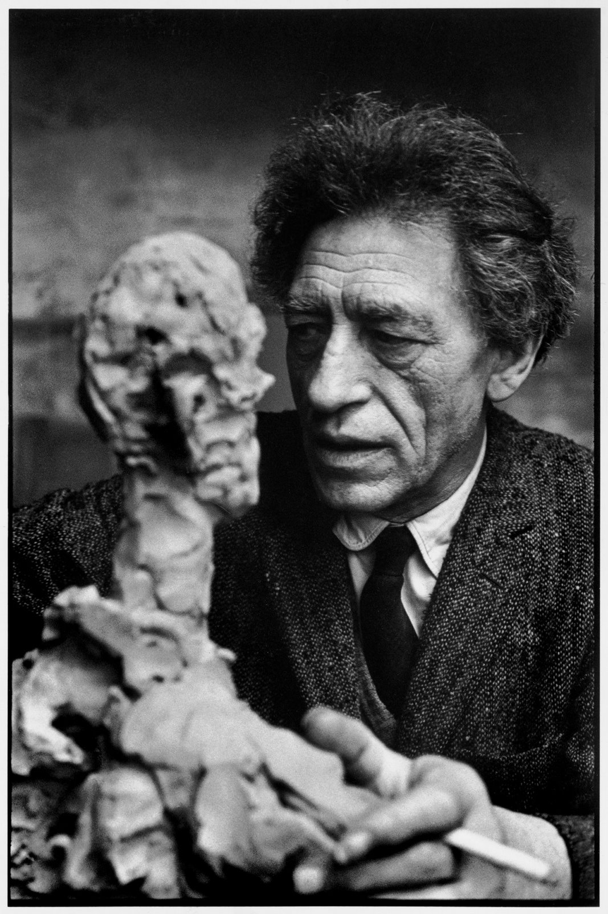
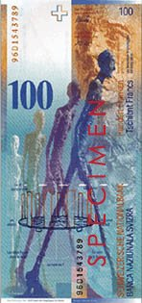
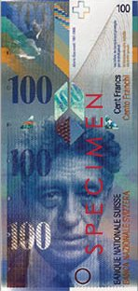
Alberto Giacometti, The City Square, 1948
Bronze, 8.5 x 25.25 x 17.25”
Collection MoMA, NY
Auguste Rodin, Walking Man, 1900
The current 100 Swiss Franc banknote
Notes:
Alberto Giacometti, The City Square, 1948
Figures are isolated, whether solitary or in groups
Conveys a sense of alienation
Again, that distance
Like a Hopper painting…
Strives for fragility – compulsion to whittle down his figures until he thought one more touch would destroy them completely
Metaphor for the fragility of human life following the war?
Skeletal
Have been referred to as “fugitives from Dachau”
Oversized base a common element in his work
Figures share a common ground, yet a fundamentally alone
Unfinished Quality
Modeled rather than carved, like Brancusi’s work
We are connected to the process of sculpting
You can imagine where the fingers pressed and rubbed the clay
A freshness and immediacy palpable!
Clearly influenced by Rodin, a giant in French sculpture
Play of light across the surface enhanced
“It’s impossible to ever really finish anything.”

Slide 16
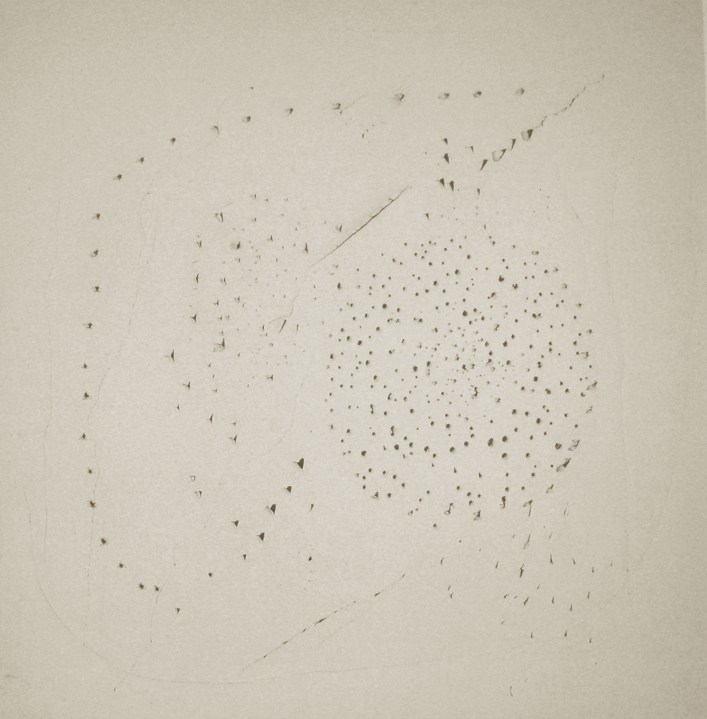
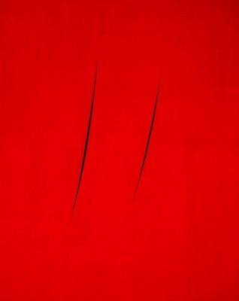
Lucio Fontana, Concetto Spaziale (Spatial Concept), 1949
White paper mounted on canvas
Collection Fondazione Lucio Fontana, Milan
Lucio Fontana, Concetto spaziale / Attese, 1960
Oil on canvas
Notes:
LUCIO FONTANA
Italian painter, sculptor, and theorist
Born in Argentina
Of Italian descent
1947: Finds his studio completely bombed out
This works for him – ready to leave his old work behind him, as it promoted the fascist regime
Writes the Spatialist Manifesto
Interested in new techniques made possible by scientific progress
Questions the traditional reliance in Western art on a flat support such as canvas or paper
Interested in four physical dimensions
Time a part of the equation
Aims to disturb the entire environment with new artistic inventions
Uses neon light, radio, and television
SPATIALIST MOVEMENT
Part of ART INFORMEL
Loose group of artists with a similar sensibility
Working across Europe
Not a movement…more of a sentiment
Not “informal art”
Really a lack of form itself – non-formal or unformulated
About the absence of a premeditated structure or concept
Formulates ideas in texts he publishes in Italy
Based upon the principle that matter should be transformed into energy in order to invade space in a dynamic form
Devises the generic title “CONCETTO SPAZIALE” (“spatial concept”)
1950s: Two broad categories:
Both types assualt the precious surface of the canvas
Open it up to the space behind and around it
“I wanted to open up space, create a new dimension for art, tie it with the cosmos.”
BUCHI (“holes”) – punctures the canvas
1948 creates his first “stab”
Same year Barnett Newman paints his first “zip”
Jackson Pollock begins his “drip” paintings the year prior
A turning point in his career
“My discovery was the hole, period. And it wouldn’t matter if I had died after this discovery.”
TAGLI (“slashes”) – rips slits into the canvas
1958:creates first slashed canvas
Came about as he was preparing for a new exhibition
Angrily cut up a painting he considered a failure
Potential!!
Radical gesture, yes
Violent gesture, no
Opens up his fascination with the possibilities of SPACE
Lucio Fontana, Concetto Spaziale (Spatial Concept), 1949
Inspired by Futurism
Sought to escape the “prison” of the flat picture surface to explore movement, time, and space
Lucio Fontana, Concetto spaziale / Attese, 1960
Line becomes coextensive with infinite space
This move opens the space of the canvas to the space of the viewer

Slide 17
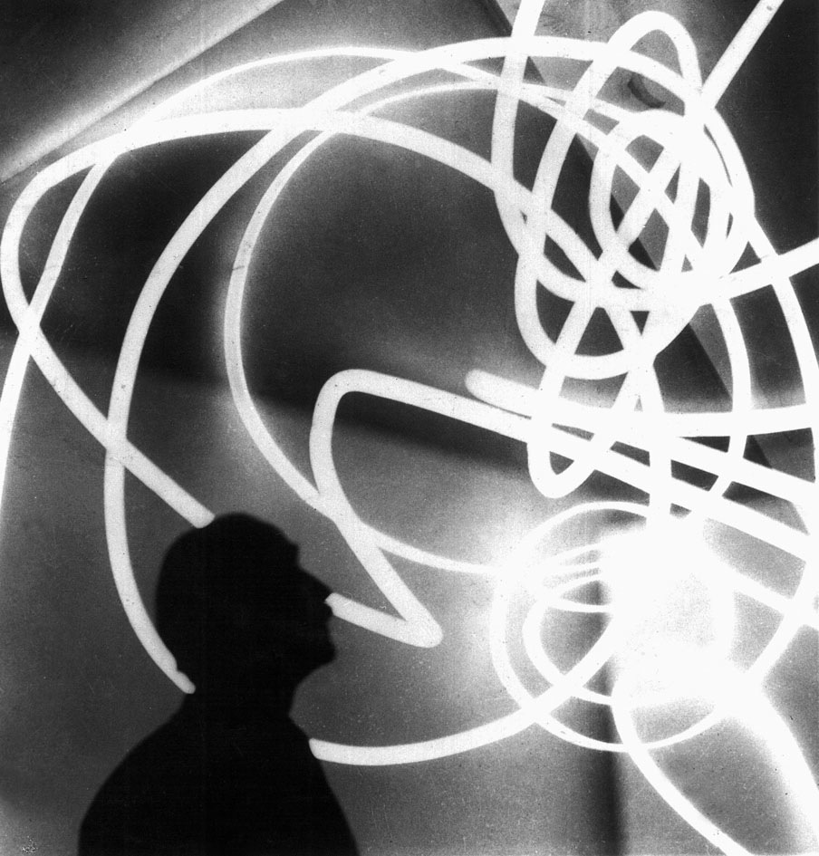
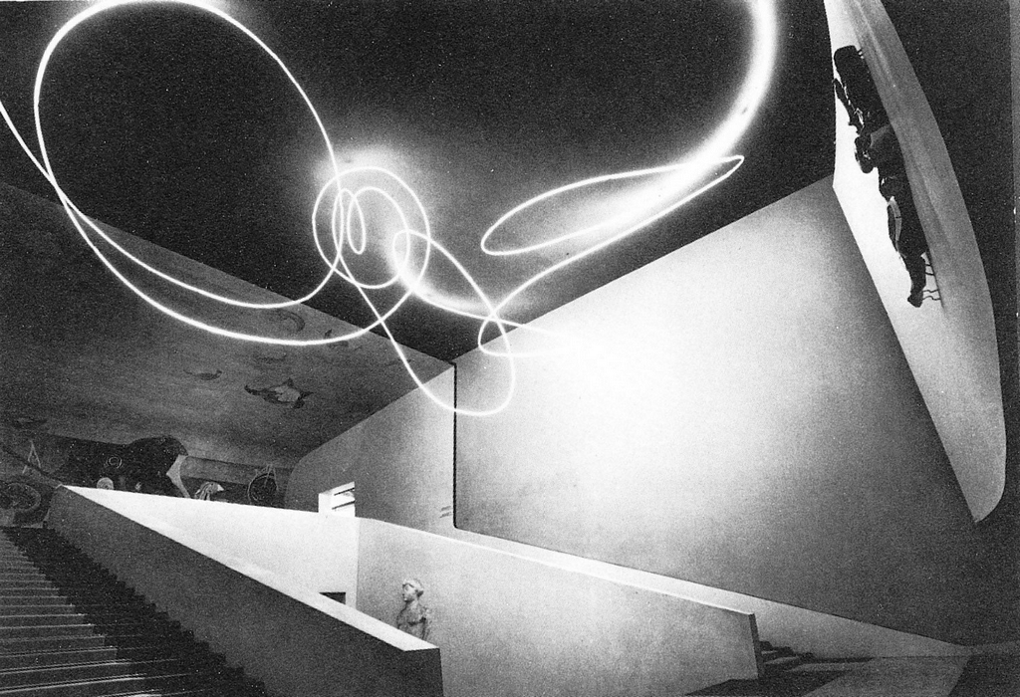
Ambiente Spaziale, Galleria del Naviglio, Milan, 1949
Lucio Fontana, Spatial Concept, the End of God, 1964
Oil on shaped canvas, 70 x 48.5”
Rachofsky Collection, Dallas
Notes:
Ambiente Spaziale, Galleria del Naviglio, Milan, 1949
1949: Installs his Ambiente Spaziale at the Galleria del Naviglio in Milan
Consists of an abstract object painted with phosphorescent paint and lit by a neon light
Pioneering example of what became known as installation art
Lucio Fontana, Spatial Concept, the End of God, 1964
Opens space
The first shaped canvas we’ve seen!
Recall Picasso’s Synthetic Cubism
Egg-shape, recalls origin of life
One of many with this title and in this format

Slide 18
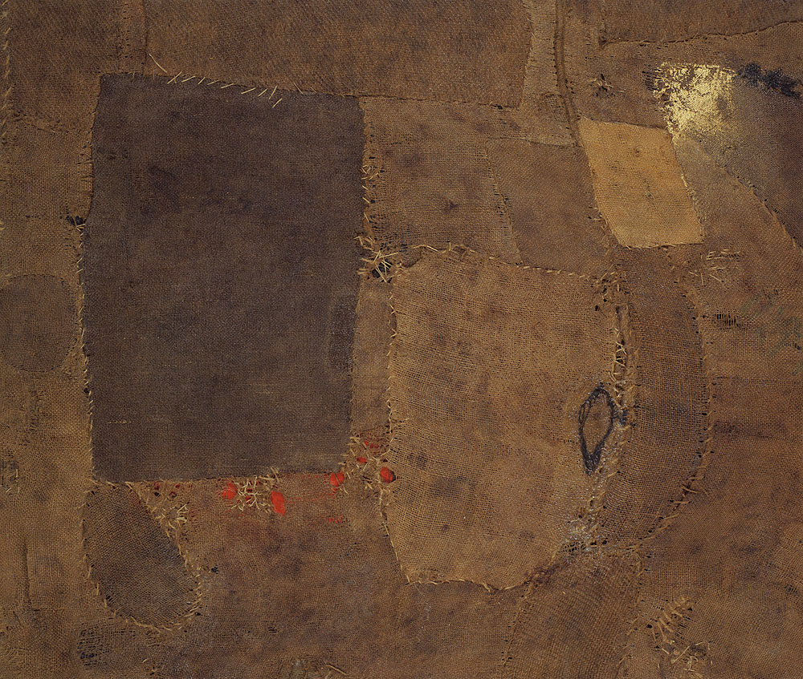
Alberto Burri, Composition, 1953
Oil, gold paint, and glue on burlap and canvas, 34 x 39.5”
Collection Solomon R. Guggenheim Museum, NY
Notes:
ALBERTO BURRI (1915-1995)
Italian artist working alongside Fontana
Redefining what it meant to make art in Italy after the war
Part of ART INFORMEL
A release from the canvas and paint
Unconventional materials and approaches pave the way for the younger generation of Arte Povera (“Poor Art”) artists (next class)
They continue to expand upon materials and approaches, but engage for explicitly with social and political concerns
Alberto Burri, Composition, 1953
Raw materials such as sacking, cloth, and wood
Sewed, cut, and burned these items
1943: Doctor in the Italian army
Captured by British and sat out rest of war in a Texas POW camp
Begins to paint here
Uses burlap as canvas when other materials not available
1946: Renounces medicine and becomes an artist
Inherent beauty of simple materials
Very different from traditional “high” art mediums (oil paint, marble, bronze, canvas, etc.)
Early critics saw stitched surfaces as a reference to injured skin and war
A direct reference to the relief supplies sent to Italy in such bag?
Burri maintained his use of materials determined by formal demands
“If I don’t have one material, I use another. It is all the same. I choose to use poor materials to prove that they could still be useful. The poorness of the medium is not a symbol: it is a device for painting.”
Not painting in the traditional sense – oil, gold paint, and glue on burlap
Relies on lessons learned from Cubism (fracturing of the surface)
A sort of burlap collage
The mending of Fontana’s slits…

Slide 19
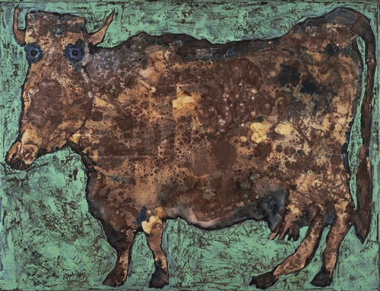
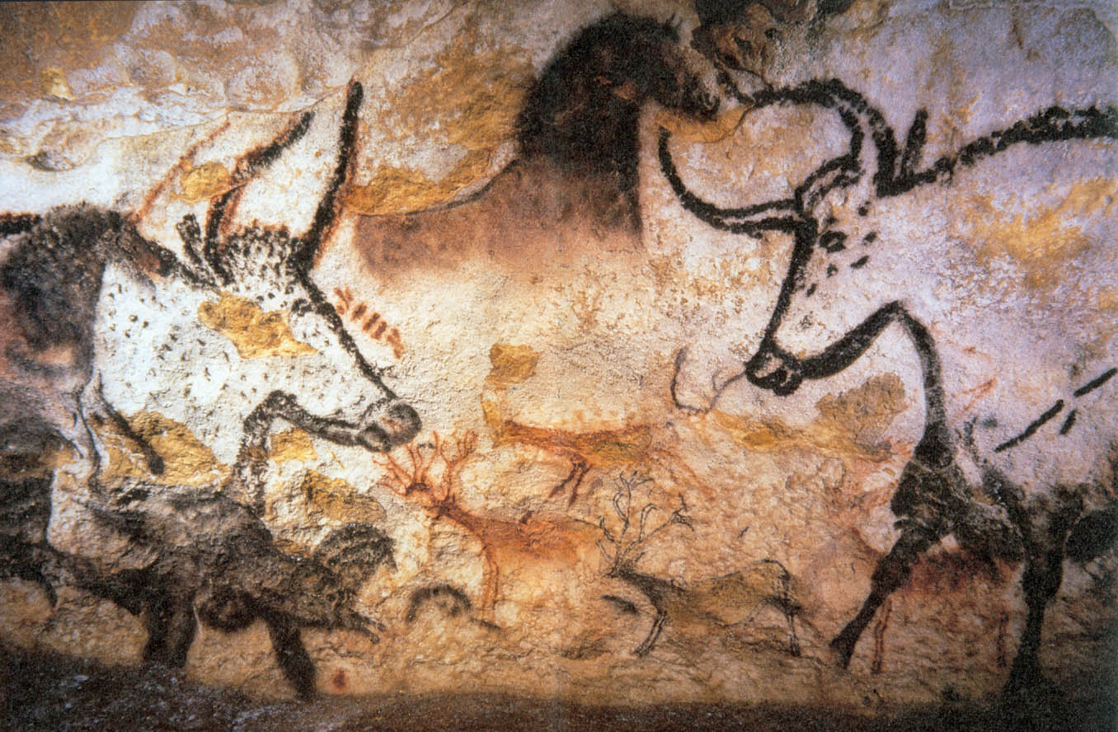
Jean Dubuffet, The Cow with the Subtile Nose, 1954
Caves at Lascaux, Paleolithic cave paintings, ca. 15,000 BCE
Lascaux, France
Notes:
In France, the SCHOOL OF PARIS:
A group of French and non-French artists working in Paris between the wars, and post-WWII
Not any one movement
Very loose term
Paris still producing art, but it is no longer the hub of the avant-garde
JEAN DUBUFFET (1901-1985)
French painter, sculptor, printmaker, collector and writer
Lived in Paris during German occupation
1942: Begins seriously painting
ART BRUT (“Raw Art”)
His form of primitivism
Saw this type of art as being untainted
Not looking to the tribal cultures of Oceana and Africa (Gauguin / Picasso)
Instead, looked to those who had no formal artistic training
People in mental hospitals, prison, folk art, and children
A revolt against beauty and conformity
Part of ART INFORMEL
Closely related to TACHISME (French for “stain”)
European equivalent of Abstract Expressionism in America
Characterized by spontaneous brushwork, painting directly from the tube, drips and blobs of paint, and a scribbling recalling calligraphy
Jean Dubuffet, The Cow with the Subtile Nose, 1954
“Subtle” in English
His wife was taking a rest cure in the countryside
On his visits, he took calming walks and saw many cows
Captivated by their dumbness
Kid’s art the most fresh and immediate form of reaching the raw, uninformed humanity we all share
They haven’t been taught the “correct” way to make art
Emotions are part and parcel of their imagery
Often dream-like and scattered
Strong outlines with areas of flat color
Use the perspective that gives the most information – no interest in believable space or scale
Also looks to contemporary graffiti
Plural of “graffito” – “a scribbling”
Dubuffet attempts to unlearn his artistic training
As all modernists, he rejects the past
“Art should always make people laugh a little, and frighten them a little.”
Caves at Lascaux, Paleolithic cave paintings
Ancient “graffiti”
First known use of images added to a support for means of communication

Slide 20
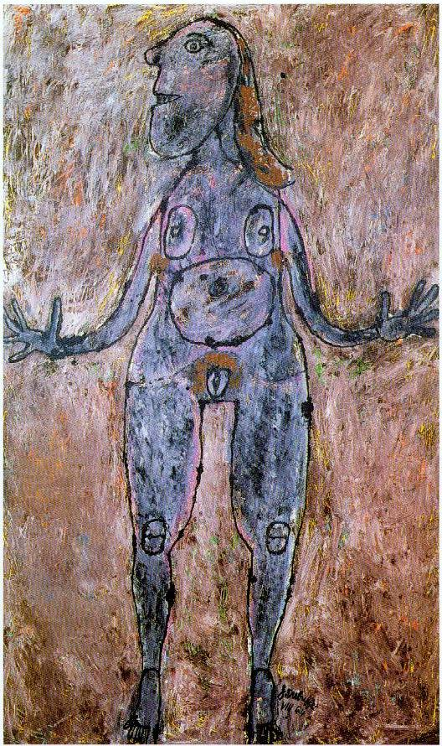
Jean Dubuffet, Large Sooty Nude, 1944
Ash and oil on canvas
Notes:
Jean Dubuffet, Large Sooty Nude, 1944
Often smeared oil paint on his canvases with a spatula – texture of cake icing
Then sprinkled ash, sand, and coal dust, over wet paint to darken it
Incises outlines of the image – cuts through gritty layers of textured paint
Digging the image from the canvas
Shows the next generation that ANYTHING can be used to make art
Recall the history of the female nude…
What better way to attack art than to attack the female nude?
Legacy of perfection and refined beauty

