Slide 1
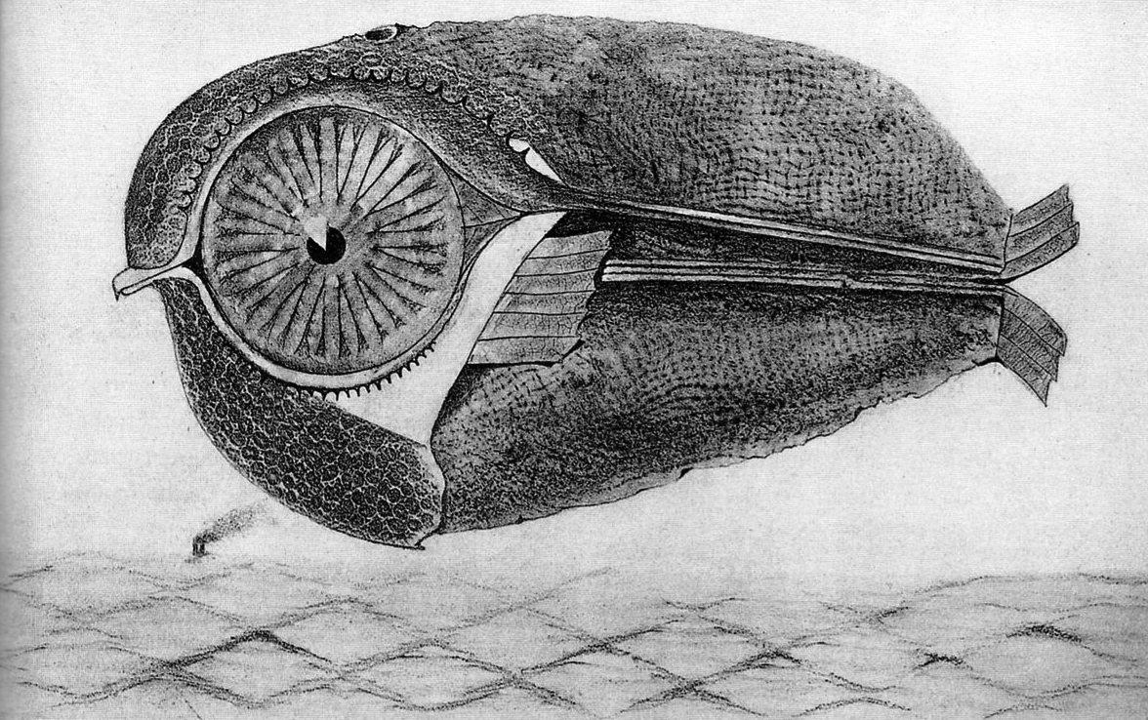
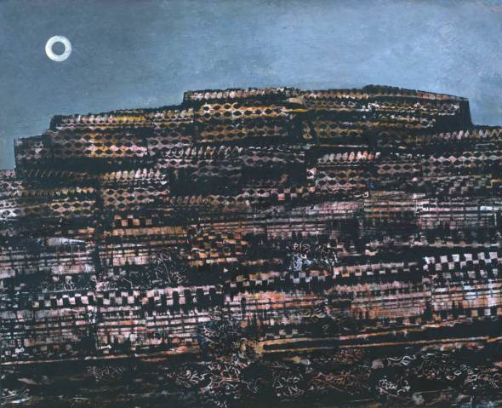
Max Ernst, L’évadé (The Fugitive) - from Historie Naturelle (Natural History, 1926
Graphite on paper (frottage)
Max Ernst, La Ville entière (The Entire City), 1934
Oil on paper laid on canvas (grattage)
Collection Tate Modern, London
Notes:
PSYCHIC AUTOMATISM
Techniques used to release the subconscious mind
Aimed to create a work of art without rational intervention
Produced surprising new juxtapositions of imagery and forms
FROTTAGE
A technique developed by painter Max Ernst
Cologne Dada artist
Later joins Breton’s circle in Paris
1925: develops the automatist technique of frottage
Simply the rubbing of pencil on canvas or paper over a specific object or textured material
Produces an image that stimulates the imagination
Discover within it plants, landscapes, animals, body parts, etc.
Articulates these more clearly with additional drawing
Max Ernst, L’évadé - from Historie Naturelle, 1926
Use of symbolic images (the fish, the bird, the eye)
Interested in locating the myths of his time
GRATTAGE
Scraping layers of paint over a canvas laid on a textured surface
“Reveal” the imagery seen in the paint with additional painting
Max Ernst, La Ville entière (The Entire City), 1934
“Art is beyond beauty and nature, beyond questions of good taste and bad taste.”
Side note: Ernst moves to NY in 1941 and marries collector Peggy Guggenheim
Her uncle is Solomon R. Guggenheim (NY museum)
Her collection is in Venice

Slide 2
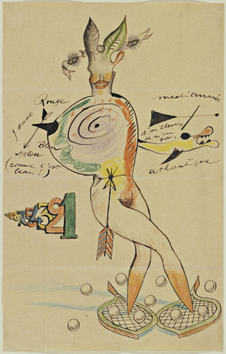
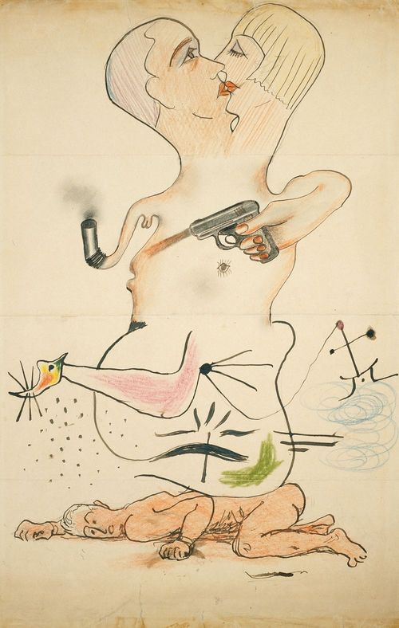
Nude, Yves Tanguy, Joan Miró, Max Morise, Man Ray, 1926-27
Composite drawing of ink, pencil, and colored pencil on paper, 14 x 9”
Collection MoMA, NY
Untitled, Man Ray, Yves Tanguy, Joan Miró, Max Morise, 1928
Pencil, India ink and crayon on paper
Collection Chicago Art Institute
Notes:
CADAVRE EXQUIS (“cadavre x-kee”)
A collaborative, chance-based parlor game
Typically involved four players
Each participant would draw an image (or, on some occasions, paste an image down) on a sheet of paper, fold the paper to conceal their contribution, and pass it on to the next player for his contribution
Taking turns adding onto each other’s drawings and collages resulted in fantastic composite figures
Nude, Yves Tanguy, Joan Miró, Max Morise, Man Ray, 1926-27
The resulting nude female figure combines a humorous and absurd array of features—from leaf ears to snowshoe feet.
A perfect parlor game, involving elements of unpredictability, chance, unseen elements, and group collaboration
All in service of disrupting the waking mind’s penchant for order

Slide 3
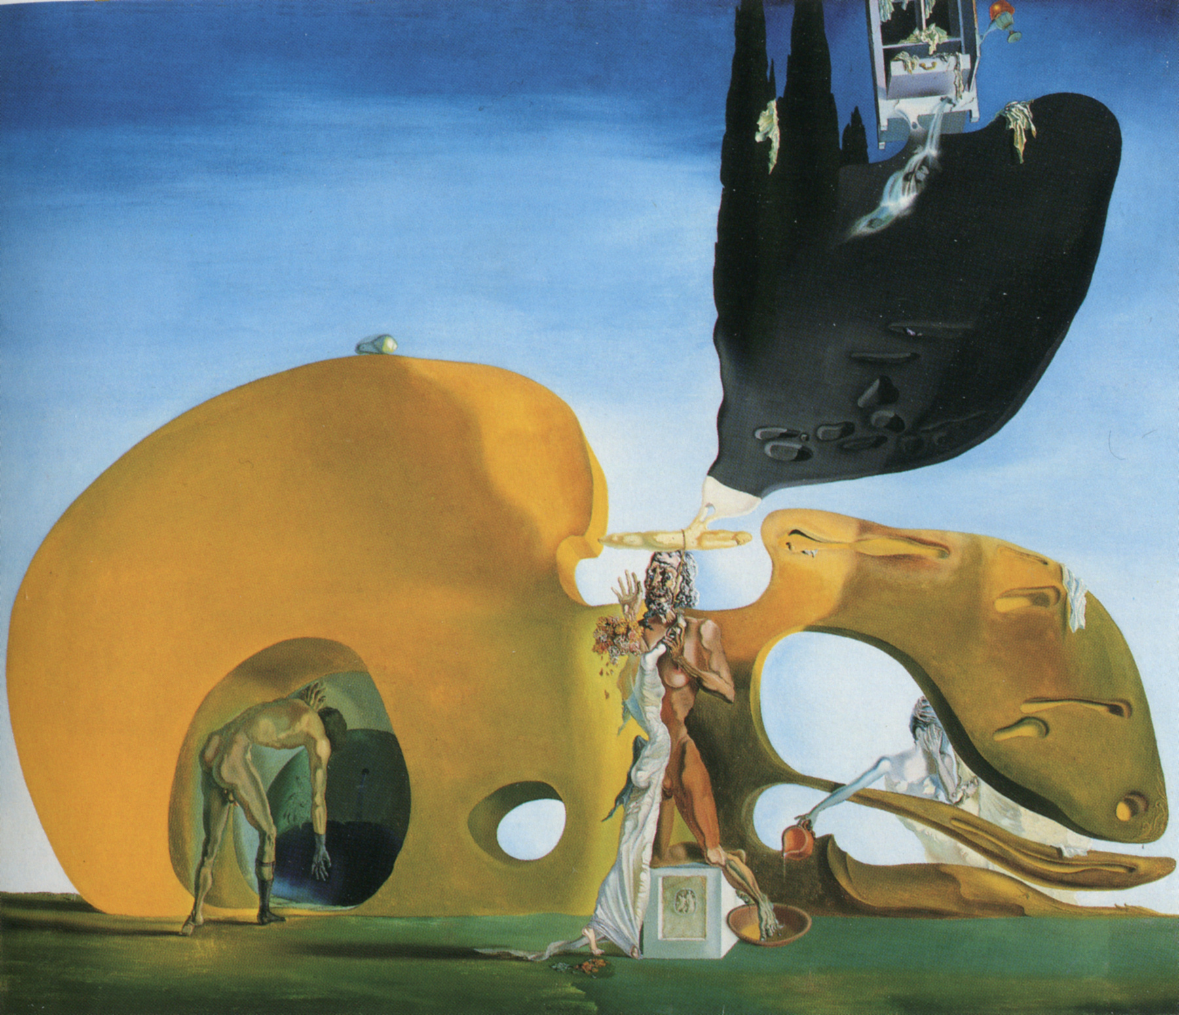
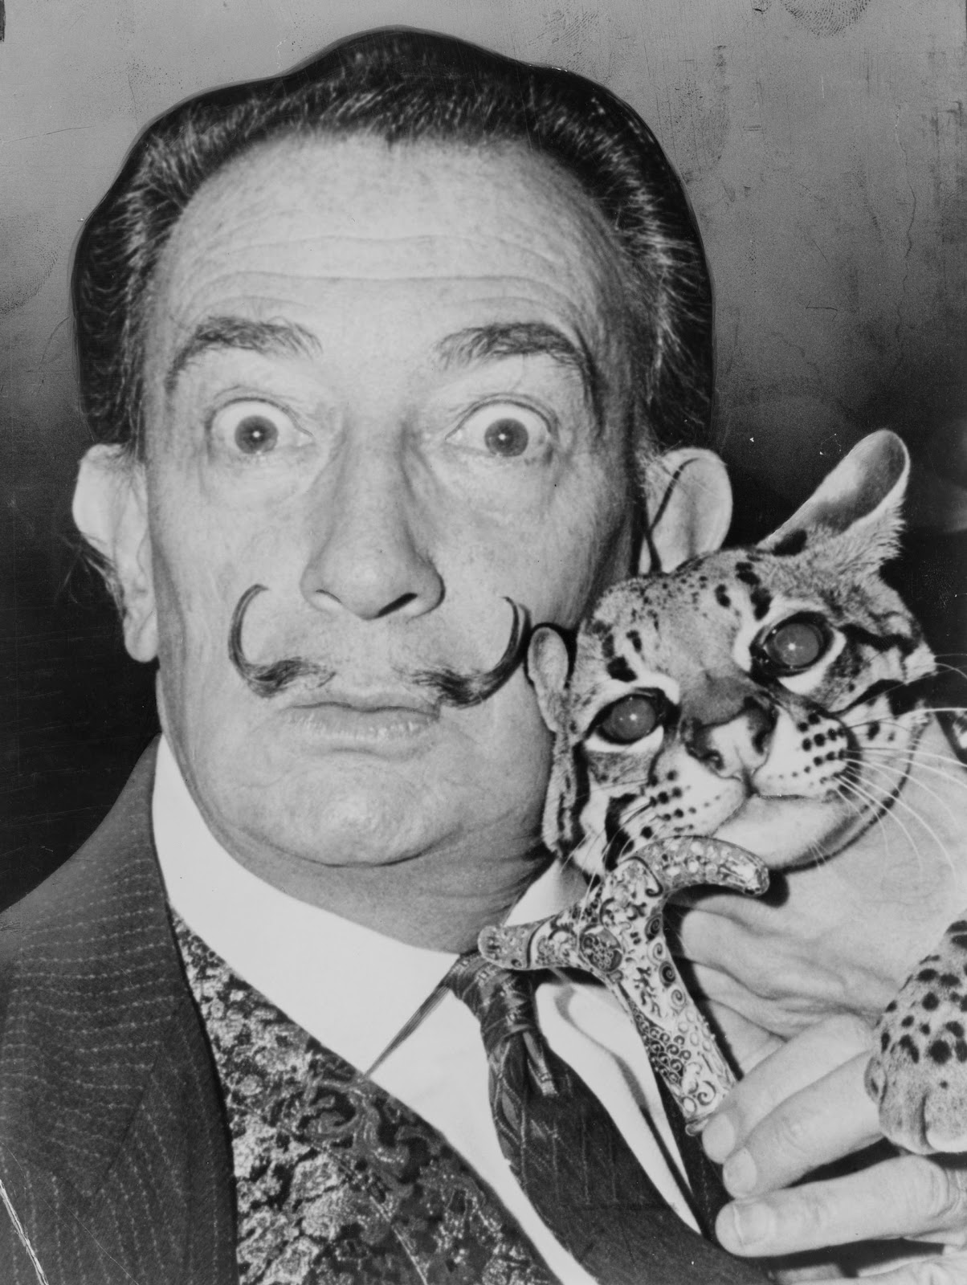
Salvador Dalí, Birth of Liquid Desires, 1931-32
Oil and collage on canvas, 96.1 x 112.3 cm
Collection Solomon R. Guggenheim Museum, NY
Notes:
UNEXPECTED JUXTAPOSITIONS
Biomorphic Surrealism: Miró, Baziotes, and Gorky
Naturalistic Surrealism: Dali and Magritte
Paintings of Dalí have recognizable imagery
Full of figures and forms
Reveal the visual wonders of the subconscious mind
Fantastic and otherworldly
Salvador Dalí, Birth of Liquid Desires, 1931-32
Dalí trained at San Fernando Academy of Fine Arts, Madrid
Master of illusionistic painting
Key themes: Sexuality, Violence, Putrefaction
Juxtaposes alternate realities and objects for a jarring effect
Here we see a large yellow biomorphic form – ambiguous (face, woman’s body, painter’s palette?)
Four figures
Woman in white
Hermaphroditic figure
Two emaciated figures flank them(one entering a cavernous hole)
What is happening here?!
Dali claimed to have painted his nightmares
Okay, so what of them?
Defy rational interpretation
Trigger strong emotions of fear, anxiety, existential angst
Dali the most popular Surrealist painter – he captures popular imagination
The cult of personality looms large with him (see above)

Slide 4
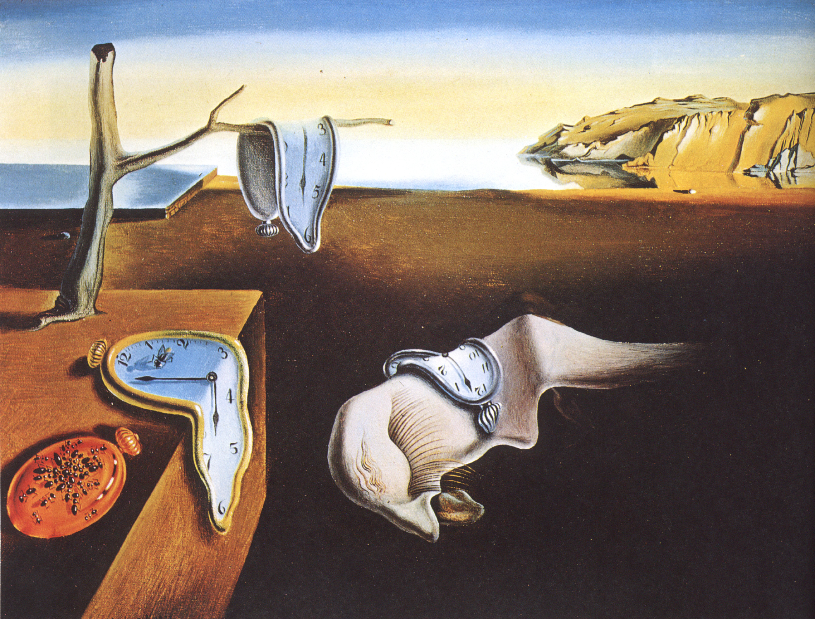
Salvador Dalí, The Persistence of Memory, 1931
Oil on canvas, 9.5 x 13”
Collection MoMA, NY
Notes:
Salvador Dalí, The Persistence of Memory, 1931
Perhaps his most famous painting
Dalí frequently described his paintings as “hand painted dream photographs.”
He based this seaside landscape on the cliffs in his home region of Catalonia, Spain.
The ants and melting clocks are recognizable images that Dalí placed in an unfamiliar context or rendered in an unfamiliar way.
The large central creature comprised of a deformed nose and eye was drawn from Dalí’s imagination
Frequently interpreted as a self-portrait.
What may or may not be a tongue oozes from its nose like a fat snail from its shell
TIME
Time is the theme here, from the melting watches to the decay implied by the swarming ants.
Strange, timeless and placeless landscape (modeled on the hills of Catalonia)
Eerie
Uses what he called “the usual paralyzing tricks of eye-fooling.”
Painted this work with “the most imperialist fury of precision to systematize confusion and thus to help discredit completely the world of reality.”
Enigmatic and surreal
Time malleable
Einstein’s Theory of Relativity published at start of 20th century (1905: special relativity; 1916: general relativity)
Also, general unrest in Europe at the time…time bomb ticking

Slide 5
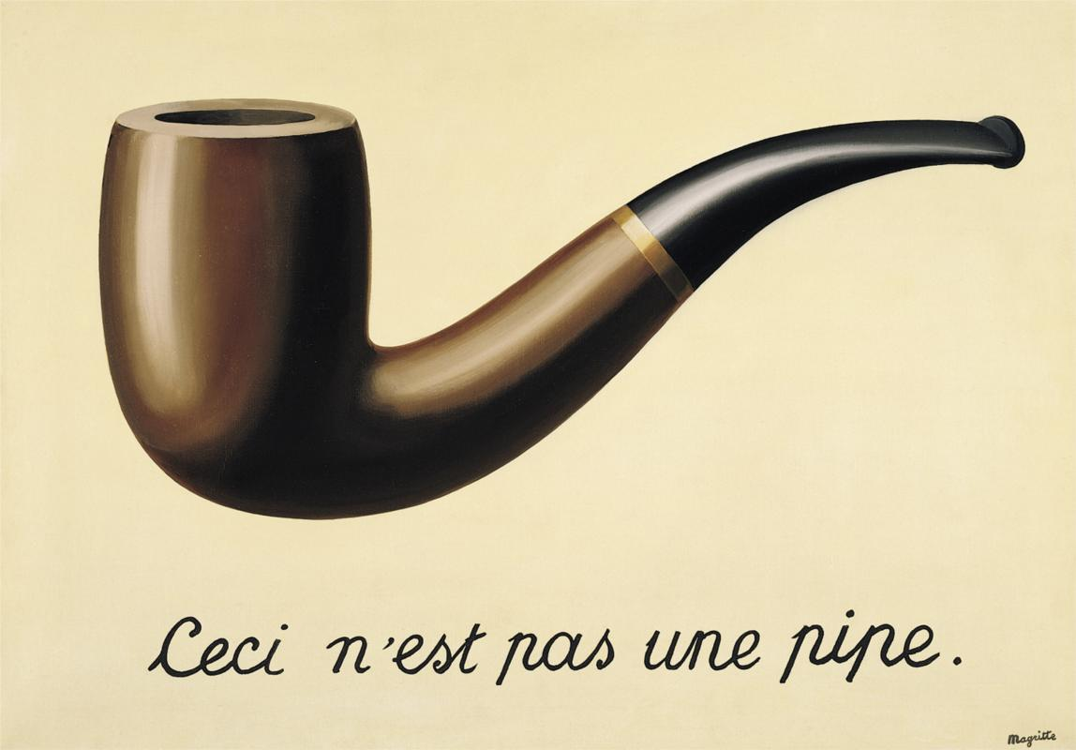
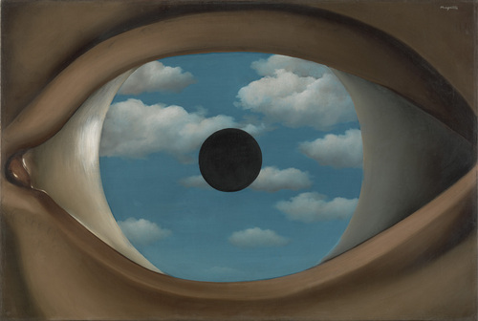
René Magritte, The Treachery of Images, 1928-29
Oil on canvas, 25 x 37”
Collection Los Angeles County Museum of Art
René Magritte, The False Mirror, 1928
Oil on canvas, 21.25 x 32”
Collection MoMA, NY
Notes:
Like Dali, Magritte’s images are a part of popular memory
Belgian painter, printmaker, sculptor, photographer, and film maker
One of the major figures of Surrealism
Arguably the greatest Belgian artist of the 20th century
René Magritte, The Treachery of Images, 1928-29
"The famous pipe. How people reproached me for it! And yet, could you stuff my pipe? No, it's just a representation, is it not? So if I had written on my picture "This is a pipe", I'd have been lying!”
Drawing on the literary side of Surrealism, cheekily questioning the reality of language
The play between the signifier and the signified
Not painting objects, but IMAGES of objects (important distinction, given the history of painting as a “window onto the world”)
René Magritte, The False Mirror, 1928
Dream-like imagery
Title seems to insinuate limits to the authority of optical vision
Mirrors provide faithful visions of their reflections
Eyes are selective and subjective in nature
Several layers here:
We look at the eye
We look through the eye, as a window
We are seen by the eye
This painting was owned by the photographer Man Ray during the 1930s
Described it as as painting that “sees as much as it itself is seen.”

Slide 6
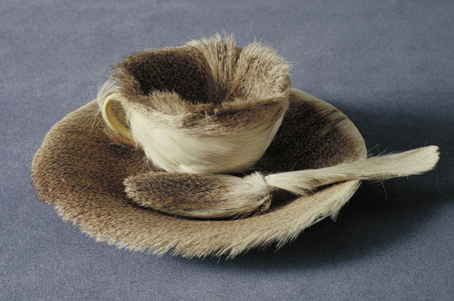
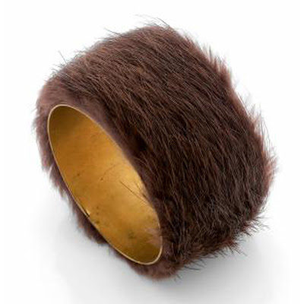
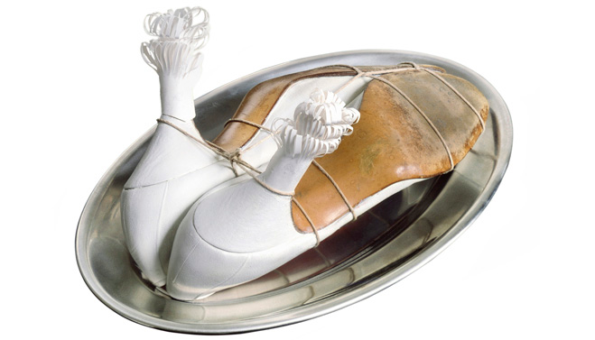
Meret Oppenheim, My Nurse, 1936
Women’s shoes, string, paper, platter
Collection Moderna Museet, Stockholm
Meret Oppenheim, Object, 1936
Fur-covered cup, saucer, and spoon
Collection MoMA, NY
Notes:
MERET OPPENHEIM
Swiss artist born in Germany, lived in Paris
After seeing an exhibition of Bauhaus work, she makes her first Surrealist work (series of pen and ink drawings)
1933: Meets the Surrealists through Alberto Giacometti and Hans Arp
One of only a few women associated with the group
Soon known as the “femme-enfant” of the group
As a woman, thought by the n=male Surrealists to have a more direct and spontaneous access to the world of dreams and the unconscious
Celebrated as the “fairy woman whom all men desire”
Quite an arrangement - how can you be taken seriously as an artist??
Often a model of Man Ray’s photographs
1966: Exhibits with the group until Breton’s death
Meret Oppenheim, My Nurse, 1936
1936: First one-woman show in Basel
Giacometti encouraged her to make Surrealist objects
Created disturbing assemblages from everyday items
Suffused with latent erotic content
Here we see a pair of pumps tied down to a platter
Likened to a nude woman on her back, legs apart, frills on the heels
Speaks to the vulnerability that comes with the trappings of femininity…
Meret Oppenheim, Object, 1936
This Surrealist object was inspired by a conversation between Oppenheim and her friends Picasso and Dora Maar (his then-partner)
Oppenheim was wearing a bracelet covered in fur
Picasso remarked that one could cover anything with fur, to which she replied, "Even this cup and saucer."
As her tea grew cold, she called out “Waiter, a little more fur!”
Soon after, Breton invited her to participate in the first Exposition of Surrealist Objects
Oppenheim then bought a teacup, saucer, and spoon at a department store and covered them with the fur of a Chinese gazelle.
In so doing, she transformed genteel items traditionally associated with feminine decorum into sensuous, sexually punning tableware.
1936: Causes a sensation when presented in the exhibition
Some dubbed it the “quintessential Surrealist object”
Also highly derided
Oppenheim ambivalent – a “youthful joke”
Overwhelmed by the stir, Oppenheim slowed her creative production until the 1960s
A long and prolific career
Sculpture, painting, drawing, poetry, illustration
Explores themes of desire, friendship, love, reality, imagination, and the lives of objects

Slide 7
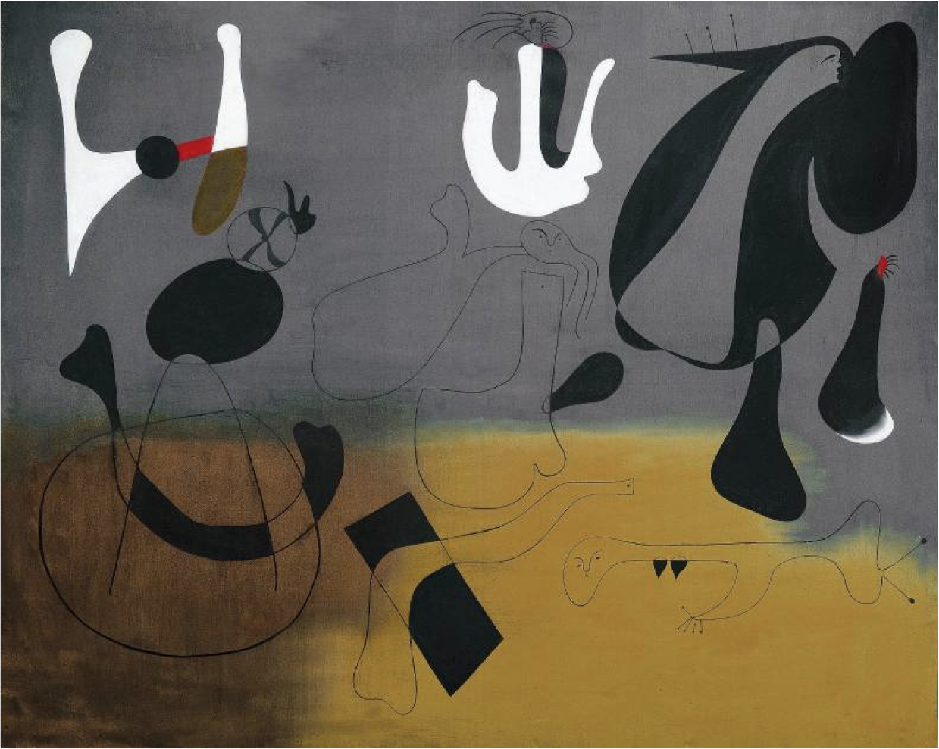
Joan Miró, Composition, 1933
Oil on canvas, 51.25 x 63.5”
Notes:
JOAN MIRO
Catalan painter, sculptor, ceramicist
Born in Barcelona (1893)
Went to business school and began his career as a clerk
Nervous breakdown, abandons business and resumes art studies
1917: Meets Francis Picabia (Dada artist)
PARIS
1920: first trip to Paris
Meets Picasso
Spends his time with poets
1923: Has work in the Salon d'Automne
1924: Joins the Surrealist group
Began experimenting with collage and lithography and etching
1936: Leaves Spain due to Spanish Civil War
State of Spanish citizens dire in the Great Depression (1929-39)
Liberal government finally elected in ‘36
Spanish military tries to organize a coup
Turns against its own people
General Francisco Franco the fascist ruler
Republic saw it as their country being invaded by foreign troops
Brutal and aided by Hitler and Mussolini (Guernica bombed by Hitler)
Thus, a worldwide struggle between fascism and democracy
1941: Returns
1936: Included in MoMA’s Cubism and Abstract Art and Fantastic Art, Dada, Surrealism
One of the most influential artists of modernist abstraction
Joan Miró, Composition, 1933
Based on an earlier collage of fragments from sale catalogues
Image of abstract, biomorphic forms interlocked across the painting’s surface
Primarily black and white linear forms
Ground is a hazy veil of grey and yellow
Creates a tension between the illusion of depth and an emphasis on surface effects
Amoeba-like forms seem to be in continual flux
They waver between purely formal elements and the suggestion of bodily forms or organic entities
Given the time period, the large, dark, and foreboding forms could be seen as invasive and subsuming others
Parallels the rise of fascist violence and cruelty in his home county, and elsewhere in Europe

Slide 8
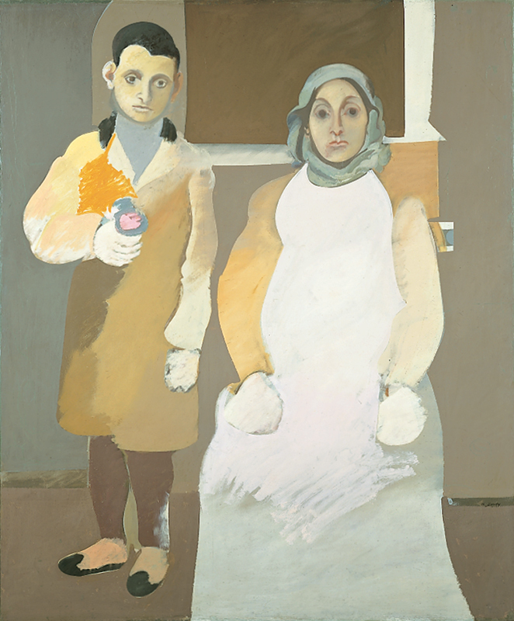
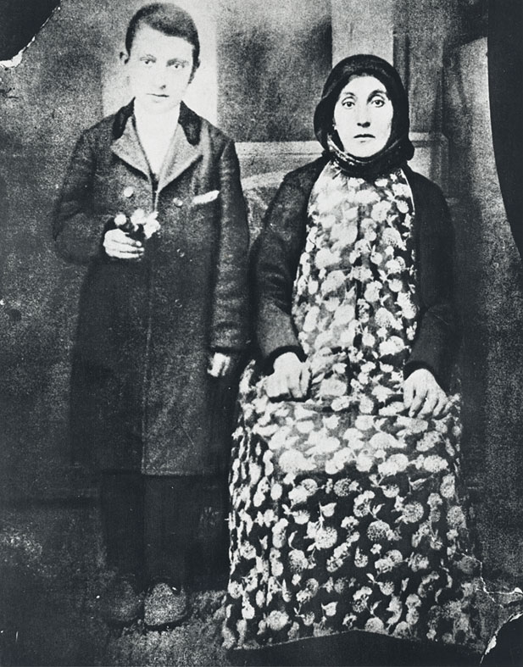
Arshile Gorky, The Artist with His Mother, 1926-36
Oil on canvas, 60 x 50”
Collection Whitney Museum of American Art, NY
Notes:
ARSHILLE GORKY
Born early 20th century in an Armenian province on the eastern border of Ottoman Turkey
1915: As a teenager, he witnessed the Armenian genocide perpetrated by Turkish troops
Drove his family out of their homeland
1919: his mother dies of starvation in his arms
1920: He and his sister eventually emigrate to the US
Changes his name to Arshile Gorky and invents a new life for himself
1924: Settles in NY
Some formal training, but essentially self-taught
Obtained most of his information by visiting museums and reading art books and magazines
Became familiar with avant-garde European art
Systematically studied Cezanne, Picasso, and Miró
Gorky stressed the importance of continuity
An artist can only mature after having completed a time of apprenticeship and study
1930s and 40s: Prominent in the NY art scene
Meets several members of the Surrealist group (they are forced to flee Europe due to war)
Formed a close friendship with Breton
Chilean-born painter Roberto Matta encourages his to improvise and experiment with biomorphic forms (we will see this soon)
Introduces him to the technique of automatic drawing
First, let’s look at an early work…
Arshile Gorky, The Artist with His Mother, 1926-36
Based on photo from 1912
Pathos apparent
Redemption of the memory of his mother
Hands - an erasure, a violence
Muteness (elective silence due to trauma)
Tightly closed mouths
Muted color palette
You can see the influence of Cezanne and Picasso
Abstraction is impending (large, flat areas of color)

Slide 9
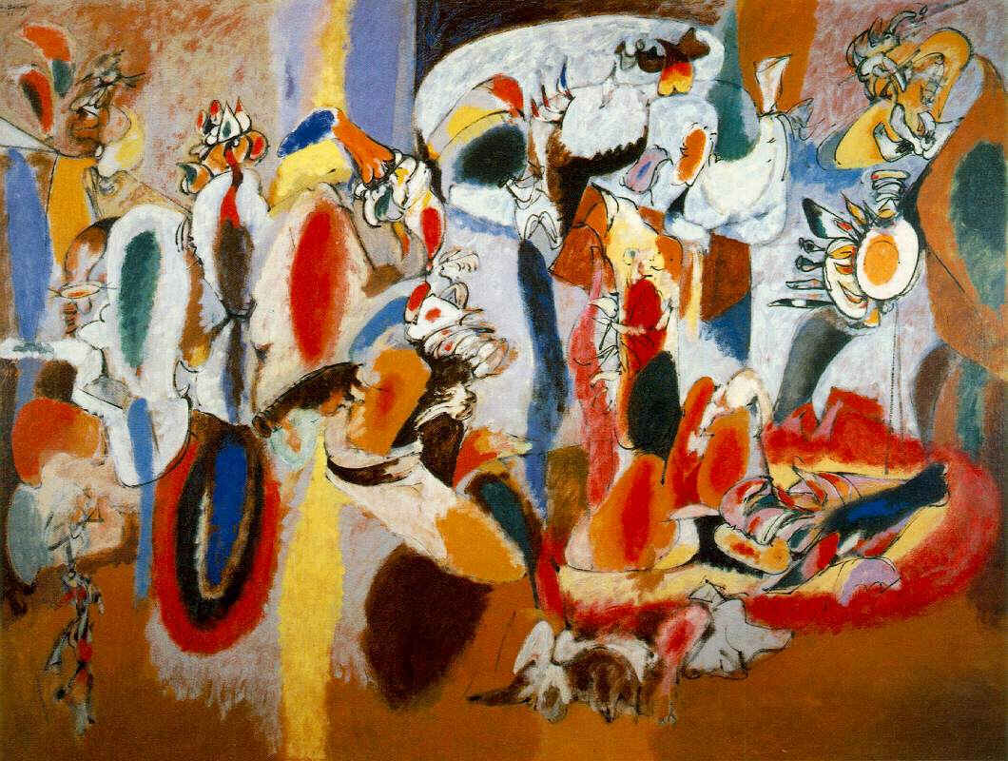
Arshile Gorky, The Liver is the Cock’s Comb, 1944
Oil on canvas, 186 x 249 cm
Collection Albright-Knox Art Gallery, Buffalo
Notes:
Arshile Gorky, The Liver is the Cock’s Comb, 1944
We see this write large in this panting from the 40s
Bridge between abstraction and representation
Brilliant colors!
Biomorphic shapes
One of many innovative landscapes from the 1940s
Abstract vocabulary embraces natural and organic forms
Explosive, erotic energy (enhanced by the predominance of red)
Recall what I mentioned about automatic drawing
Treats his paint as if it is a watercolor
Thin, translucent paint
Looks like seeing through an atmosphere
Allows drips to remain – accidental markings of paint becomes the subject matter (remember automatism of Surrealism?)
Gorky continued to paint highly original abstractions
Combined memories of his Armenian childhood
Especially the gardens, orchards, and wheat fields
Directly observed nature
Very influential in developing Surrealism in America
Seen as a bridge between Surrealism and Abstract Expressionism, which we will dive into on the 20th, after our holiday next week.

Slide 10
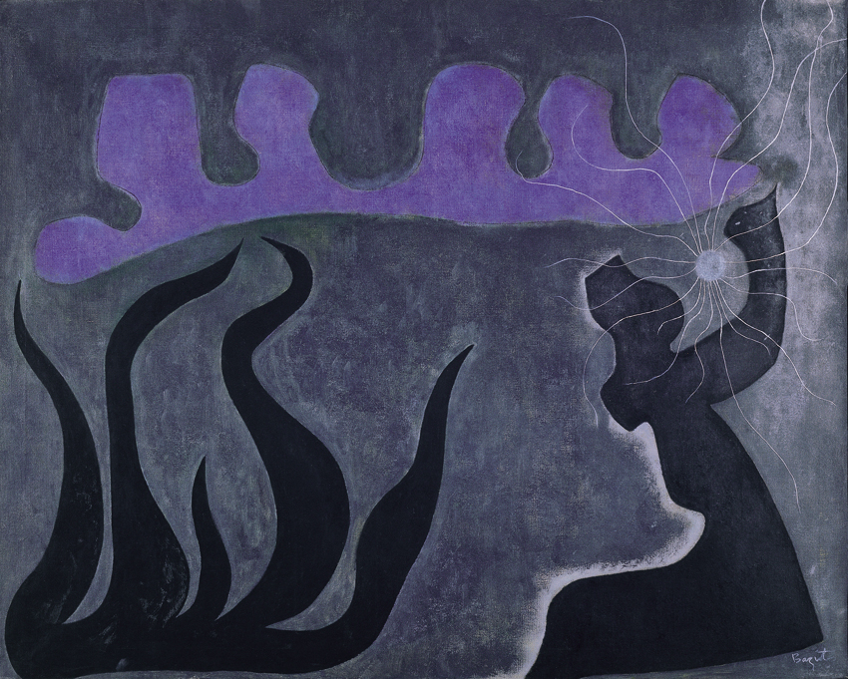
William Baziotes, Sea Phantoms, 1952
Oil on canvas, 41.25 x 60”
Collection MAMFW
Notes:
WILLIAM BAZIOTES
American painter
1912: born Pittsburg
1936-38: Taught through the Federal Art Project
1938-40: Worked on the WPA (Works Progress Administration)
1940s: Becomes close friend of Abstract Expressionist artists Jackson Pollock, Robert Motherwell, and Mark Rothko (contemporaries of Surrealists – we will study them in the coming weeks)
Shared the group’s interest in primitive art and automatism, work is more in line with European Surrealism
Friends with European Surrealists at NYU
1944: First solo exhibition at Peggy Guggenheim’s gallery, Art of This Century
Had a love of ancient Greek art and sculpture (parents were Greek)
Also admired the poetry of Charles Baudelaire
William Baziotes, Sea Phantoms, 1952
This painting included in the 1942 NY Surrealist exhibition
Characterizes his mature style of 1944-62
Enigmatic landscapes with careful attention to spatial arrangements
Shapes seem to float in space, unanchored
No focal point, but an “all-over” composition
Flat forms
Uses a nearly dry brush and thin layers of pigment
Private symbolism
A seascape
The light blue sphere is a recurring theme in his work
Mysterious and moody
Sense of the fantastic
Meant to be enigmatic…
Any artist who unlocks the truth of their imagery “should smash the mirror and whip himself into despair. A despair that only a madman in a cage can ever know.”
As we will see next class, post-war American artists embrace the heroic and dramatic in their work!
As his literary hero, Baudelaire stated, “I have a horror of being easily understood.”
Biomorphic forms (similar in sensibility to Miró and Gorky)

Slide 11
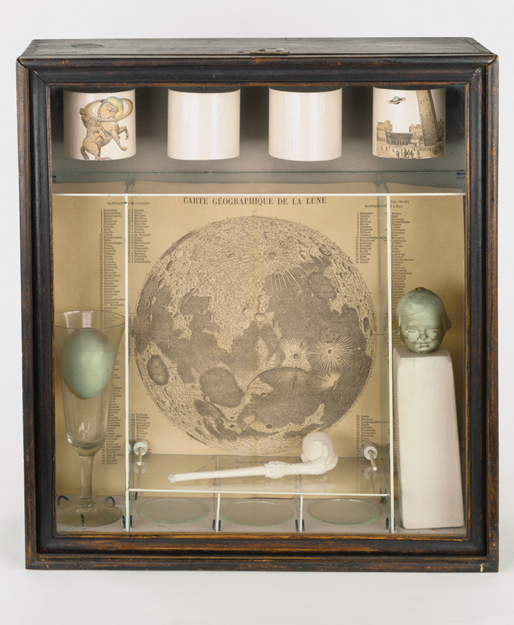
Joseph Cornell, Untitled (Soap Bubble Set), 1936
Mixed Media
Notes:
JOSEPH CORNELL
An American sculptor greatly influenced by the Surrealists
1903: Born Nyack, NY
1917-21: Studies at Phillips Academy, Andover, MA
1929: Moves to Flushing, spends rest of life there
Known for being a recluse
Worked as a textile salesman as a young man
1931: Loses his job as a salesman
1929: Begins to make montages of engravings
No formal training
That winter he finds Julian Levy’s gallery and introduces himself and his work
1932: Begins producing his shadow boxes, one of which is in our collection
We will see it next, first…
Joseph Cornell, Untitled (Soap Bubble Set), 1936
Earliest hand-made box assemblage
Formed part of a larger installation at the fantastic Art, Dada, Surrealism exhibition at MoMA (organized by Alfred H. Barr, Jr.
Incorporates the hallmarks of much of his work
Series of compartments containing objects
Arcane engraved images
The whole is unified by various conceptual and visual associations
Here, we see four cylindrical weights, an egg in a wine glass, a cast of a child’s head, a clay pipe, and a detailed map of the moon
Clay pipe – references soap bubbles / childhood
For Cornell the soap bubble also referenced the contemplation of the cosmos (see lunar map)
Circular repetition in all of the visual elements
Loose associations bear an affinity with Surrealist art
No interest in the subconscious and psychology, however
In fact, he wrote to Barr prior to the exhibition to distance himself from mainstream Surrealism
Also no interest in erotic themes favored by the group
French movement acted as more of a catalyst, rather than a model

Slide 12
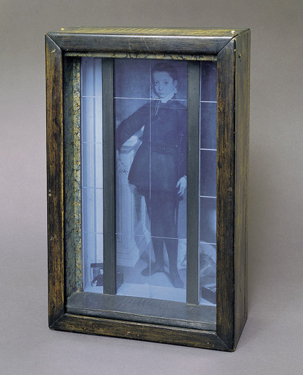
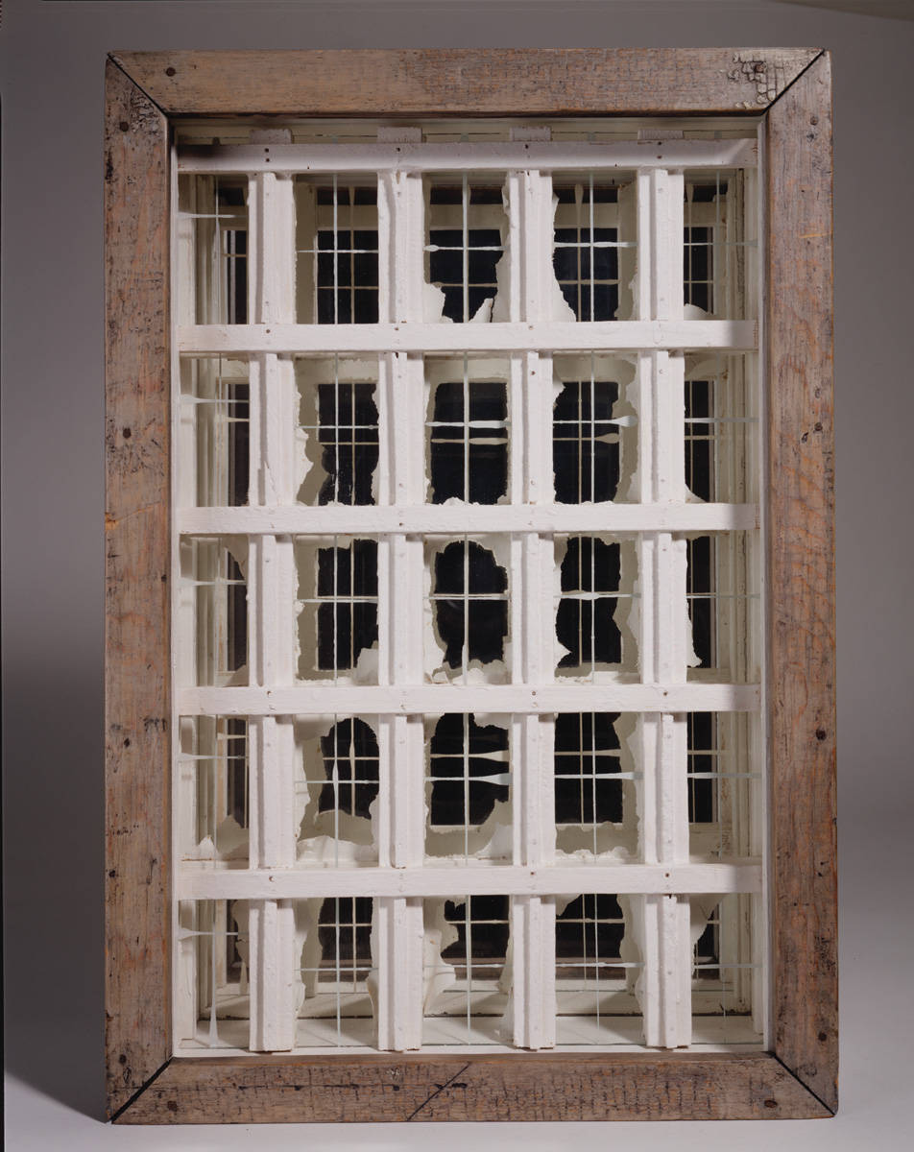
Joseph Cornell, Untitled (Window Façade), 1950-52
Joseph Cornell, Untitled (Medici Boy), 1953
Wood, glass, oil, and paper, 18.25 x 11.5 x 5.5”
Collection MAMFW
Notes:
Joseph Cornell, Untitled (Medici Boy), 1953
Enigmatic image of a young boy
Sequestered within a box, also behind a grid of lines – a protective cage?
Dreamlike
Who is this?
NOT a Medici prince, but a Renaissance portrait of a young boy
The Medici were highly influential in the Italian Renaissance
Patrons of Raphael, Michelangelo, Donatello, etc.
A very wealthy and powerful banking family
“Princes” of the Republic of Florence
Does have the feel of a Medici portrait
Actually a reproduction of Portrait of Marchese Massimiliano Stampa (1557) by female artists Sofonisba Anguissola
Nine year old nobleman
Not a jab at art history, like L.H.O.O.Q.
Simply used to make connections in our minds
A sense of history exudes from the image
1935: Learns woodworking from a neighbor so that he can custom-build his wooden boxes for assemblage
Only occasionally used found boxes
Also made films – highly re-edited versions of popular films
Incongruous transitions
Breaks original narrative sequence
We will see this strategy again in the film and video works of the 1980s
1935: These works included in first Surrealist group show in America – Wadsworth Atheneum
1936: Work included in MoMA’s Fantastic Art, Dada, Surrealism
Meets many of the Surrealists at Julian Levy Gallery, NY
Also meets Duchamp
1936: Begins to make glazed handmade-boxes containing mysterious assemblages of objects
These have a poetic association
“memory-box”
Uses clay pipes, wine glasses, engravings, mirrors, and astronomical maps
Influenced by Max Ernst’s collages
Victoriana flavor to his works
Allusions to opera or ballet (careful revealing and concealing; theatricality)
Imagery related to 19th century Romantic and Symbolist writers
A sense of a bygone era
Inspired by the Duchampian “readymade”
Cornell elevated the found object/image
Created a new paradigm of the artist as collector/archivist
MATERIALS
Made frequent trips to NY secondhand shops
Magazines
1940s: Pays more attention to his writing – contributes to a number of journals
1940s: Tends to work in themes
For example, a series called Pharmacy showcases small glass bottles filled with an assortment of objects
Birds are also very prevalent during this time
1950s: Produces illustrations and designs layouts for Vogue and House and Garden
Also produces a number of austere, black and white abstract boxes inspired by Mondrian’s work (see above)
Moved to collage in the 1960s

Slide 13
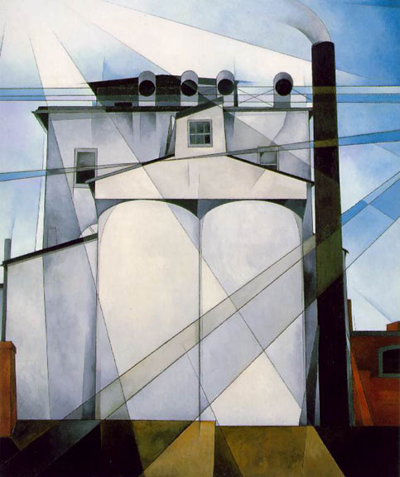
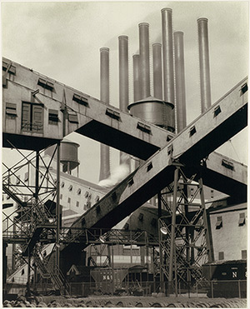
Charles Demuth, My Egypt, 1927
Oil on fiberboard, 35.75 x 30 “
Collection Whitney Museum of American Art, NY
Charles Sheeler, Criss–Crossed Conveyors, River Rouge Plant, Ford Motor Company, 1927
Gelatin silver print
Notes:
AMERICAN MODERNISM, PRE-WWII
The influence of the Armory show on American art is undeniable
American Modernism
Prior to WWII, not as progressive as their European counterparts (Picasso, Matisse, Surrealists, etc.)
Didn’t use abstraction as rigorously as the European modernists did
Tended to utilize elements of the European avant-garde, but very conservatively
We begin to see a hard-edged abstraction
PRECISIONISM
Not a formal group
United via subject matter and style
Circa 1920, artists around American began to experiment with a highly controlled approach to technique and form
Reduced their compositions
Simple shapes underlie geometrical structures
Clear outlines and minimal detail
Smooth handling of surfaces
Influenced by contemporary American photographers
Utilizing sharp focus and lighting
Unexpected viewpoints
Cropping
An emphasis on the abstract form of the subject
Borrow from Futurism’s celebration of technology
Imbue their compositions with dynamic speed
Important to note that the group did distance themselves from European artists
Selected subjects from the American landscape and regional American culture
Included elements unique to early twentieth-century life
Urban settings (particularly the dramatic engineering advances of skyscrapers and suspension bridges)
The sprawling industrial locales of steel mills, coalmines, and factory complexes
Charles Demuth
During the first decades of the 20th century, face of urban American drastically changes
Skyscrapers and factories boom
Artists like Demuth saw them as symbols of invention, modern technology, and America’s expanding wealth
You can see he is looking to Cubism’s geometric simplifications and faceted, overlapping planes
Charles Demuth, My Egypt, 1927
Concrete grain storage elevators in Demuth’s hometown of Lancaster, PA
Monumental and heroic
Crossed by strong diagonals of light
Conveys a sense of the might of American agriculture and industry (remember, this is during the Great Depression)
Uses geometry to unite American architecture with the ancient pyramids of Egypt
America’s crowning achievement
Charles Sheeler
American, born 1883 Philadelphia
Traditional training
Travels to Europe in early 1900s
Develops interest in Italian paintings of the late Middle Ages (Giotto, Masaccio, Piero della Francesca)
Simple, strong massing of forms
Visits Paris home of Sarah and Michael Stein
Big Picasso and Braque patrons
Works in a Cubist style for several years
Works as a freelance photographer in Pennsylvania
Taught himself photography
Begins photographing the interior of his home
Realistic painter and photographer
Looked to uncover the coherence in the forms of indigenous American architecture
Abstracted images
Not the teeth of the European avant-garde
Charles Sheeler, Criss–Crossed Conveyors, River Rouge Plant, Ford Motor Company, 1927
Series commissioned by Ford through an ad agency
Widely reproduced in Europe and America in the 1920s
A striking image of technological utopia
Speaks to the supposedly transcendent power of industrial production in the early modern age

Slide 14
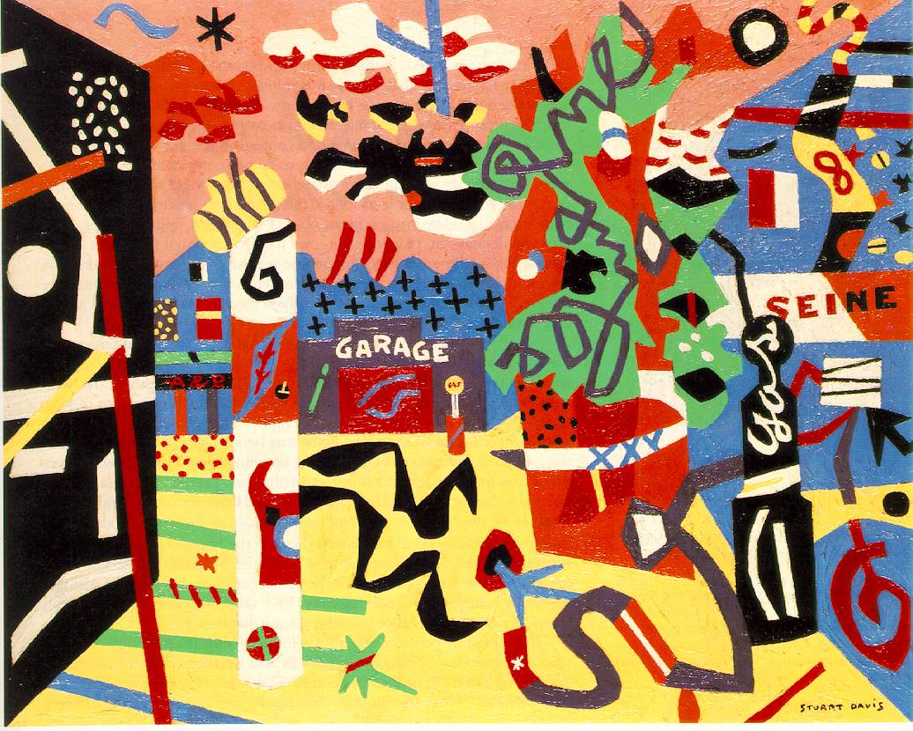
Stuart Davis, Report from Rockport, 1940
Oil on canvas, 24 x 30”
Collection Metropolitan Museum of Art, NY
Notes:
STUART DAVIS
Davis born 1892, Philadelphia
1910-13: Studies with Robert Henri in New York
Leader of the Ashcan School of American Realism
Organizer of the group known as “The Eight”
A loose association of artists who protested the restrictive practices of the conservative National Academy of Design (sounds like the French Salon issue, no?)
His teachings emphasized the importance of social subject matter
Davis takes this up in his own work
1913-16: works as a magazine illustrator for "The Masses”
1927: Davis has turned away from realism with his Cubist-inspired paintings
Often includes words and letters in his compositions.
1928-29: A trip to Paris in 1928–29
Begins to develop the style of nature-based abstraction that was to characterize his mature work.
Stuart Davis, Report from Rockport, 1940
Considered among Davis's most important works from the 1940s
It is a pivotal work, as it was the first in which he utilized his newly articulated "color-space" theory.
Davis postulated that color could be used to indicate spatial relationships through its positioning next to other colors.
We will see this with Hans Hoffman’s theories soon…
Some colors advance, while others recede, which suggests the illusion of a three-dimensional space on a two-dimensional surface.
A profusion of colors, lines, shapes, and decorative patterns almost obscures identification of the scene — the town center at Rockport, Massachusetts
Composition is filled with gas pumps, trees, and storefronts
A yellow road leads the viewer's eye back to the garage, situated in the middle distance
Flat, but with depth suggested through color, primarily
In addition to these recognizable elements, the surface is covered with words, letters, and random lines that create an allover feeling of movement and speed
Quite different from the Futurists, however!
The disjunction of so many elements and colors successfully conveys the vitality of modern American life.
1930s: Davis teaches at the Art Students League in New York
Employed by the mural division of the Works Progress Administration's Federal Art Project.

Slide 15
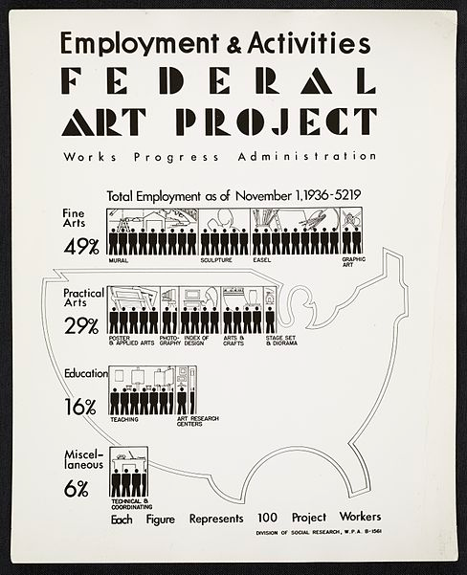
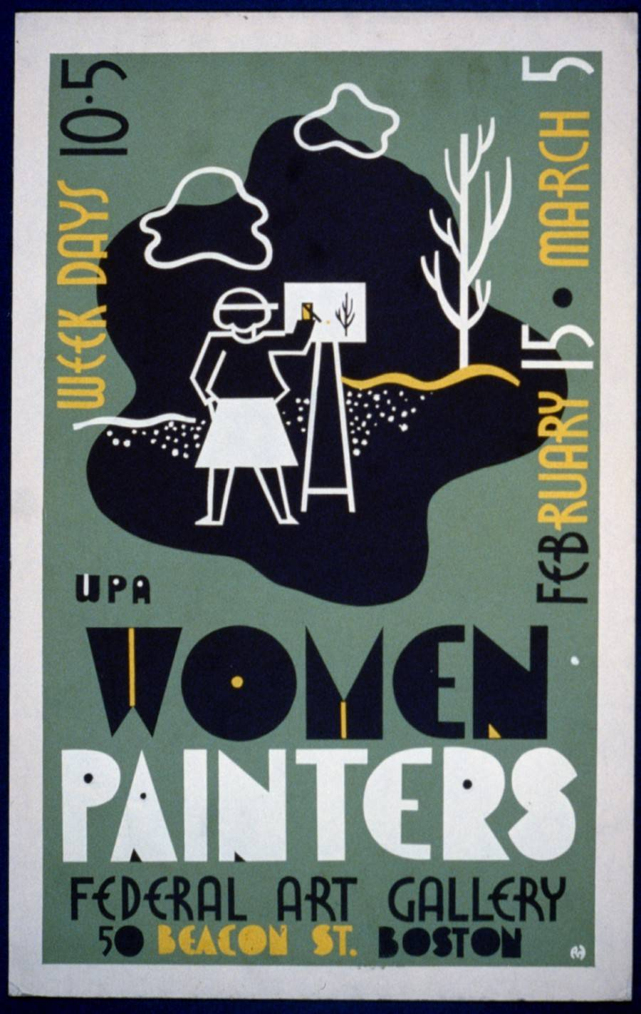
Notes:
WPA
The Federal Art Project (FAP) is the visual arts arm of the Great Depression–era New Deal Works Progress Administration program
August 1935-June 1943
Created more that 200,000 separate works
Posters, murals, paintings
Some are extant
No distinction was made between representational and abstract art
Of course, abstraction was not yet in favor in America of the 30s and 40s
As a result, the program supported artists such as Jackson Pollock before their work could earn them an income
Primary goals
To employ out-of-work artists
To provide art for non-federal government buildings: Schools, hospitals, libraries, etc.
FAP artists received $23.86/week (a Woolworth’s clerk earned $11/week)
Fostered a sense of community amongst artists (remember, there is not the café culture of Paris…New York had a little of it)
Conveyed the importance of art to the country – faith in art
Work divided into art production, art instruction, and art research
So many well-known artists took advantage of this program:
William Baziotes
Romare Bearden
Thomas Hart Benton
Stuart Davis
Arshile Gorky
Adolph Gottleib
Philip Guston
Marsden Hartley
Jackson Pollock
Ad Reinhardt
Ben Shahn
The list goes on…
As a result of all this money going to the arts, artistic communities begin to blossom
NYC: many things begin to form
Art Students League
Hans Hofmann School of Fine Arts
Cedar Tavern
These all become very important in the formation of Abstract Expressionism
Again, we will delve into this in our next class

Slide 16
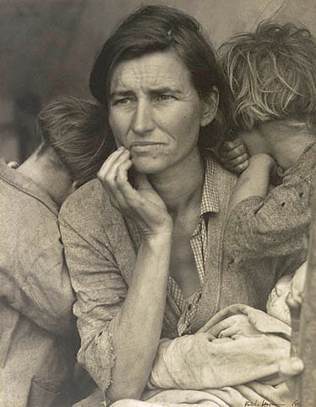
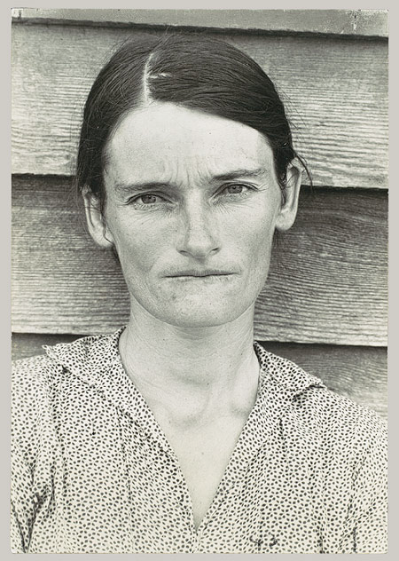
Dorothea Lange, Migrant Mother, Nipomo, California, 1936
Gelatin silver print
Walker Evans, Alabama Tenant Farmer Wife, 1936
Gelatin silver print
Notes:
FSA PHOTOGRAPHY
Resettlement (later Farm Security) Administration, a New Deal agency in the Department of Agriculture
RA/FSA photographers assigned to document small-town life
Worked to demonstrate how the federal government was attempting to improve the lot of rural communities during the Depression
So, propaganda – an ideological agenda
From their first appearance in magazines and books in the late 1930s, these direct, iconic images entered the public's collective consciousness and are now deeply embedded in the nation's shared visual history of the Depression
Dorothea Lange, Migrant Mother, Nipomo, California, 1936
Documents migratory farm laborers escaping dustbowl conditions during the Great Depression
Nipomo, California, Lange meets Florence Owens Thompson and her children in a camp
“I saw and approached the hungry and desperate mother, as if drawn by a magnet. I do not remember how I explained my presence or my camera to her, but I do remember she asked me no questions. I made five exposures, working closer and closer from the same direction”
One photograph from that day, now known as Migrant Mother, was widely circulated to magazines and newspapers at the time and became a symbol of the plight of migrant farm workers during the Great Depression
“She and her children had been living on frozen vegetables from the field and wild birds the children caught. The pea crop had frozen; there was no work. Yet they could not move on, for she had just sold the tires from the car to buy food.”
Walker Evans, Alabama Tenant Farmer Wife, 1936
Most of Evans' early photographs reveal the influence of European modernism
Formalism and emphasis on dynamic graphic structures.
He gradually moves away from this highly aestheticized style
Develops his own notions of realism, of the spectator's role, and of the poetic resonance of ordinary subjects
Aims to distill the essence of American life from the simple and ordinary
1935-36: The Depression years most productive for Evans
June 1935: he accepts a job from the U.S. Department of the Interior
Aim is to photograph a government-built resettlement community of unemployed coal miners in West Virginia
He quickly parlayed this temporary employment into a full-time position as an "information specialist" in the Resettlement (later Farm Security) Administration, a New Deal agency in the Department of Agriculture
1936: Took leave and went South with a friend to photograph a story on sharecroppers for Fortune magazine
Evans made the vast majority of his Hale County photographs in and around the four-room cabin of Floyd and Allie Mae Burroughs
Lived there on and off for several weeks in August 1936
The family owned nothing—not their home, land, mule, or farm tools, all of which they leased from their landlord.
Burroughs was a cotton "sharecropper" or "halver”
At harvest time, he had to give his landlord half his cotton and corn crop, and pay off any other debts incurred during the year for food, seed, fertilizer, and medicine.
In 1935, the family had ended the year $12 in debt.
Dire times for farmers, and many Americans
Evans seeks to express that via photographic images
This image THE ICON of the Great Depression
Evans made four photographs of Allie Mae Burroughs against the rear wall of the family's cabin.
Although compositionally similar, they record distinct facial expressions
1938: Evans selected for his seminal publication, American Photographs, the negative that shows Allie Mae at her most content, welcoming, and accessible.
But in Let Us Now Praise Famous Men, Evans presented a more closed and irritated Allie Mae (see above)
A troubled victim of both the Depression and the camera's burrowing eye.
It is this portrait, with the psychological ambiguity of a Mona Lisa, which was seized upon by early reviewers as the book's quintessential image.
As a series, these photographs seem to have elucidated the whole tragedy of the Great Depression; individually, they are intimate, transcendent, and enigmatic.
For many, they are the apogee of Evans' career in photography.

Slide 17
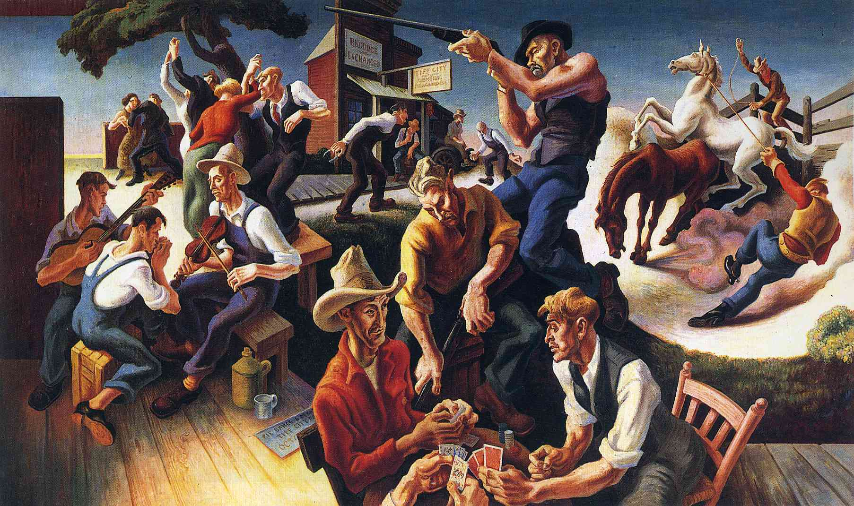
Thomas Hart Benton, The Arts of the West, 1932
Oil on canvas
Collection New Britain Museum of American Art, CT
Notes:
AMERICAN REGIONALISM
Concurrently, American Social Regionalism is happening:
With the Great Depression, American painters make Social Realism their own
An international art movement (not to be confused with Socialist Realism, a Russian style institutionalized by Stalin in ‘34 and supported by Communist governments)
Springs from 19th century European Realism we studied in our last class
Artists like Courbet and Millet
Interest in working class and poor
Effects of industry on the common person
American Social Realists aimed to expose the everyday conditions of the working classes and the poor
A sense of criticality of the social structures that maintain these conditions
Often a heavy dose of regional pride and celebration
More of a descriptive realism
An anti-modernist movement that sprouted in the American Midwest in the late 1920s / early 30s
A response to the modernism they saw coming out of Europe and metropolises like New York City
Heavy focus on local subject matter
Simple, realistic, easily comprehendible style
In the wake of the Great Depression, provides solace to the people
“I wallowed in every cockeyed ‘ism’ that came along, and it took me ten years to get all that modernist dirt our of my system.”
The sense of a return to something truly American
Thomas Hart Benton, The Arts of the West, 1932
Benton begins his career under the influence of the Old Masters
Then emulates the avant-garde abstraction he sees coming out of Europe
Spends time in Paris in the early 1920s
Upon returning to New York, declares himself an “enemy to Modernism”
Finally lands on “Regionalism”
You can see here the individualism and ruggedness of the American west – the ideal
Benton actually the mentor of the young Jackson Pollock, which we will discuss in more depth later
Very different approach to the issue of representation than we’ve been seeing
Fluid, sculpture-like figures
A rhythm and slow pace to his compositions
Movement and energy are palpable
Vignettes of American life, as it is lived
This painting is part of a larger series titled “The Arts of Life in America”
Large murals painted for the Whitney Museum of American Art
Each section of the country has a mural
Painted at the height of the Great Depression.
Roosevelt was campaigning for the White House.
Prohibition was the law of the land -- Bootlegging of illegal alcohol was big business, especially in the cities.
For this project, he took sketching trips by car in the 1920s and 1930s through various sections of the country, getting to know each region
Benton was born in Neosho, Missouri
Absorbed the life of the western frontier
Although he later spent much time in cities (Washington, D.C., Chicago, Paris, New York for 20 years), he never forgot his rural roots

Slide 18
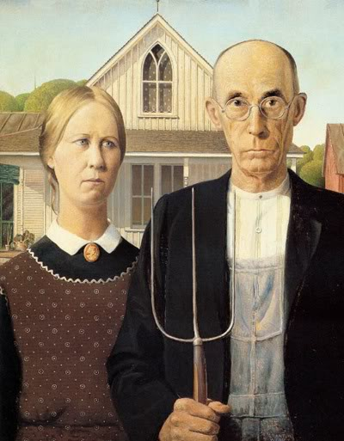
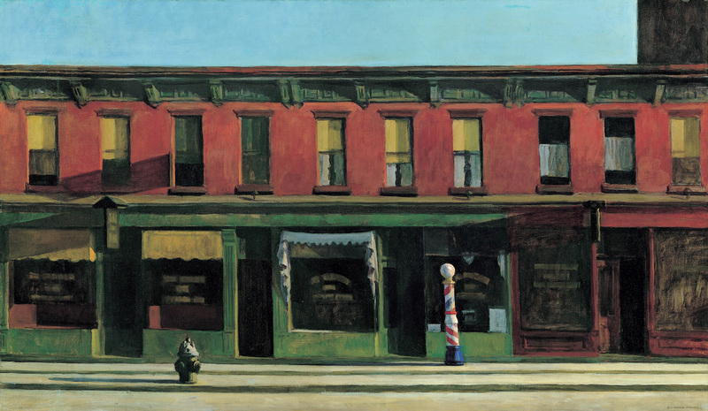
Edward Hopper, Early Sunday Morning, 1930
Oil on canvas, 35.25 x 61.25
Collection Whitney Museum of American Art, NY
Grant Wood, American Gothic, 1930
Oil on Beaver Board, 30.75 x 25.75”
Collection Art Institute of Chicago
Notes:
GRANT WOOD
Born Animosa, Iowa (1891)
Realistic figurative style
Celebration of American Midwestern culture
Plain, no-nonsense, authentic, honorable
Grant Wood, American Gothic, 1930
Iconic image
Exhibited publicly for the first time at the AIC
Wins a $300 prize and instant fame for the image and the artist
Why??
Gothic revival window in the farmhouse behind the couple
Aims to demonstrate that the values of the pioneers were still being upheld – in the Midwest
The impetus for the painting came while Wood was visiting the small town of Eldon in his native Iowa.
Saw a little wood farmhouse, with a single oversized window, made in a style called Carpenter Gothic.
“I imagined American Gothic people with their faces stretched out long to go with this American Gothic house,”
He used his sister and his dentist as models for a farmer and his daughter, dressing them as if they were “tintypes from my old family album.”
NOSTALGIA!
The highly detailed, polished style and the rigid frontality of the two figures were inspired by Flemish Renaissance art, which Wood studied during his travels to Europe between 1920 and 1926.
After returning to settle in Iowa, he became increasingly appreciative of midwestern traditions and culture, which he celebrated in works such as this.
Often understood as a satirical comment on the midwestern character, quickly became one of America’s most famous paintings and is now firmly entrenched in the nation’s popular culture.
Wood intended it to be a positive statement about rural American values
An image of reassurance at a time of great dislocation and disillusionment.
The man and woman, in their solid and well-crafted world, with all their strengths and weaknesses, represent survivors.
EDWARD HOPPER
Portrays American life, lived by real people
Often only a few, or no, people populate his images
He did have a figure at a window, but painted it out, as the architecture conveyed his feelings
Edward Hopper, Early Sunday Morning, 1930
Example of American Social Realism
Based on an experience of an early morning walk in Greenwich, NY
An ambiguous scene as key details such as road signs are left out - it could be anywhere in the United States
A barber shop is the only sign of business or even any life within the area.
Quiet and idyllic
Or a comment on the Great Depression
Many businesses tanked, but places like barber shops often thrived
This painting is an example of his striking use of light to create an otherworldly mood.
Silence and emptiness
It is stark and efficient and conveys a sense of desolation
COMPOSITION AND SHADOW
The shops extend in a continuous line beyond the confines of the picture and reinforce the horizontal format of the canvas
Emphasizes the ubiquity of small-time businesses in the United States.
On the upper-right corner of the picture, the dark brown passage of paint suggests the side of a large building
Indicates the possible encroachment of the corporate world on this sunny block.
Other shadows that are also cast from the right subtly imply that the small-time shopkeeper, the Progressives' symbol of the individual and the early nineteenth-century American ideal, is in conflict with larger, less clearly defined forces.
“Sunday” was not a part of the original title – connotes closure due to religious convictions – added by someone else
Hopper not opposed to it, but it does change the meaning
Saw it as “an almost literal translation of 7th Avenue” in New York

Slide 19
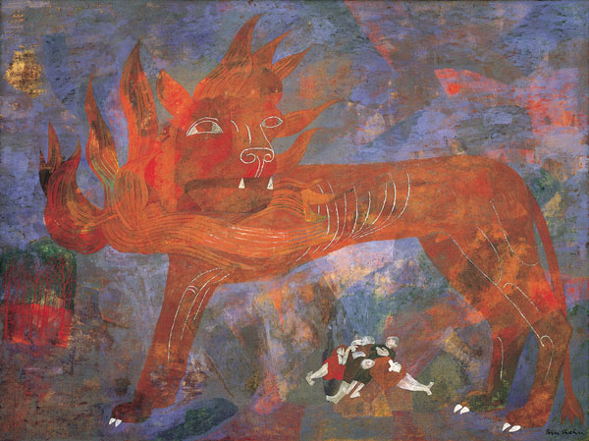
Ben Shahn, Allegory, 1948
Oil on board
Collection MAMFW
Notes:
BEN SHAHN
Shahn also a Social Realist
Lithuanian-born
Comes to America as a young child
Leftist politically
Began as a graphic designer and lithographer
Primary medium is egg tempera (thin, hence the layers you see here)
Made the “European Pilgrimage”
Also influenced by contemporaries such as Diego Rivera and Walker Evans
Explored polemic themes of modern urban life, organized labor, immigration and injustice
Compassionate tone
Ben Shahn, Allegory, 1948
Has a unique symbolism
Here, a lion with a fiery mane standing in an abstract red, blue, green and purple landscape
A bright red-orange thicket of trees in the bottom left corner
Sleeping (or dead) pile of people rest beneath the lion
What type of allegory is this?
On January 16, 1947, a fire killed four children in the attic of a tenement on the west side of Chicago
After losing four of his children, James Hickman, who told his surviving son that people were not meant to burn, shot the landlord, David Coleman, and killed him
The case was far more complicated than a simple homicide, though
Hickman alleged that the landlord had previously threatened to commission an associate to burn the house down if the Hickman family did not move out.
The Hickman’s were African-American
Rampant racism in Chicago
No agency
Connects this tragedy to the Holocaust, which had just ended in Europe

Slide 20
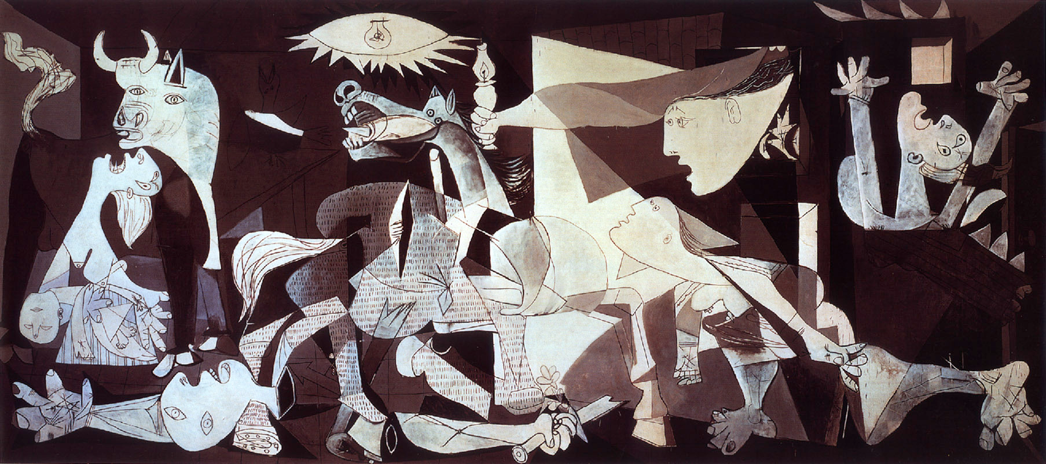
Pablo Picasso, Guernica, 1937
Oil on canvas, 11 x 23’
Collection Reina Sofia, Madrid
Notes:
Given we are talking about the war, let’s look at several artists who are making bold political statements against it:
Artists like Picasso express their horror…
“Painting is not done to decorate apartments. It is an instrument of war for attack and defense against the enemy.” –Picasso
Pablo Picasso, Guernica, 1937
Stark and gruesome picture painted in 1937
With the Spanish Civil War raging, the Spanish Republican government in exile in Paris
January: Ask Picasso to paint a mural for them to fill the Spanish Pavilion of the Paris International Exposition that summer
April: The small town of Guernica (a holy city) bombed by Nazis
Hitler, along with Mussolini, was supporting Franco and his fascist regime
Over 7000 dead – all innocent civilians
Picasso in grief and horror
Paints this image in response to the senseless devastation of his homeland
Depicts an on-the-ground experience of the bombing
Horror, confusion, anguish all around
Simulated newspaper print – this is how the world learned of this atrocity
Horse = Humanity
Bull = Brutality and Darkness
Dead babies and maimed women
Light Bulb = recalls the sun, or an eye
Minimalist palette - the horror takes top billing
Black background – no hope
Picasso loaned this canvas to MoMA for years
Stipulated that is should be given to Spain only when democracy restored
1975: Franco dies
1981: painting given to Spain, now at Reina Sofia in Madrid

Slide 21
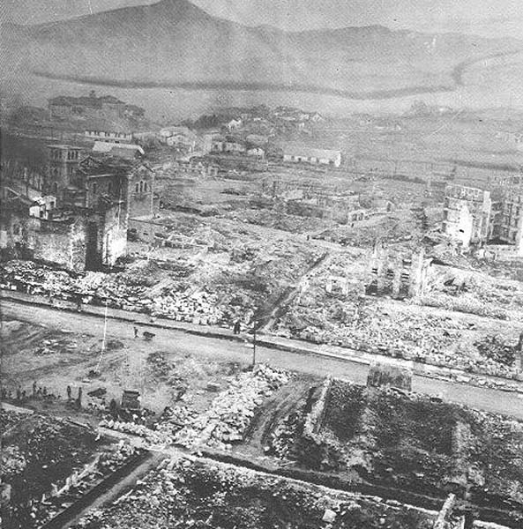
Notes:
Guernica after aerial bombardment by Hitler’s troops

Slide 22
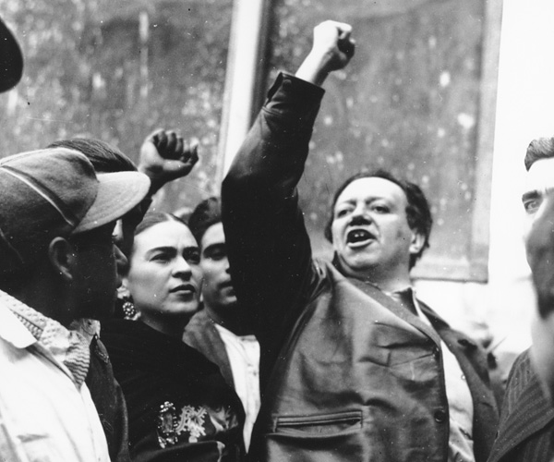
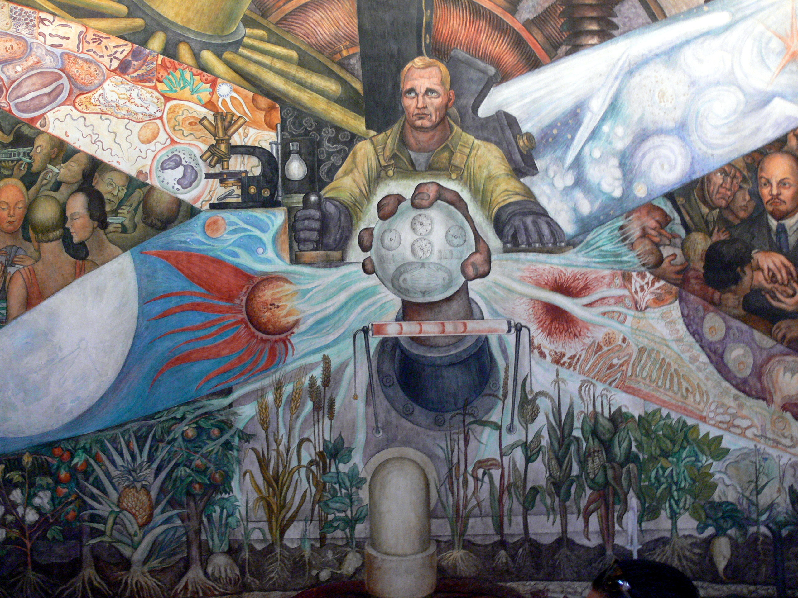
Diego Rivera, Man, Controller of the Universe, Palacio de Bella Artes, Mexico City, 1934
Fresco originally painted for the Rockefeller Center, at the request of the Rockefeller family
Notes:
Further political statements:
MEXICAN MURALISTS
DIEGO RIVERA
DAVID ALFARO SIQUIEROS
JOSE CLEMENTE OROZCO
“LOS TRES GRANDES”
1910-20: Mexican Revolution
Overthrowing of Dictator Porfirio Diaz
At the end of the Revolution the government commissioned artists to create art that could educate the mostly illiterate masses about Mexican history.
Celebrating the Mexican people’s potential to craft the nation’s history was a key theme in Mexican muralism
Between the 1920s and 1950s, they cultivated a style that defined Mexican identity following the Revolution.
An iconography featuring atypical, non-European heroes from the nation’s illustrious past, present, and future
Aztec warriors battling the Spanish
Humble peasants fighting in the Revolution
Common laborers of Mexico City
The mixed-race people who will forge the next great epoch
Los tres grandes crafted epic murals on the walls of highly visible, public buildings using techniques like fresco, encaustic, mosaic, and sculpture-painting.
Diego Rivera, Man at the Crossroads, 1934
Fresco painted at Rockefeller Center, New York
The painting was controversial because it included an image of Lenin and a Soviet Russian May Day parade (see above, right hand side)
Although the Rockefeller family had put forward the idea for the theme “new frontiers,” Rivera disapproved with the Western world’s embrace of free enterprise.
Follows his own political beliefs
Paints scenes that depict the modern worker confronted by a symbolic junction of industry, capitalism, socialism and science.
Provisionally called Man at the Crossroads Looking with Hope and High Vision to the Choosing of a New and Better Future.
The mural is arresting and inspiring.
Among some of the influential personalities portrayed on the canvas were Charlie Chaplin and the famous Russian communist leader Vladimir Lenin.
Despite protests from artists, Nelson Rockefeller ordered its destruction before it was completed
Sort of flies in the face of American capitalistic enterprise
Only black-and-white photographs exist of the original incomplete mural, taken when Rivera was forced to stop work on it
Using the photographs, Rivera repainted the composition in Mexico under the variant title Man, Controller of the Universe.

Slide 23
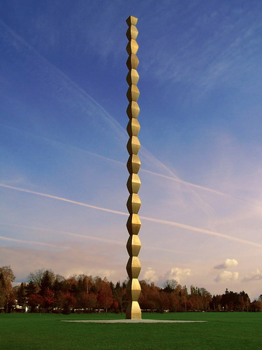
Endless Column, version I, 1918
Oak, Collection MoMA, NY
Constantin Brancusi, Bird in Space, 1928
Bronze
Collection MoMA, NY
Constantin Brancusi, Endless Column, 1938
Metal, 29.3 meters
Romania
Notes:
CONSTANTIN BRANCUSI
Romanian artist
1904: Leaves Romania permanently
Travels Europe, settling in Paris and sets-up his studio there
Continues training at the École de Beaux Arts
Attracts the attention of sculptor Auguste Rodin
1907: Begins to work by direct carving as a means of distancing himself from Rodin’s style (which was additive)
Associated with many artists of the day, including Henri Rousseau, Henri Matisse, Fernand Léger, Amedeo Modigliani, and Marcel Duchamp.
Brancusi showed five of his sculptures in the 1913 Armory Show in New York:
Constantin Brancusi, Bird in Space, 1928
Famous for his simple, streamlined sculptures
The base (pedestal) is not simply functional, but is an active part of the whole
From the 1920s to the 1940s Brancusi was preoccupied by the theme of a bird in flight.
He concentrated not on the physical attributes of the bird but on its movement.
STYLIZATION
Only the essential kept
Wings and feathers are eliminated, the swell of the body is elongated, and the head and beak are reduced to a slanted oval plane.
Balanced on a slender conical footing, the figure's upward thrust is unfettered.
Brancusi's inspired abstraction realizes his stated intent to capture "the essence of flight."
This particular conception of "Bird in Space" is the first in a series of seven sculptures carved from marble and nine cast in bronze, all of which were painstakingly smoothed and polished
One was at the Kimbell last fall, during the exhibition of works from the AIC
Constantin Brancusi, Endless Column, version I, 1918
Geometric motif used in bases for his sculptures
Gradually realized its value as an independent form
Brancusi made several versions of his Endless Column, the oak one being the first he fully developed
A single symmetrical element, a pair of truncated pyramids stuck together at their base, then repeated to produce a continuous rhythmic line
In replicating the same abstract shape, Brancusi emphasized its potential for vertical expansion
A “column for infinity”
This version is carved directly in oak, with gouges and cuts in the wood readily apparent, so that it straightforwardly declares its own materials and process of making.
Its simplicity, directness, and modularity helped to define the foundational principles of modern abstract sculpture.
We will see his influence on the Minimalists when we reach the 1960s!
Constantin Brancusi, Endless Column, 1938, Romania
He later repeated the Endless Column on larger scales and in different materials
Serve as an architectural element and a monument
This column is part of a three-part monument to Romanian soldiers of WWI
1998-2000: restored by UN and Romanian government

Slide 24
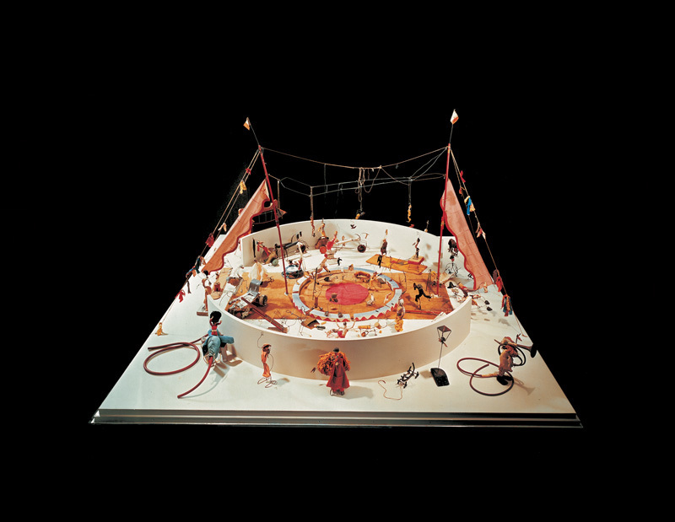
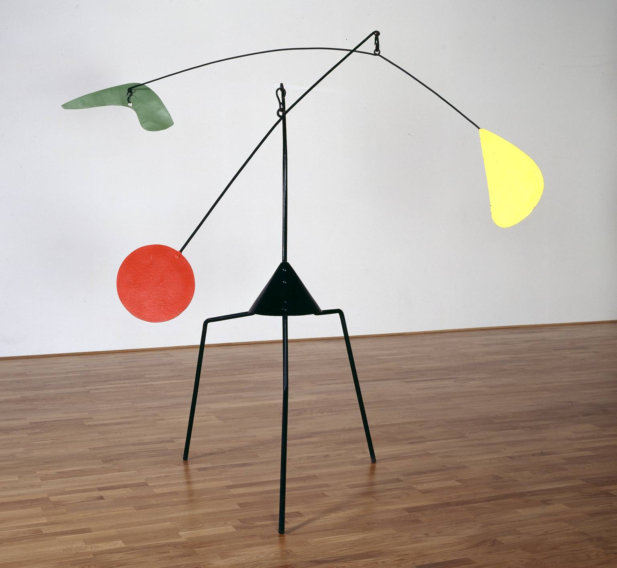
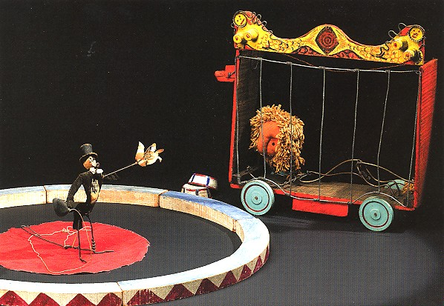
Alexander Calder, Circus, 1926-31
Wire, wood, metal, cloth, yarn, paper, cardboard, leather, string, rubber tubing, corks, buttons, rhinestones, pipe cleaners, and bottle caps
Collection Whitney Museum of American Art, NY
Alexander Calder, Untitled, 1937
Painted steel
Collection Tate Modern, London
Notes:
ALEXANDER CALDER
Abstraction in 3-D
From a family of Pennsylvania sculptors
Embraces the new aesthetics and technical experimentation of modernism.
1928: visits the studios of Mondrian Miró, whose work – in very different ways – influences his own shift into abstraction
Movement always a key element.
Calder developed hand-cranked works before embarking, in 1932, upon the series of hanging works that were dubbed mobiles (reputedly by Marcel Duchamp)
The variety and subtlety of his mobiles, with painted organic forms suspended from tiers of linked rods, served to define and dominate the form
Alexander Calder, Circus, 1926-31
This predates his famous mobiles
Many similar themes
Whimsy
Movement
Balance
Began these improvised performances during his time in France
Kinetic sculpture that consists of 70+ small figures and 100+ accessories
Created each piece by hand
Moved figures manually
Interaction creates performances he staged for family and friends
Used more than 30 musical instruments and noise makers
The ringmaster carries a whistle to blow and make announcements
Fun and entertaining
Imaginative!
Alexander Calder, Untitled, 1937
The red disc at the end of this first arm provides the counter-weight for the second arm, which balances organic green and yellow forms.
With an elegance born out of the necessity to establish these balances, Calder used progressively thinner grades of rod for the legs and arms.
The tripod stand also does away with the necessity to suspend a large and relatively heavy work from the ceiling, which had generally been his solution up to this period.

Slide 25
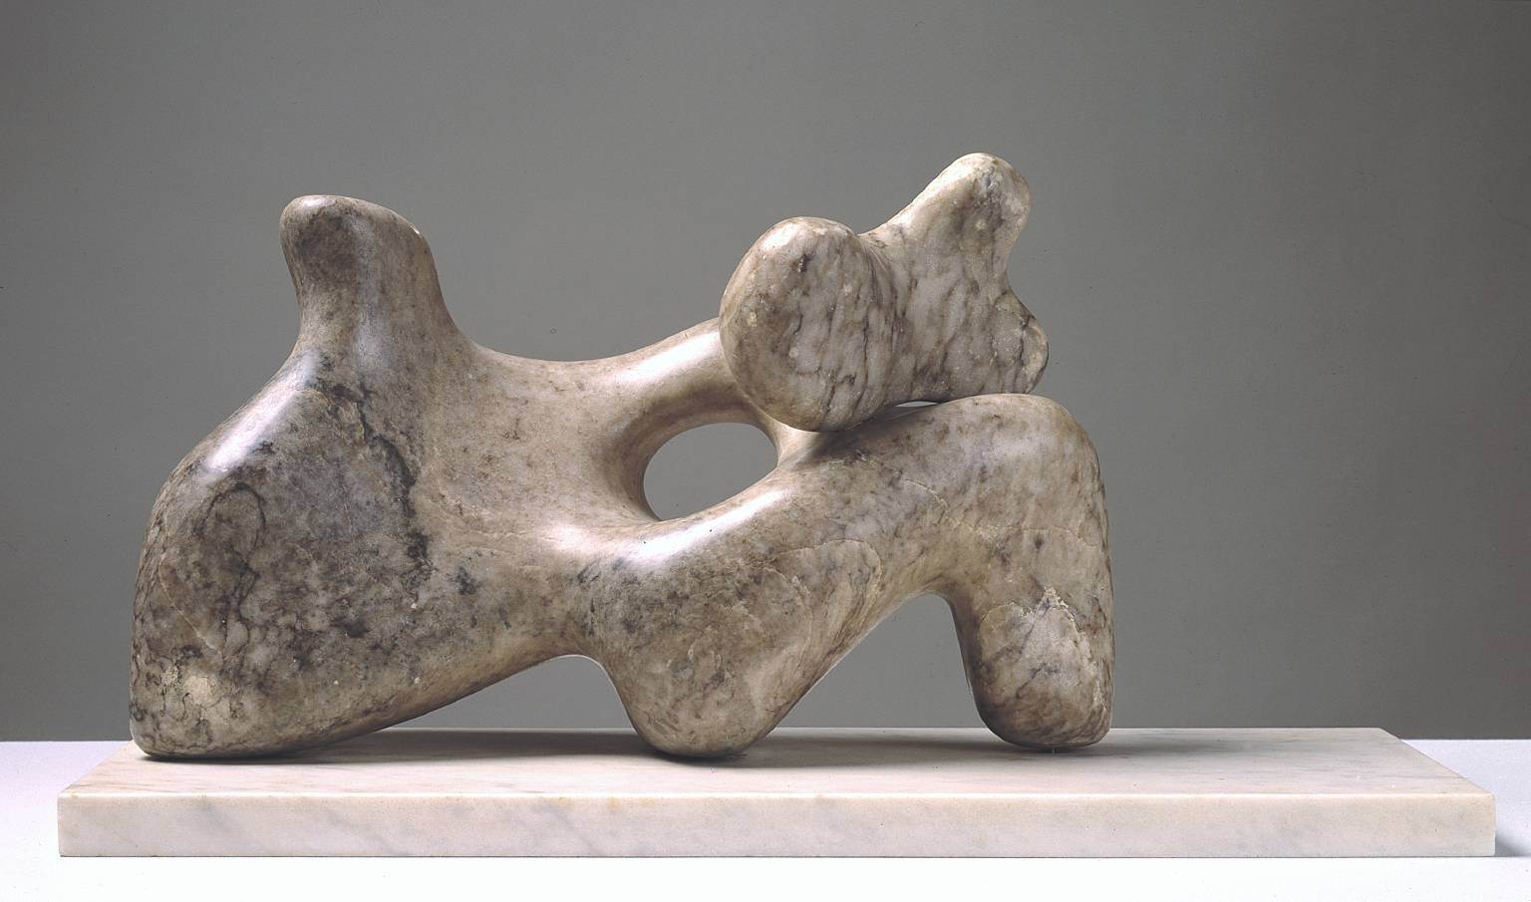
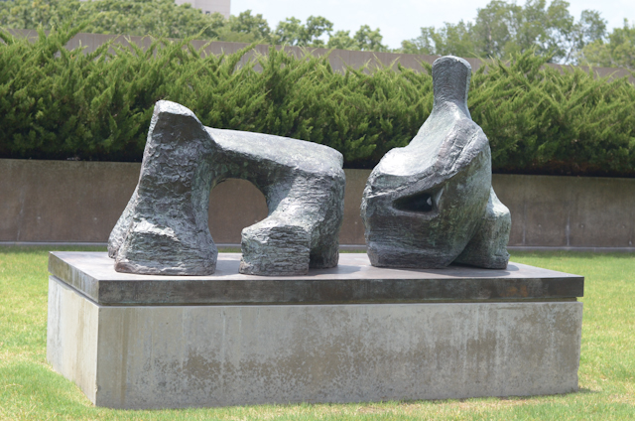
Barbara Hepworth, Mother and Child, 1934
Cumberland alabaster on marble base
Collection Tate Modern, London
Henry Moore, Two-Piece Reclining Figure No. 2, 1960
Bronze with brass base
Collection MAMFW
Notes:
BARBARA HEPWORTH
British sculptor
1933: Becomes a member of a Paris-based group called Abstraction-Création
Produces multi-part sculptures that reconciled natural forms with abstract shapes - hybrids
Barbara Hepworth, Mother and Child, 1934
This work reflects Hepworth’s experience of motherhood – she carved it while pregnant
It also shows how she had recently developed a new range of abstract forms by carving holes into her sculptures
Ambiguity – organic, but what does it reference in the world?
Monumentality key
Soft, smooth surfaces also seen in the work of British sculptor Henry Moore
HENRY MOORE
British sculptor, draughtsman and printmaker
Generally acknowledged as the most important British sculptor of the 20th century
The human figure his central subject-matter throughout his career.
Borrows from diverse cultural traditions and artists in order to give his work a profound resonance with the art of the past.
His female figures, echoing the forms of mountains, valleys, cliffs and caves, extended and enriched the landscape tradition, which he embraced as part of his English artistic heritage
Henry Moore, Two-Piece Reclining Figure No. 2, 1960
Quite a few two-piece reclining figures
Exercise in breaking up the form
“In doing these Reclining Figure sculptures it came naturally and without any conscious decision that I made them in two separate pieces, the head-and-body end, and the leg-end. I realized that I was simplifying the essential elements of my reclining figure theme. In many of my reclining figures the head-and-neck part of the sculpture, sometimes the torso part too, is upright, giving contrast to the horizontal direction of the whole sculpture. Also in my reclining figures I have often made a sort of looming leg – the top leg in the sculpture projecting over the lower leg, which gives a sense of thrust and power, as a large branch of a tree might move outwards from the main trunk, or as a seaside cliff might overhang from below, if you are on the beach…In that sense I think these sculptures are more fully in the round than any previous work of mine. Being in two pieces the work separates itself from seeming to be only a representation of a reclining figure.”
“Both these sculptures are a mixture, an amalgamation of the human body with rock-forms and with landscape, and so like a metaphor in poetry giving to each element a new aspect, and perhaps a new meaning.”
Moore believes that If a sculpture is in two pieces, there’s a bigger surprise, you have more unexpected views
This is its advantage over painting and one that he fully exploits
Sees sculpture as a journey
“As you move round it, the two parts overlap or they open up and there’s space between. The three-dimensional world is full of surprises in a way that a two-dimensional world could never be.”

